Slide 1
Eii: Suspension Bridges – Tacoma Narrows Case Study
AIMS & OBJECTIVES
Why did the Tacoma Narrows bridge collapse?
To know what happens if bridges don’t transfer loads well
To consider why the Tacoma Narrows bridge failed
CONTEXT
The Tacoma Narrows bridge over the Puget Sound was the 3rd longest suspension bridge in the world when it opened in 1940.
Just four months after the bridge was opened, it collapsed.
The introduction of a light, more flexible design meant it was too flexible and became known as Galloping Gertie.

Slide 2
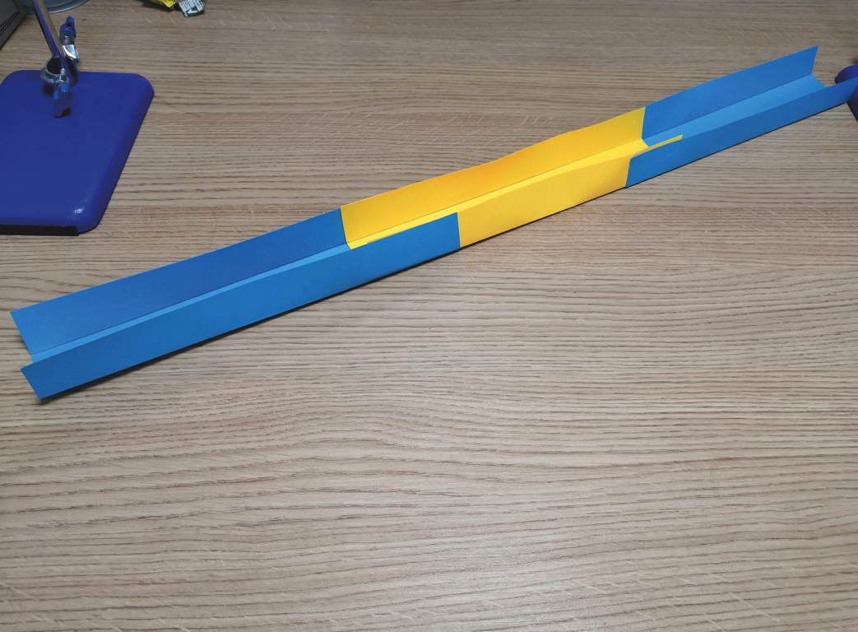
Recreating the Tacoma Narrows Bridge collapse
1
Glue three pieces of fine craft card together. Cut in half lengthways. Fold up each side to form a channel.

Slide 3
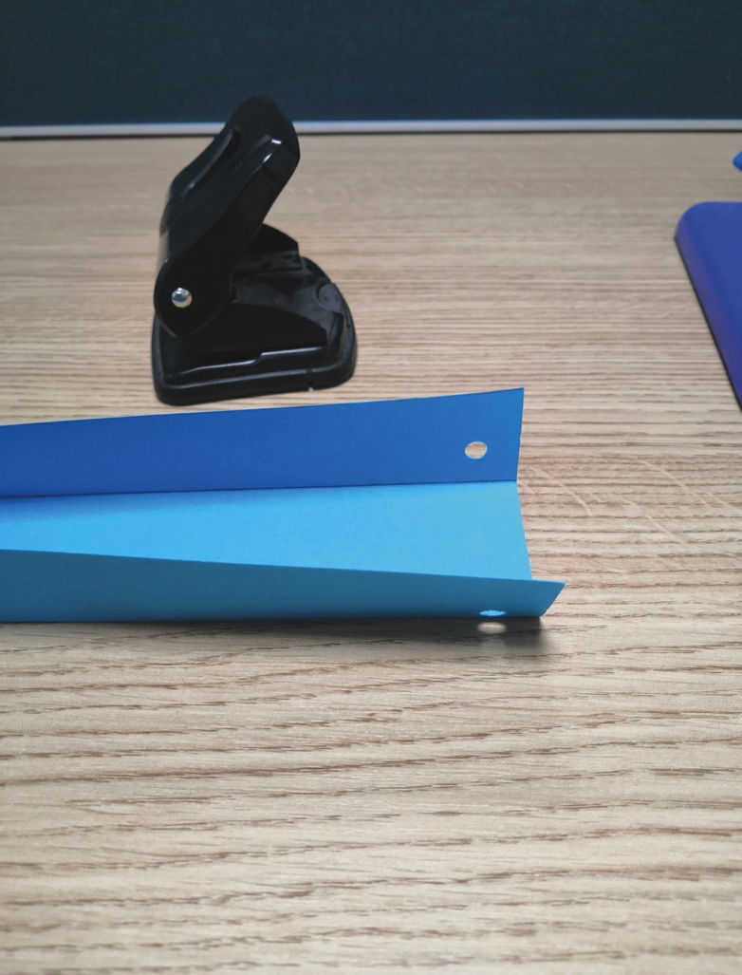
Recreating the Tacoma Narrows Bridge collapse
2
Using a hole punch, create holes at the same distance from the end, and at the same height up the side.

Slide 4
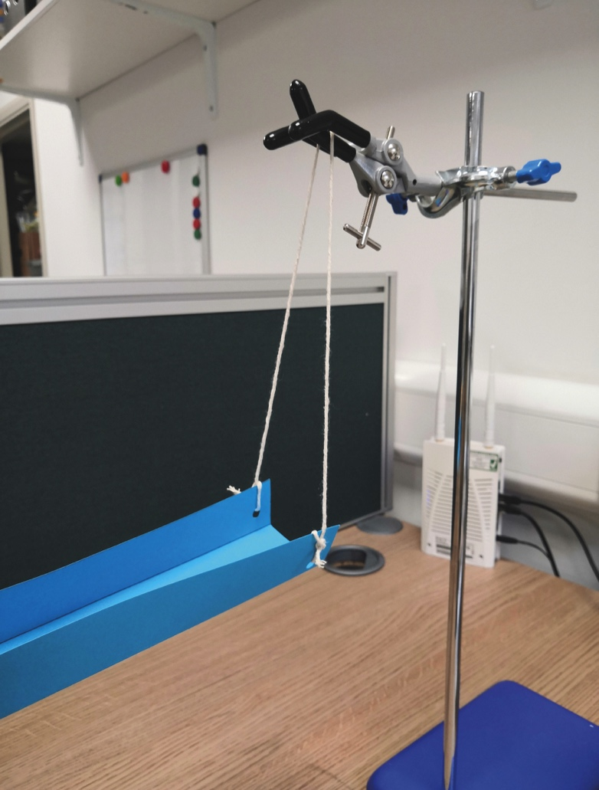
Recreating the Tacoma Narrows Bridge collapse
3
Take a 60cm length of string, and tie it through the holes at each end, creating a hanger for the bridge.

Slide 5
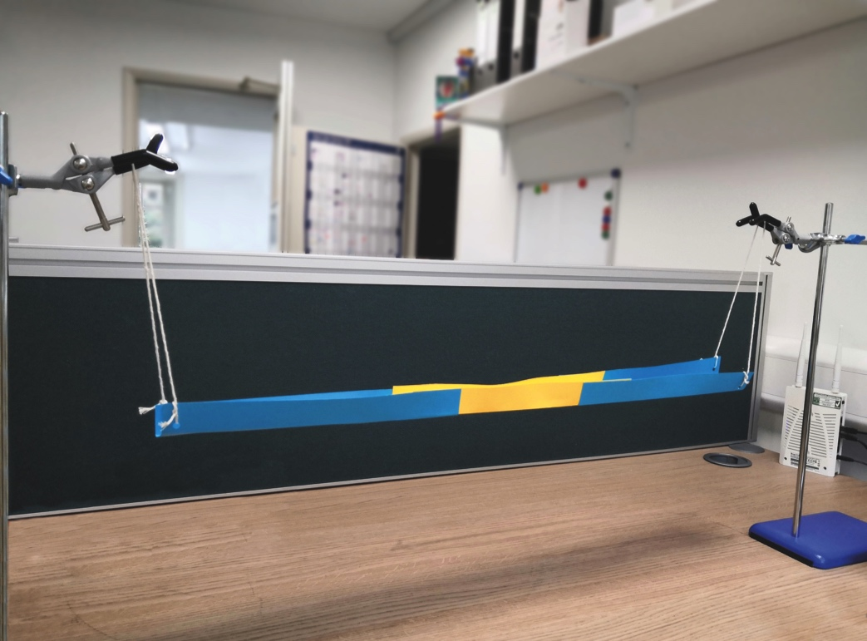
Recreating the Tacoma Narrows Bridge collapse
4
Hang the bridge from the two clamp stands. Using a hair dryer/fan, recreate wind against the bridge. How does the bridge react?

Slide 6
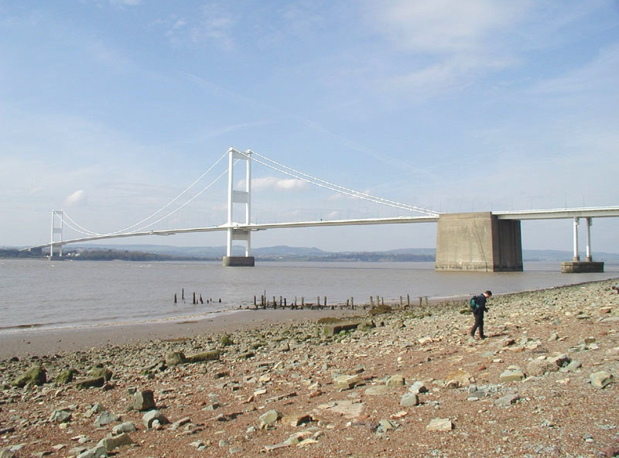
Did you know?
The Severn bridge was completed in 1966, but the design is different to its first plan.
Originally it was meant to have a truss deck design, like many other suspension bridges around the world, but after the model was destroyed in a wind-tunnel test, the design was re-worked to become a more aerodynamic hollow-box deck.

