Slide 1
Ei: Suspension Bridges – Hanging Tough
AIMS & OBJECTIVES
How do suspension bridges work?
To show how transferring loads can make a bridge stronger
To introduce the suspension bridge
CONTEXT
A suspension bridge is a type of bridge in which the deck is hung from main cables on vertical hangers. The suspension bridge was developed by engineers to cross long distances without needing extra piers, such as a beam bridge would require.

Slide 2
Suspension Bridge Terminology
Can you name the different parts of a suspension bridge?
Main Cable
Pier
Tower
Hanger
Span
Anchor
2

Slide 3
Suspension Bridge Terminology
3

Slide 4
Exploring Suspension Bridges
1
Create a K'Nex® bridge span using 6 deck slabs

Slide 5
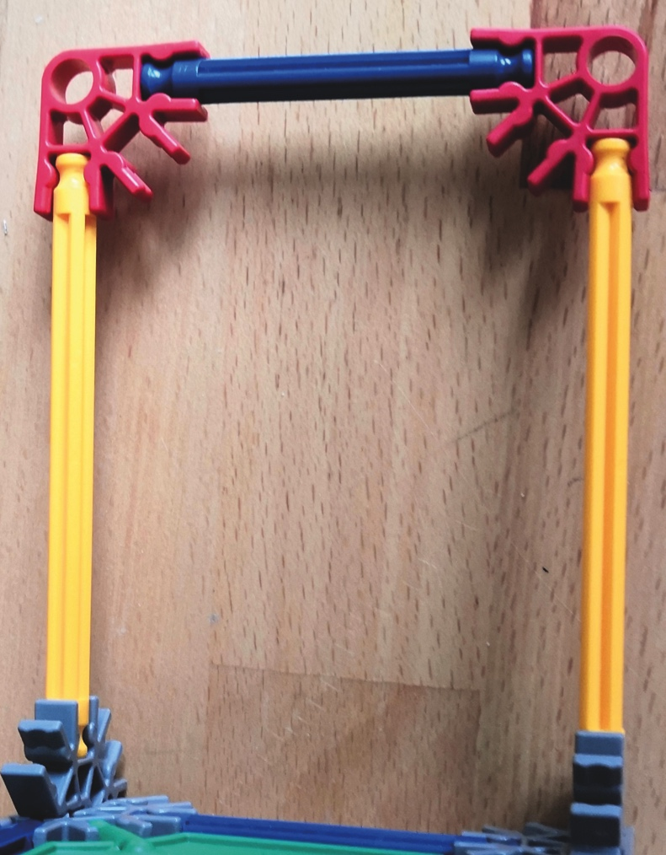
Exploring Suspension Bridges
2
Add 2 upright sections, one at each end.

Slide 6
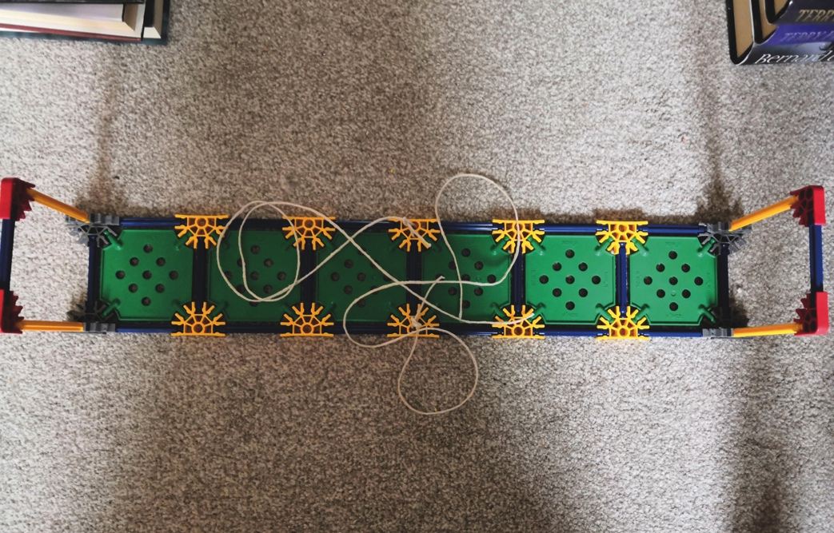
Exploring Suspension Bridges
3
Tie two 70cm lengths of string on each side of the middle of the bridge.

Slide 7
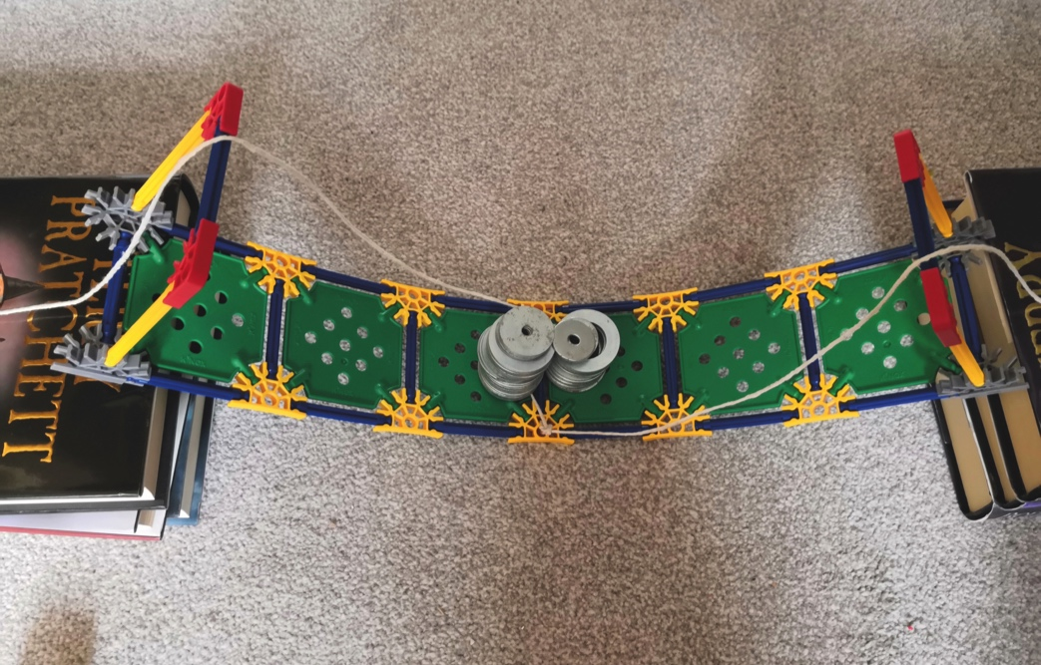
Exploring Suspension Bridges
4
Place the bridge across a 40cm gap created by books or desks.
While wearing safety glasses, add the small masses until the bridge collapses. This is the maximum load your bridge can support.

Slide 8
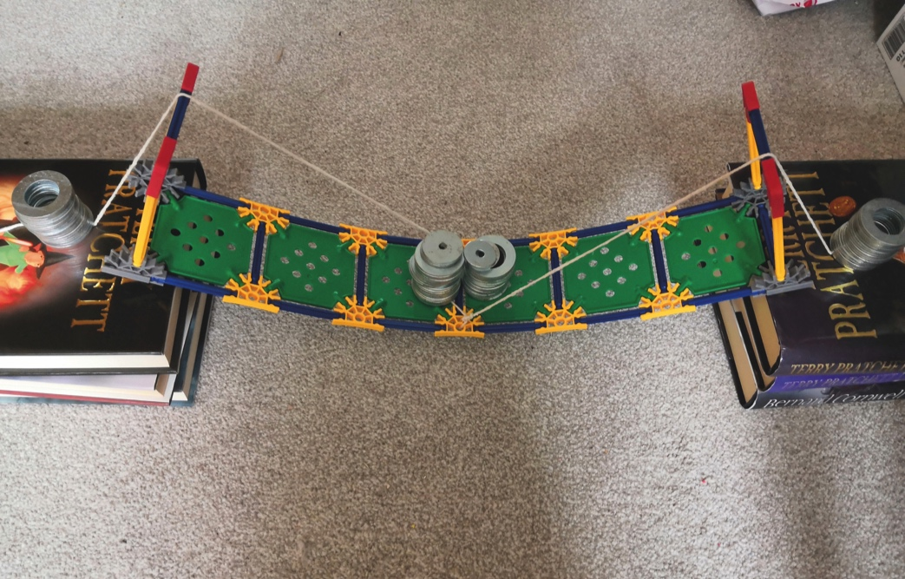
Exploring Suspension Bridges
5
Remove the maximum load from the bridge.
Bring one length of string over the right had side upright and bring the other length of string over the left hand upright. Using some small weights, weigh down the string on either end of the bridge.
Return the maximum load. What do you notice?

Slide 9
Exploring Suspension Bridges
Why do the towers on suspension bridges need to be anchored?
1
Tie string around two large books, so a 20cm (minimum) length of string acts as a bridge between the books.

Slide 10
Exploring Suspension Bridges
Why do the towers on suspension bridges need to be anchored?
2
Push down gently on to the middle of the string. What do you notice?

Slide 11
Exploring Suspension Bridges
Why do the towers on suspension bridges need to be anchored?
3
Instead of tying the string around the books, fasten the ends of the string using drawing pins.

Slide 12
Exploring Suspension Bridges
Why do the towers on suspension bridges need to be anchored?
4
Again, push down on the centre of the string. What do you notice?

Slide 13
How do forces in a suspension bridge work?

Slide 14
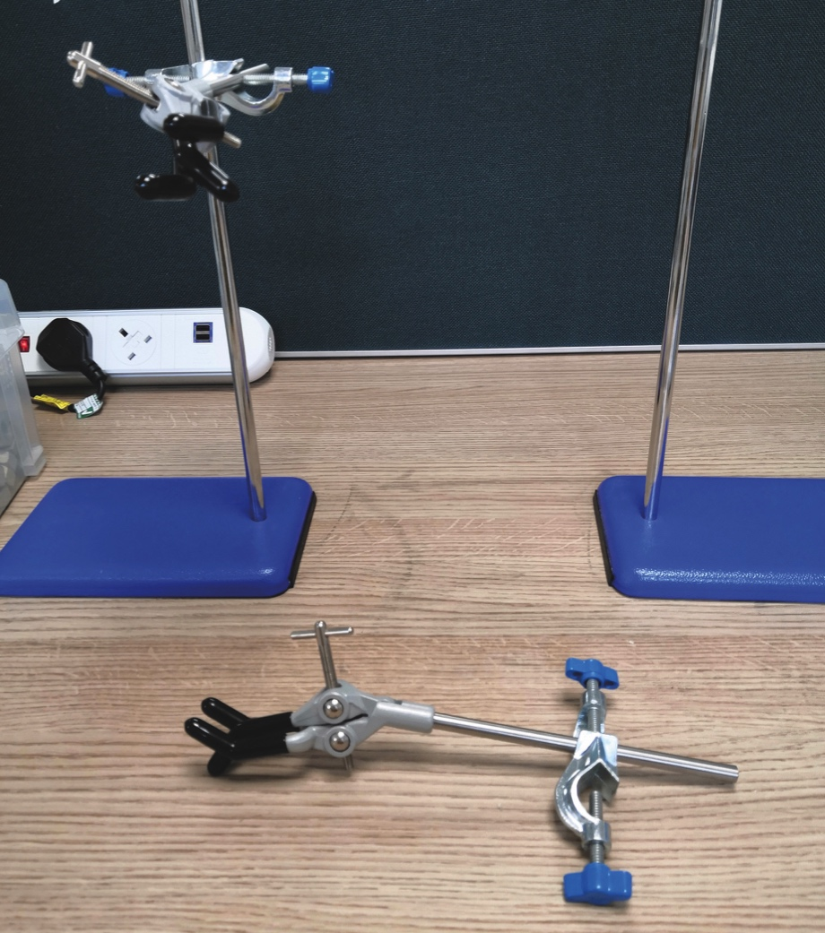
Challenge Time!
1
Fix the clamps at right angles to the clamp stand poles. Ensure both are at the same height. Set the stands 20-25cm apart.

Slide 15
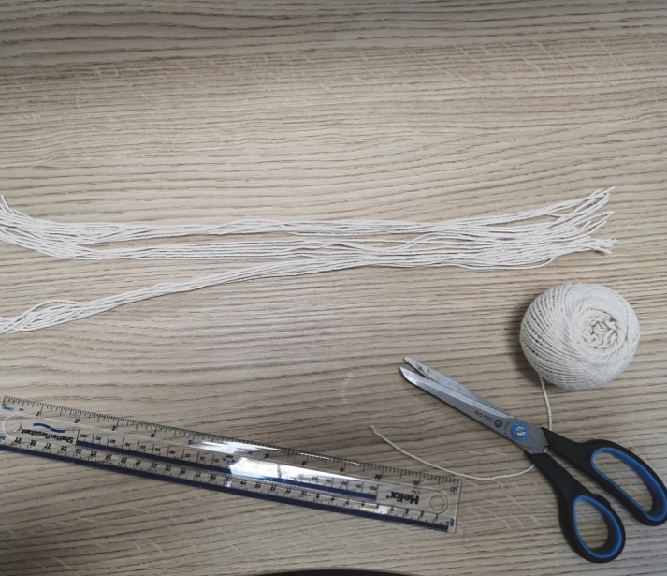
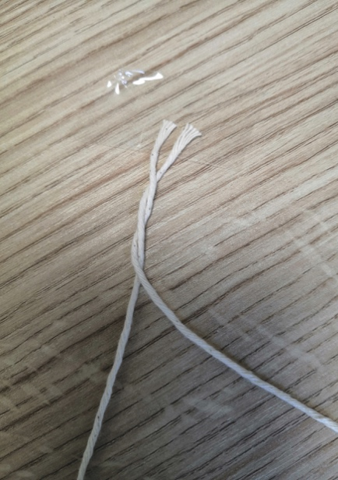
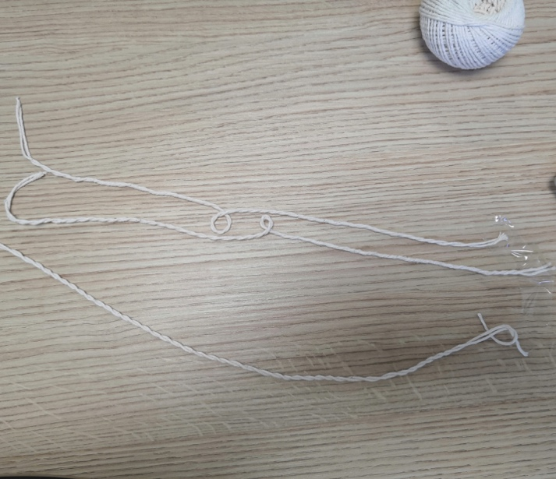
Challenge Time!
2
Cut 26 pieces of string at least 45cm in length. Weave two pieces together by twisting them around each other. Do this three times, so you end up with 3 double-thickness lengths.

Slide 16
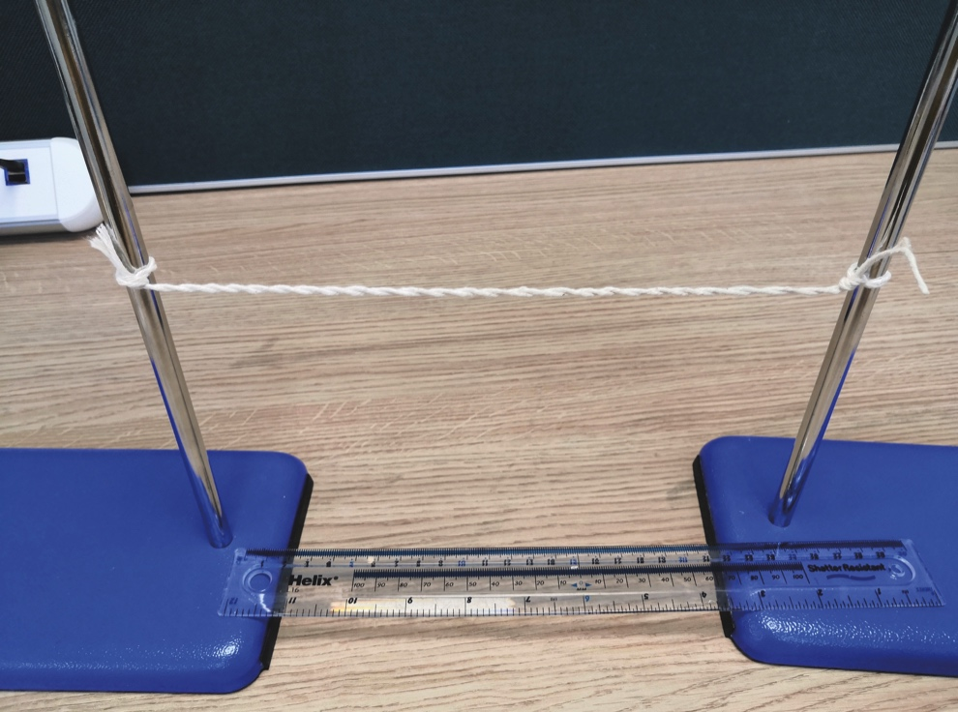
Challenge Time!
3
Take one double-thickness piece and tie it a third of the way up the uprights. Make sure the string is tight.

Slide 17
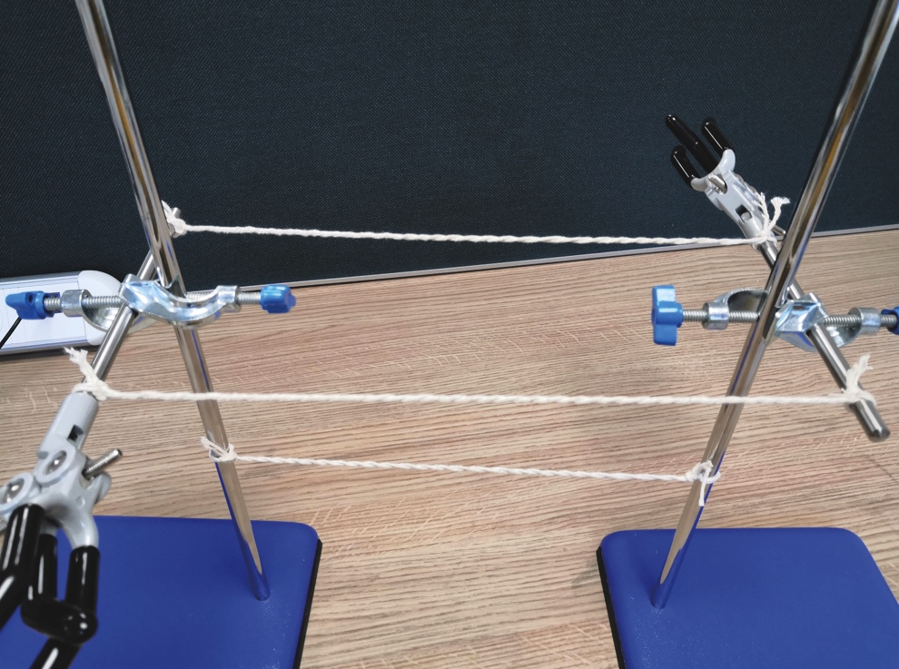
Challenge Time!
4
Take the other two double-thickness lengths and tie them between the clamps. Again, make sure they are tight.

Slide 18
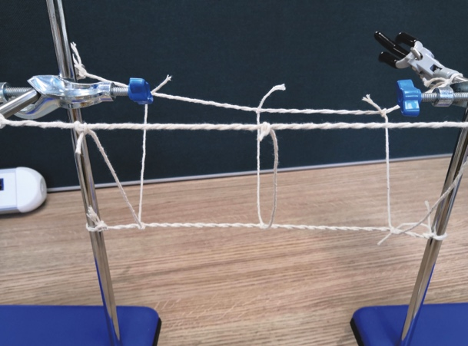
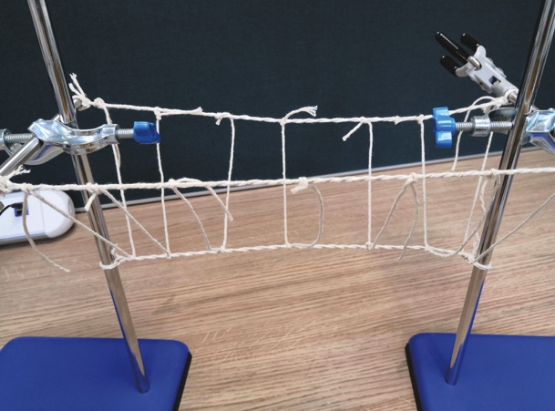
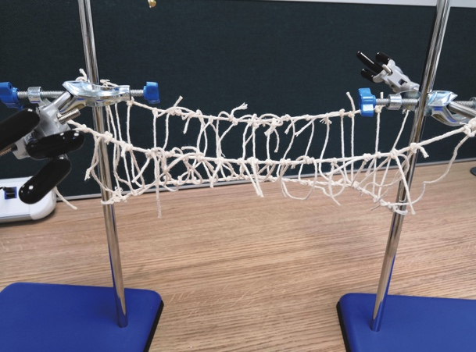
Challenge Time!
5
Take a string and tie it to one of the top double strings. Tie the middle of it to the bottom one then tie the other end to the opposite top string. Repeat this for all the strings. The strings have to be as tight as possible. Any excess string can be cut off.

Slide 19
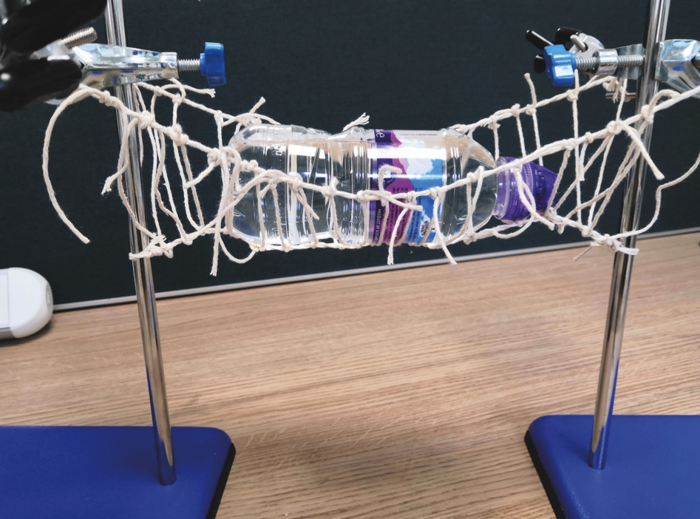
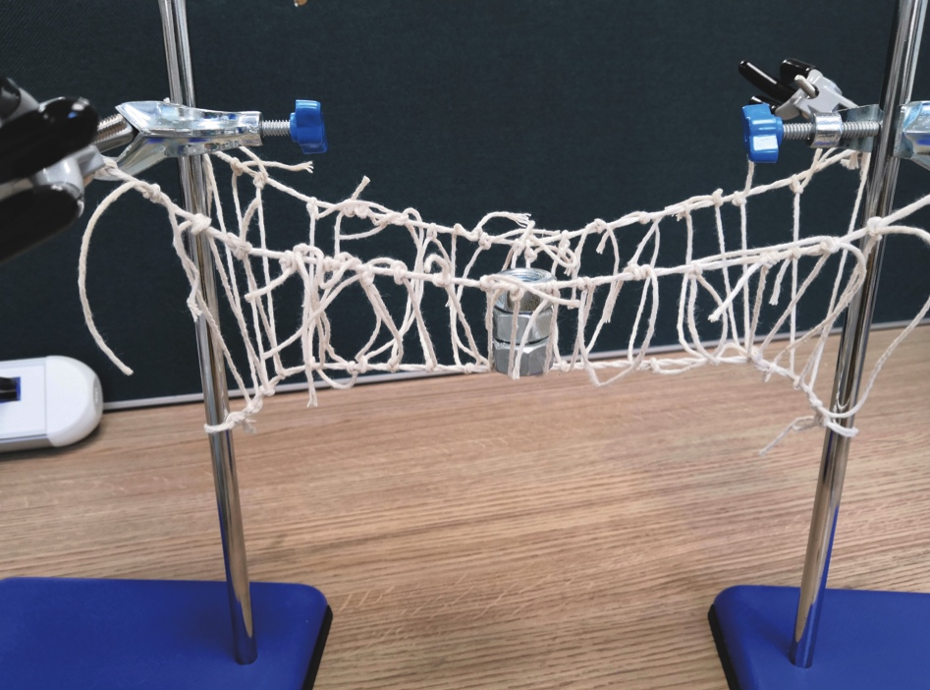
Challenge Time!
6
Test the bridge with various objects. Rope isn’t a strong material as it isn’t rigid so it will move when in use. How could the rope bridge be improved?

Slide 20
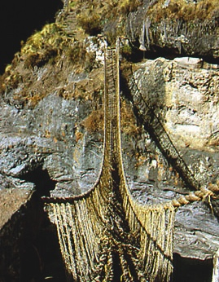
Did you know?
The Incas twisted grass to create ropes, which they used to build suspension type bridges around 500 years ago.
One still remains: Q’iswa Chaka, the rope bridge spanning over the Apurimac River in Peru.
The locals keep this ancient tradition and skill alive by renewing the bridge every June, even though there is a modern bridge nearby.

