Slide 1
C: Truss Bridges – What is a Truss?
AIMS & OBJECTIVES
It can be difficult to design beam bridges that are strong enough to carry the weight of railway tracks and trains so engineers often use truss bridges.
To understand that triangles are the strongest shape for building bridges
To explore ‘truss’ bridges
To learn the terminology for truss bridges
CONTEXT
Truss bridges are one of the oldest type of modern bridge and were widely used throughout the 19th Century, especially for railway bridges. They are economical to construct because they make efficient use of materials. Initially they were made of timber but gradually iron and steel came to be used. It is relatively straightforward for engineers to calculate the forces in a truss bridge.

Slide 2
Something to Try
What do these structures have in common?

Slide 3
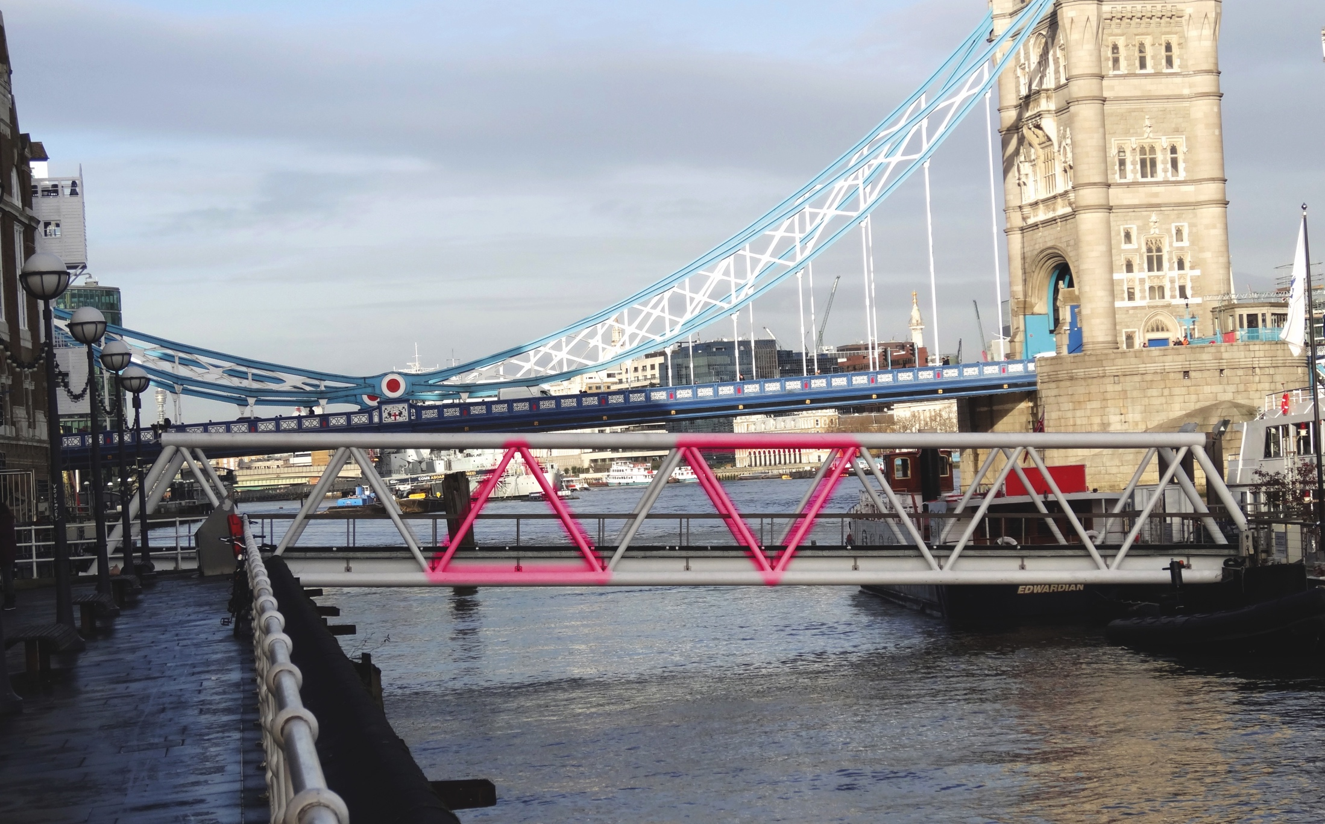

Slide 4
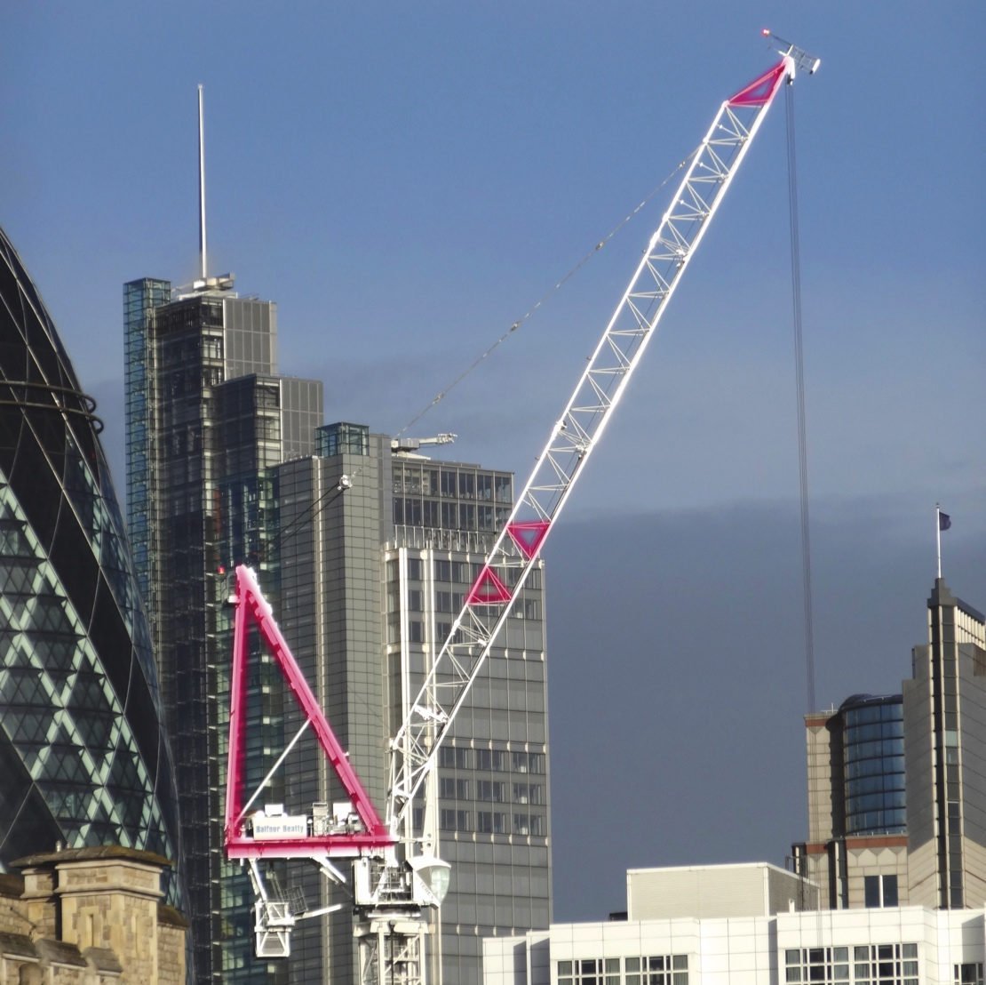

Slide 5
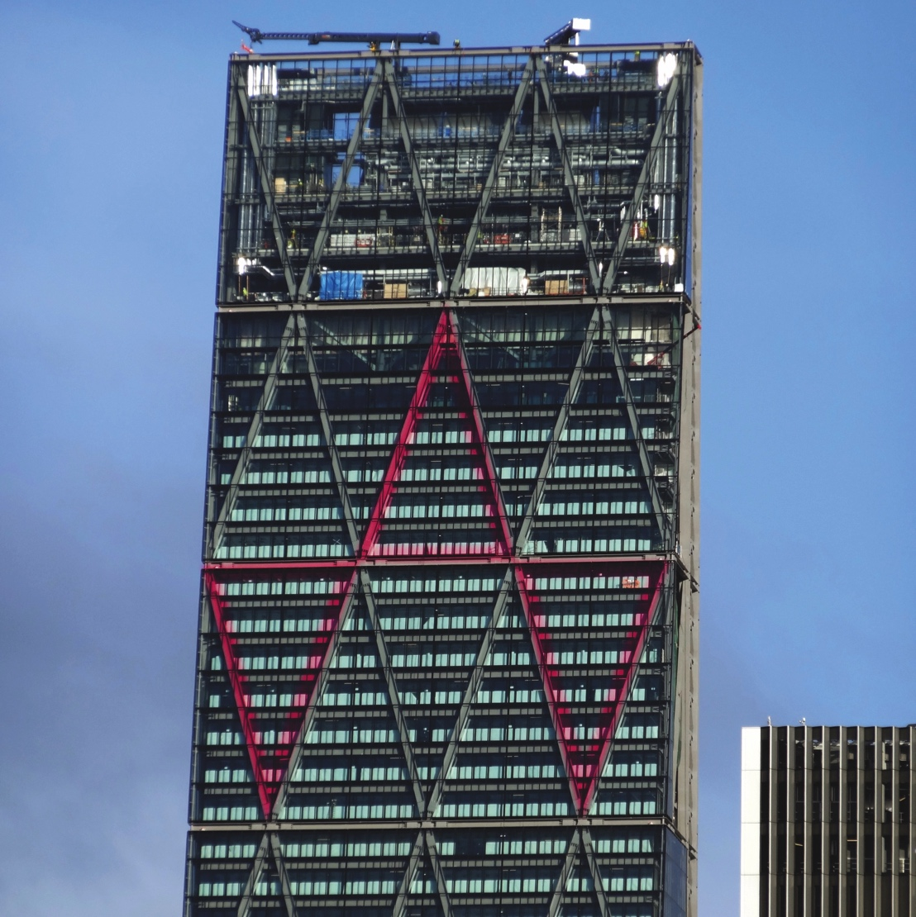

Slide 6
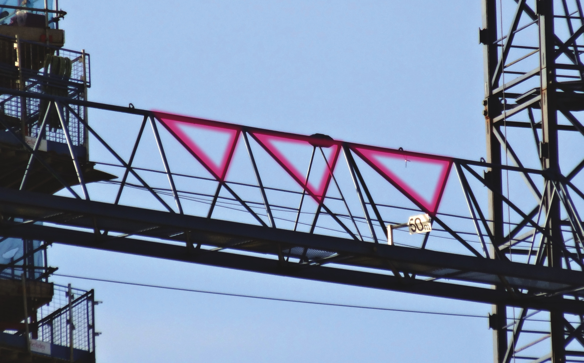

Slide 7
They are all made out of Triangles!

Slide 8
How can shapes make a bridge strong?
Make a square from four strips of card of the same length and some paper fasteners.
When completed, hold the square with one side resting on the table and test it by pushing and pulling on any side of it.
Make a triangle (with equal sides) in the same way.
Test the triangle in the same way.
What do you notice?

Slide 10
How can you make the square stronger?

Slide 11
Use triangles!

Slide 12
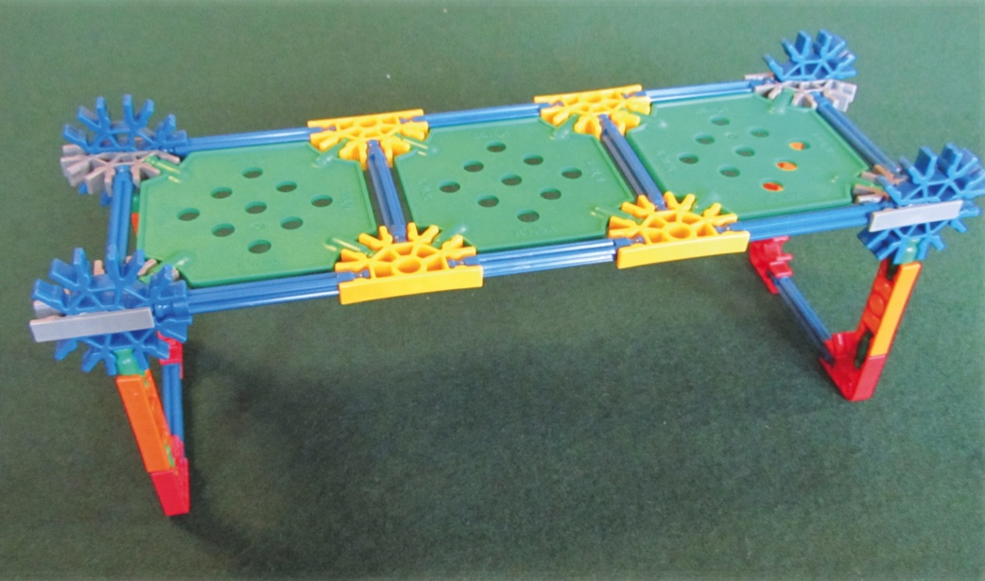
Exploring Truss Bridges
1
Build a simple beam bridge using K'Nex® using 3 deck slabs, and test it by pushing gently down in the middle.

Slide 13
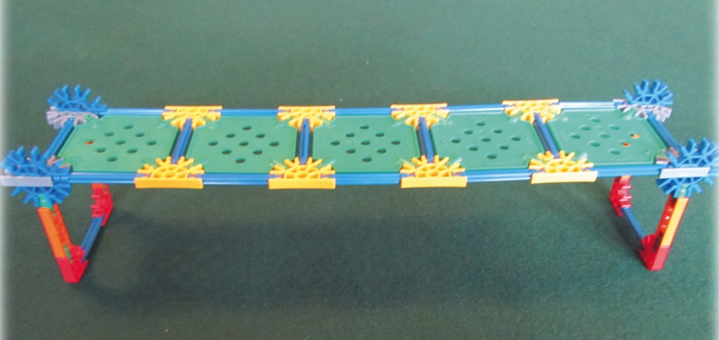
Exploring Truss Bridges
2
Extend your beam bridge using 5 deck slabs, and test it by pushing gently down in the middle.
What do you notice?

Slide 14
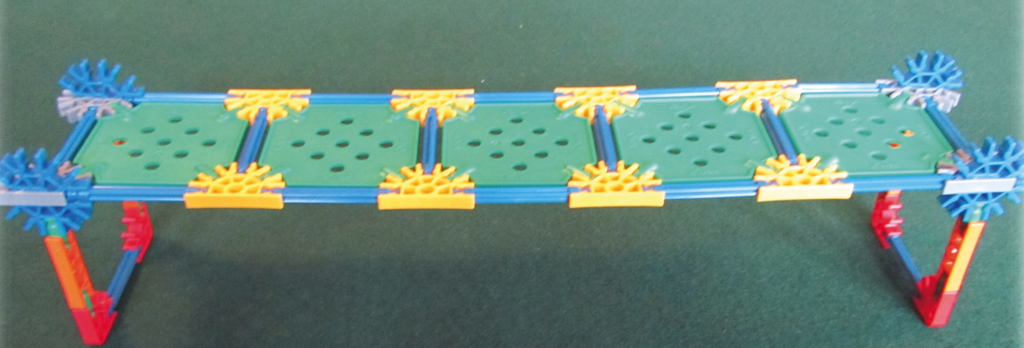
Exploring Truss Bridges
How can you make the longer bridge stronger?

Slide 15
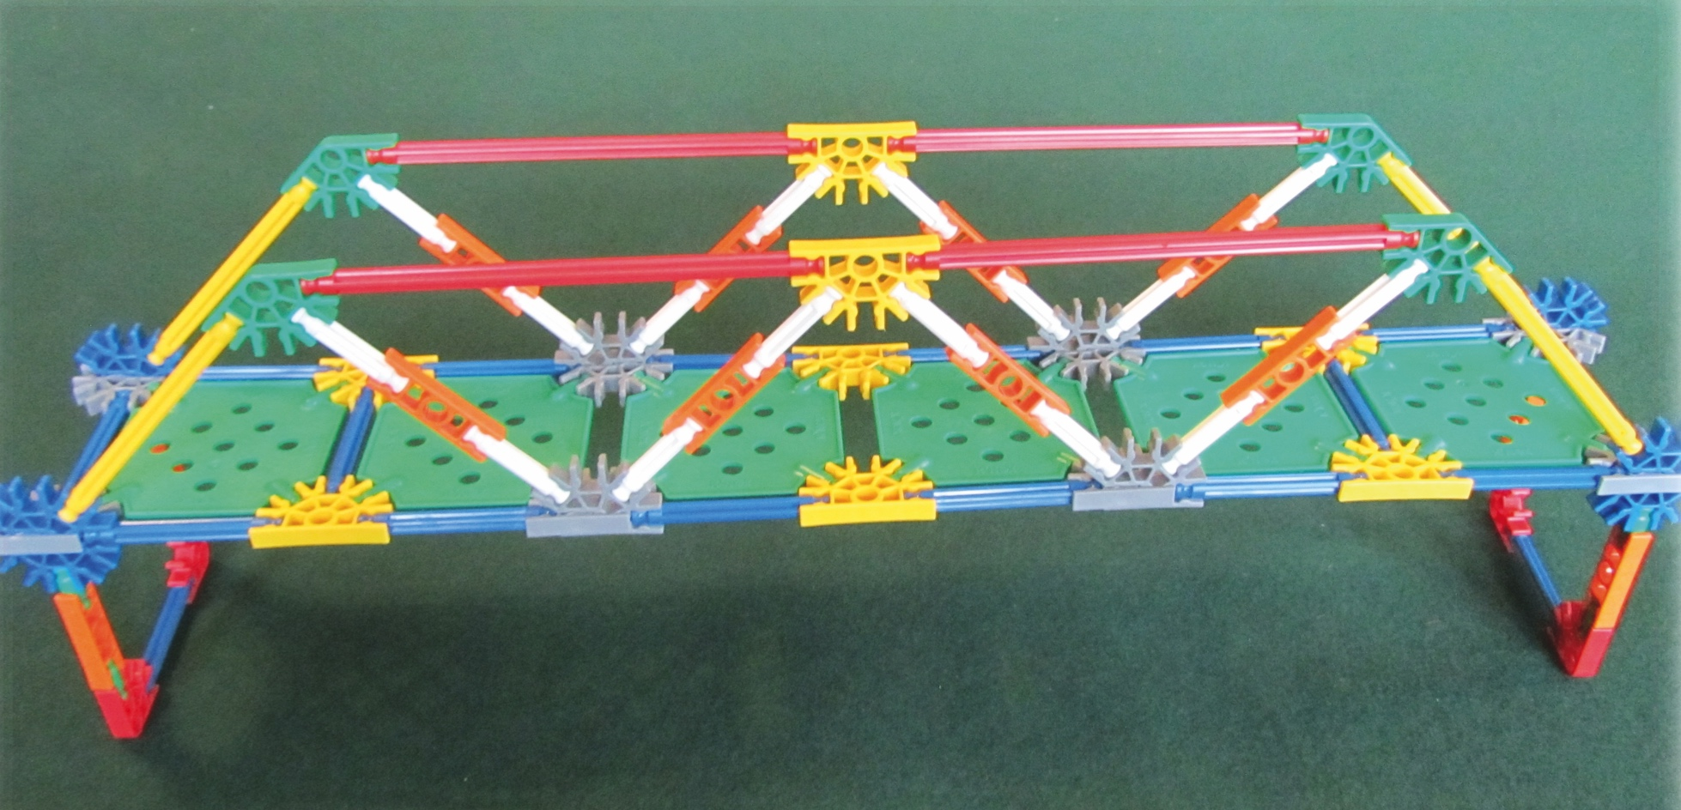
Exploring Truss Bridges
Triangles!

Slide 16
Truss Bridge Terminology
Label the parts of the bridge using the list of words below
Abutment
Span
Truss
Pier
Deck
16

Slide 17
Truss Bridge Terminology
17

Slide 18
Types of Truss
Warren Truss
One of the most common types of truss. Made up of equilateral triangles. Patented in 1848 by its designer James Warren.

Slide 19
Types of Truss
Howe Truss
The diagonal members slope up towards the centre and are in compression.
The vertical parts are in tension. Patented in 1840 by millwright William Howe.

Slide 20
Types of Truss
Pratt Truss
The opposite of a Howe Truss. The diagonal members slope down towards the centre. The vertical parts are in compression.
This type of truss can be used for spans up to about 75 metres and is very common in the US. Patented in 1844 by Thomas and Caleb Pratt.

Slide 21
Types of Truss
Baltimore Truss
This is based on the Pratt Truss but with additional bracing in the lower section of the truss to make it stronger.
This type of truss was developed in the 1870s and is mainly used for train bridges which need to be very strong.

Slide 22
Types of Truss
Bowstring Truss
This is the form of truss used on Rochester Old Bridge. Although it is a similar shape to an arch bridge it doesn’t work in the same way.
See the similarities with the Pratt Truss. Patented in 1841 by Squire Whipple.

Slide 23
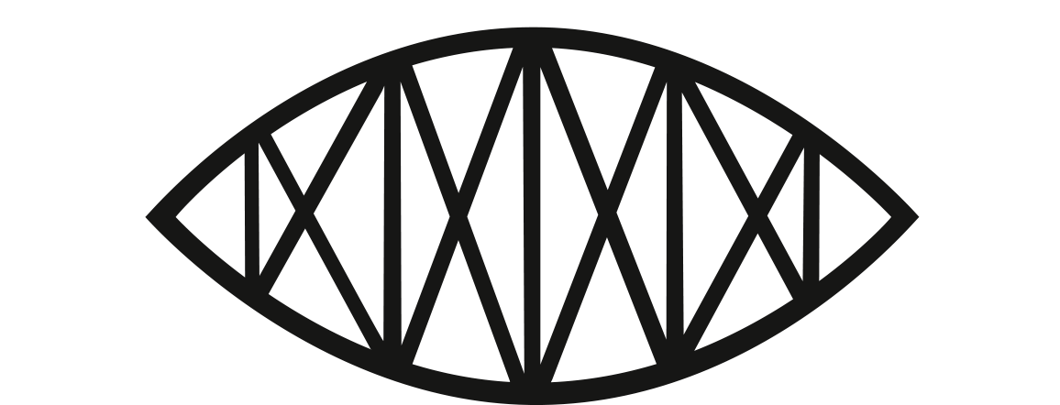
Types of Truss
Lenticular Truss
The name of this bridge comes from its shape which is like a lens you might find in a telescope or the human eye.
The most famous lenticular truss bridge is the Royal Albert Bridge near Plymouth which was designed by Isambard Kingdom Brunel and opened in 1859.

Slide 24
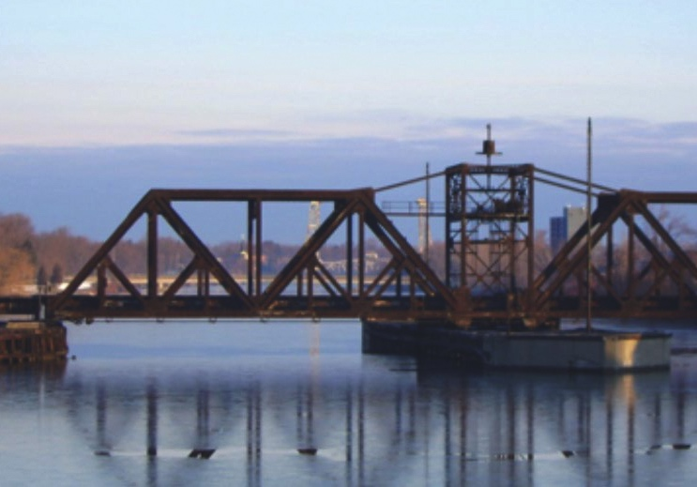
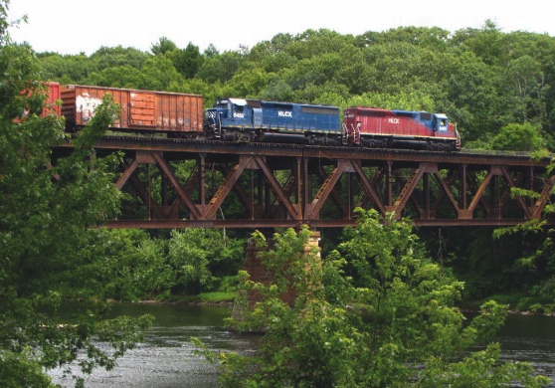
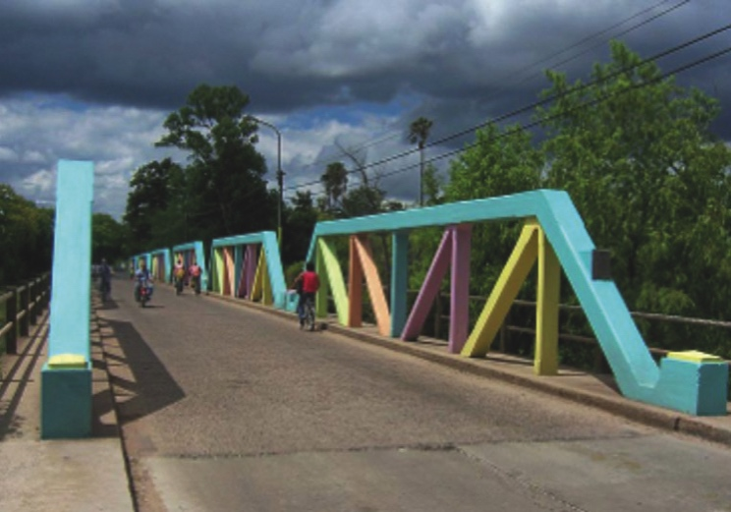
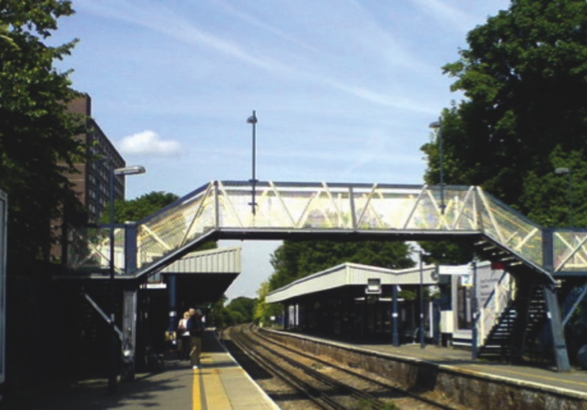
What is this Truss?
Challenge yourself to describe the trusses on these bridges.
A
B
Photo courtesy of Wikipedia
Photo courtesy of Wikipedia
Ontario, Canada
Massachusetts, USA
C
D
Photo courtesy of Wikipedia
Photo courtesy of Wikipedia
Puente Tacuarembo, Uruguay
Sidcup, Kent

Slide 25
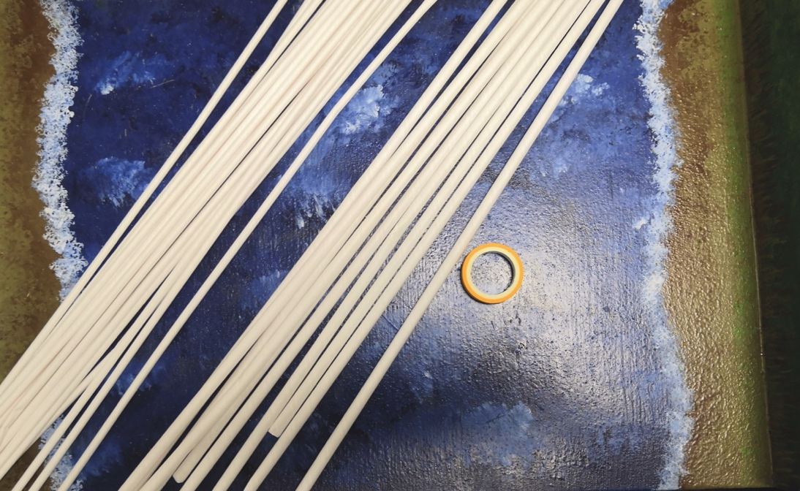
Challenge Time!
You are challenged to build a Truss bridge using only the materials provided.
You can use the handout provided to help with the truss design.
The aim is to build the strongest bridge.

Slide 26
Out and About
Try to spot a truss bridge in your local area. Take a photo (if it is safe to do so) and identify the parts using the correct terms. What type of truss bridge is it? What is the bridge used for?
If you can’t find one locally, try looking on the internet to see if you can find truss bridges around the world. Can you identify the type of truss bridge?

Slide 27
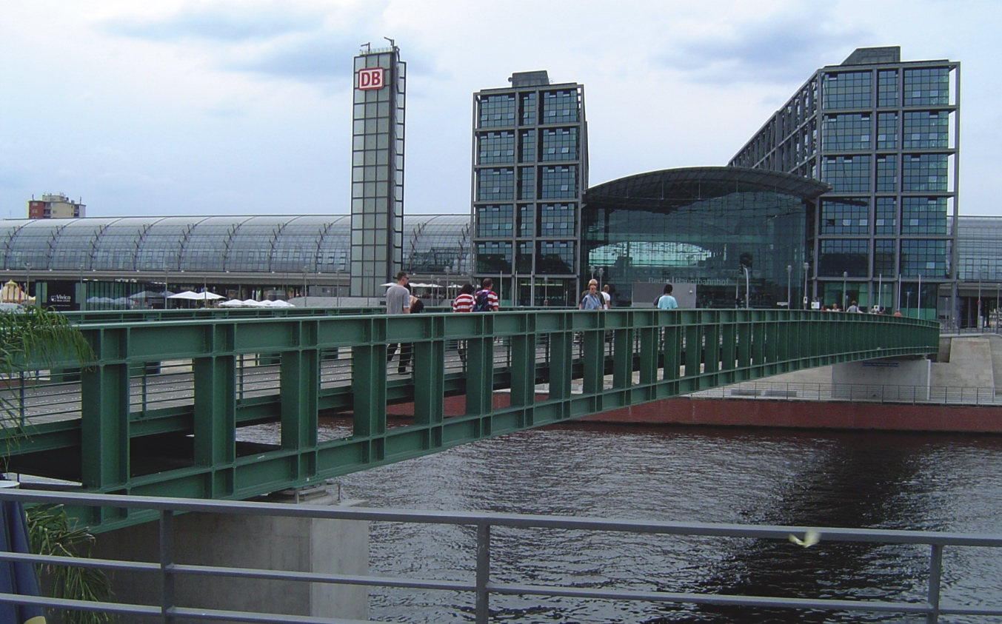
Did you know?
There is actually a truss bridge that doesn't have any triangles! Called a Vierendeel truss, it relies on having a very rigid frame instead of the diagonal bracing in the usual trusses.
Photo by Ben Titze via Wikimedia

