Slide 1
Ai: Do we need Bridges?
AIMS & OBJECTIVES
We are going to start thinking about bridges and why they’re so important
To understand what makes a bridge
To consider why we need bridges
To discuss reasons for bridges to be where they are
CONTEXT
Bridges are vital to our way of life. Bridges are unique to their location.
Understanding how bridges fail is an important part of learning how to make them stronger.

Slide 2
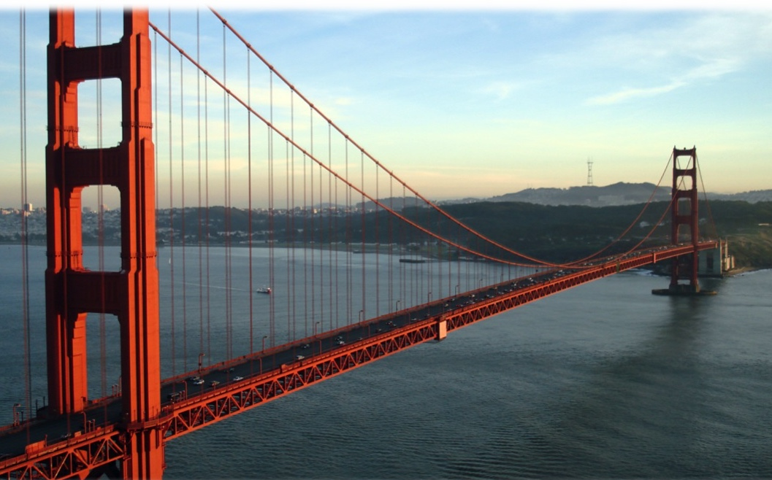
Why do we need Bridges?
Image taken from Wikipedia.org courtesy of Rich Niewiroski Jr.

Slide 3
Why do we need Bridges?
To get something...
...over…
or under…
…something else.

Slide 4
What obstacles do bridges cross?

Slide 8
What can bridges carry?

Slide 10
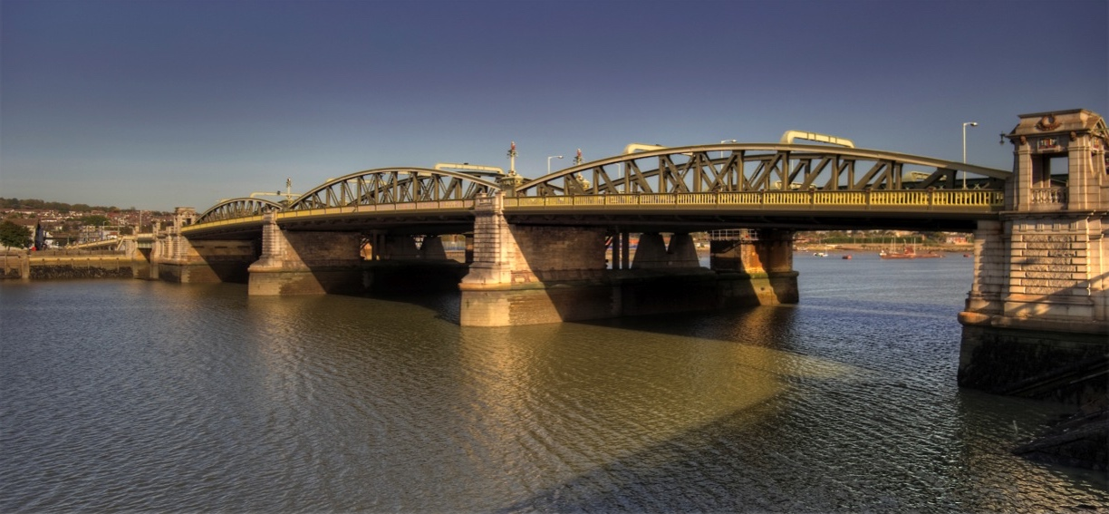
An example of a bridge
Rochester Bridge carries traffic over a river.

Slide 11
How many other situations can you think of?

Slide 12
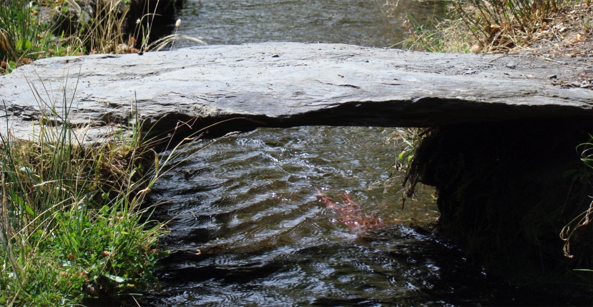
People over a stream
Image courtesy of photographer Cristina Ruiz Cortina.

Slide 13
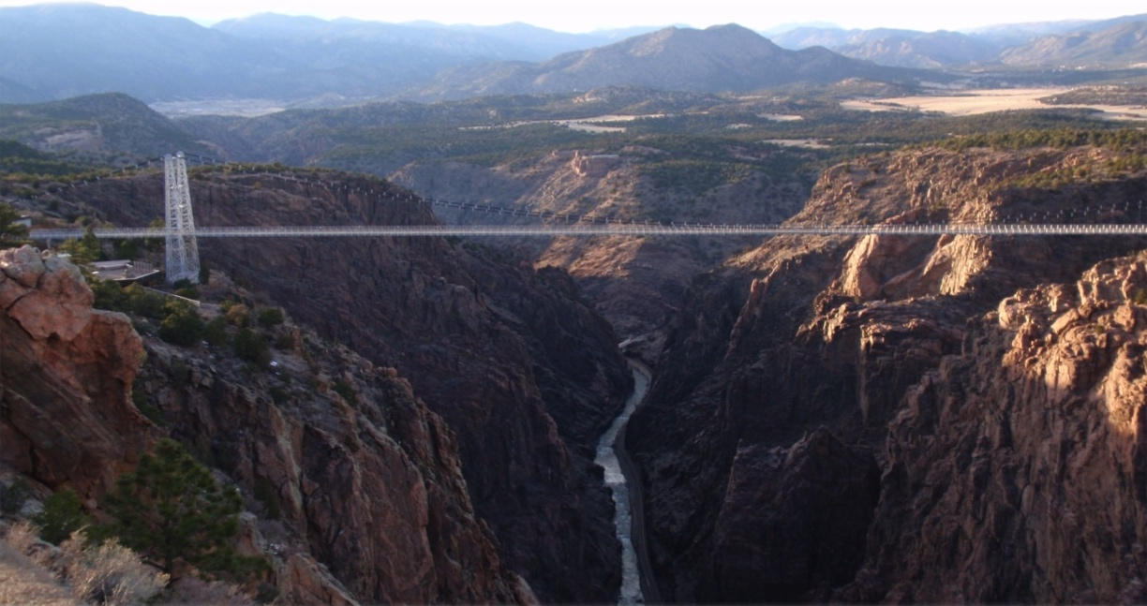
Traffic over a river
Image taken from Wikipedia.org courtesy of Flickr user SidewaysSarah.

Slide 14
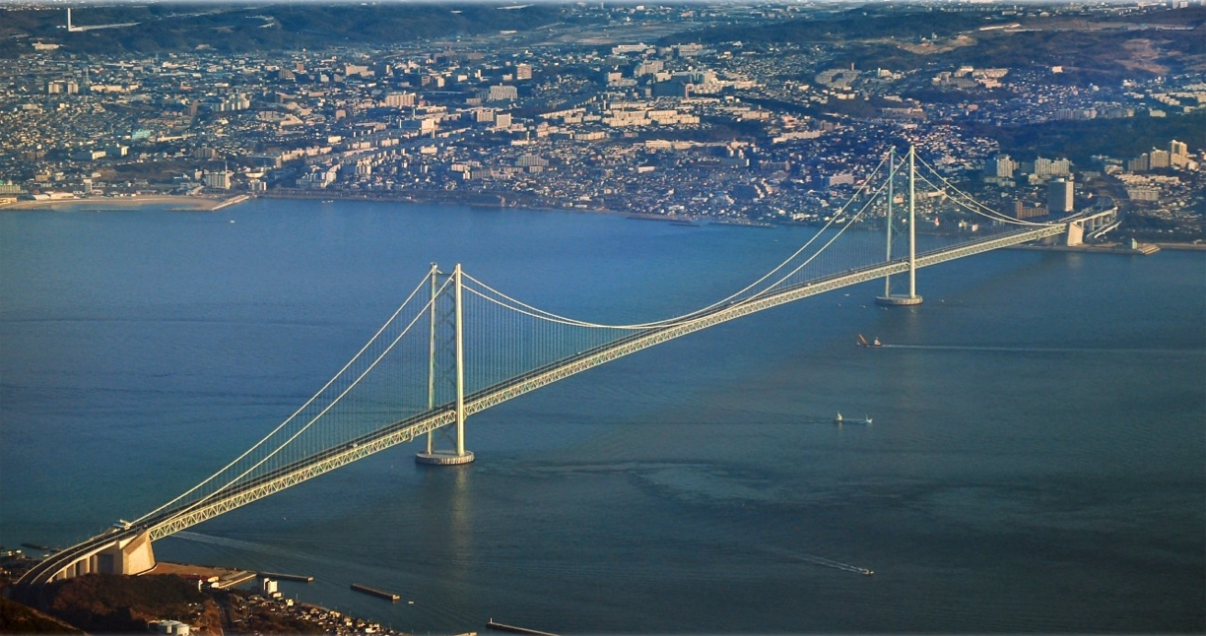
Traffic over the sea
Image taken from Wikipedia.org created by Kim Rötzel.

Slide 15
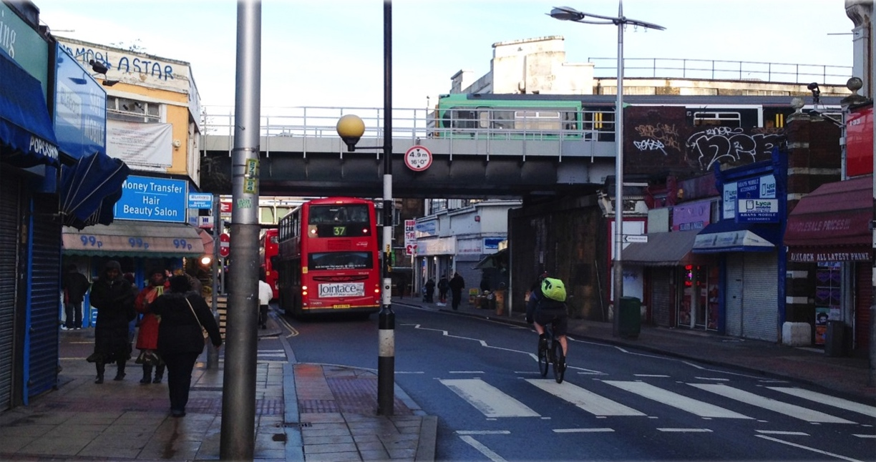
Trains over traffic
Image courtesy of Guy Fox.

Slide 16
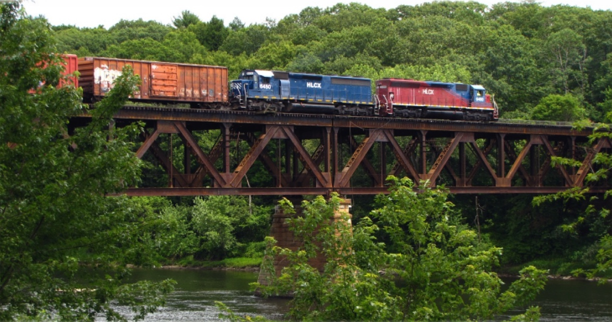
Trains over a river
Image taken from Wikipedia.org courtesy of user NellsWiki.

Slide 17
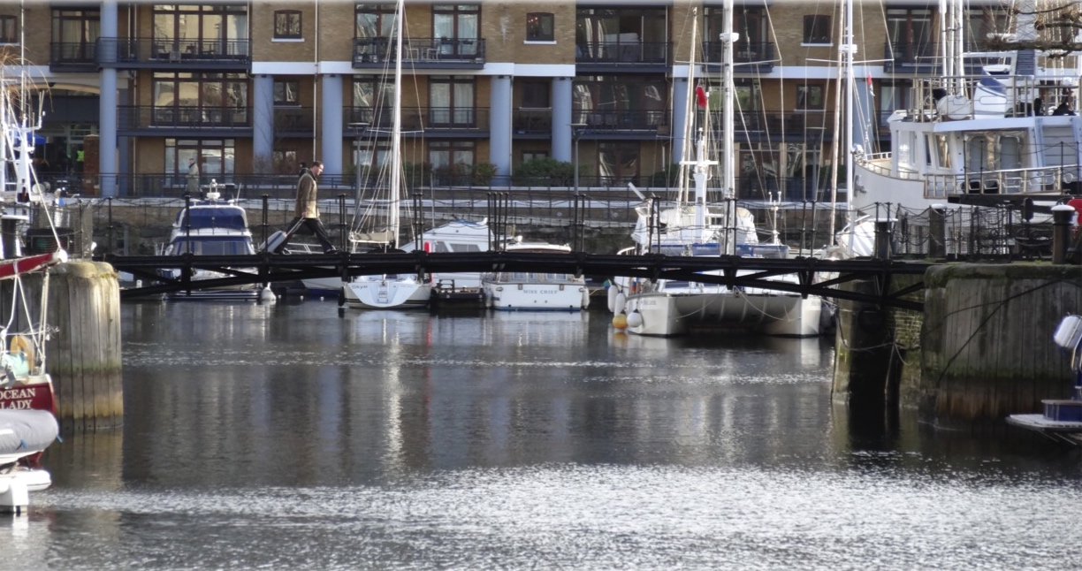
People over a river
Image courtesy of Guy Fox.

Slide 18
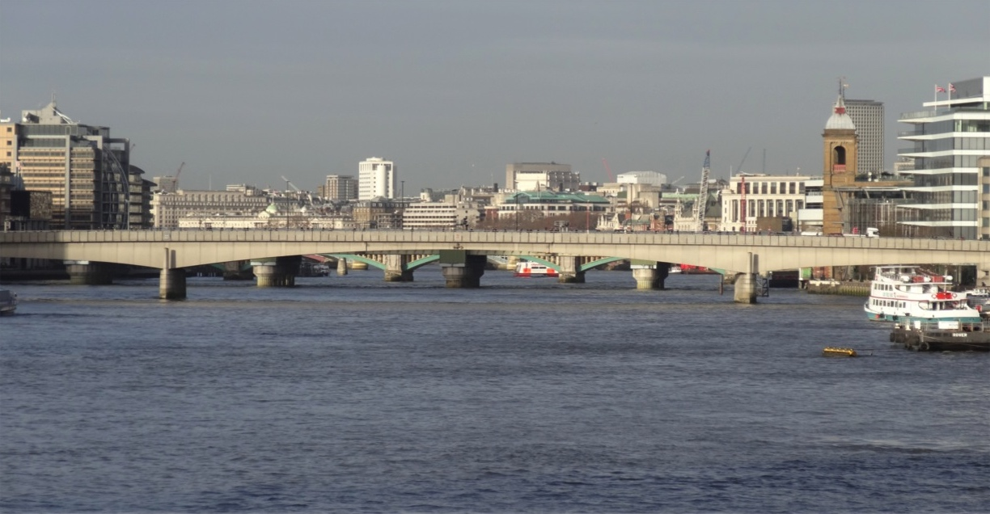
People and traffic over a river
Image courtesy of Guy Fox.

Slide 19
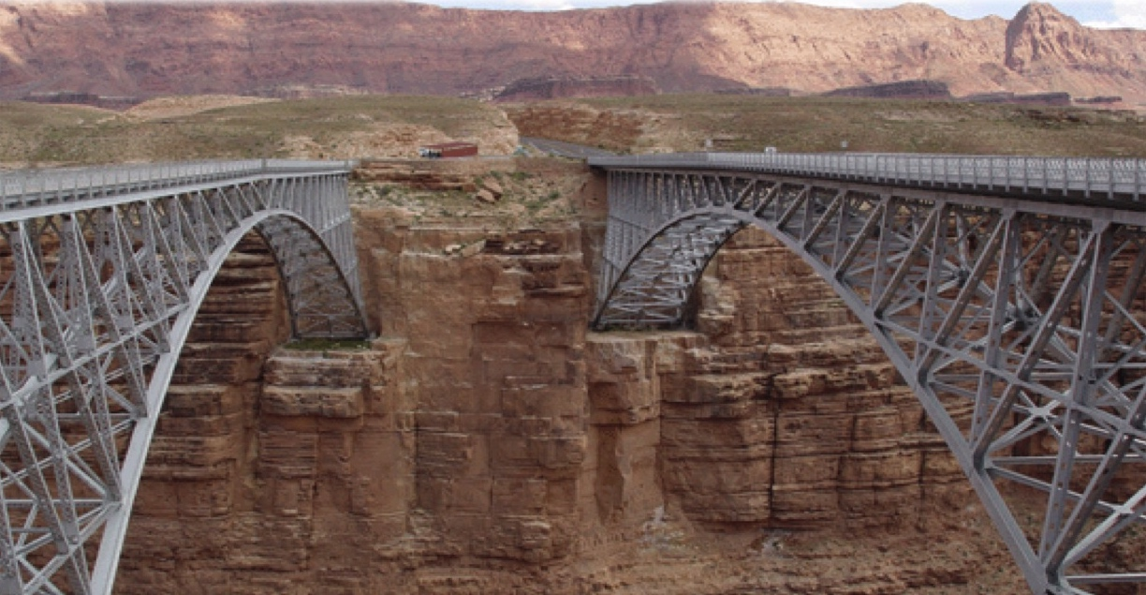
Trains over a gorge
Image courtesy of the National Park Service.

Slide 20
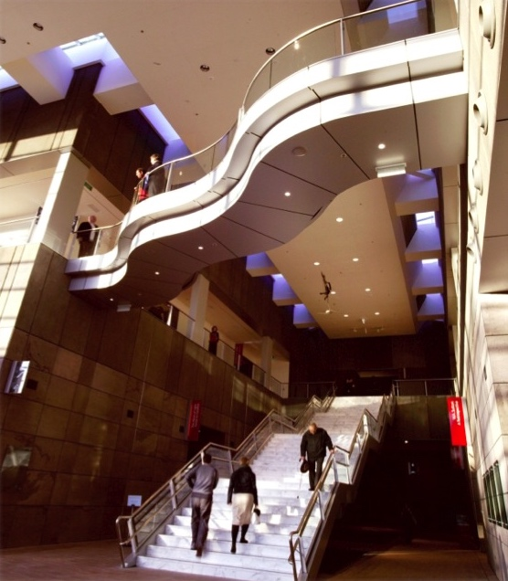
People over people in buildings
Image courtesy of The Buchan Group. Photographer: Murray Hedwig.

Slide 21
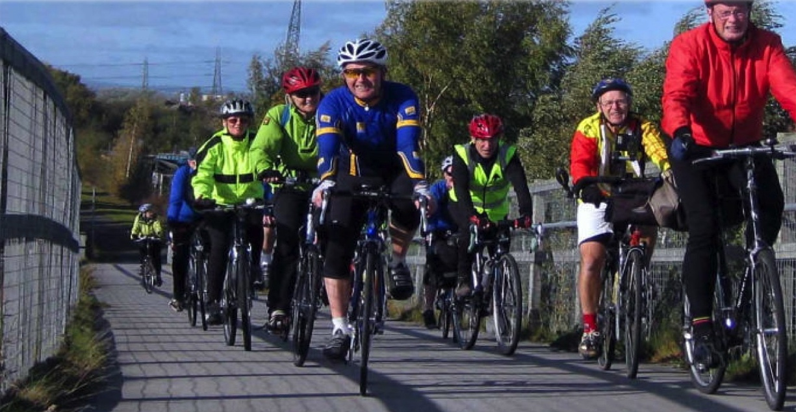
Bicycles over a road
Image courtesy of photographer Roy Spilsbury.

Slide 22
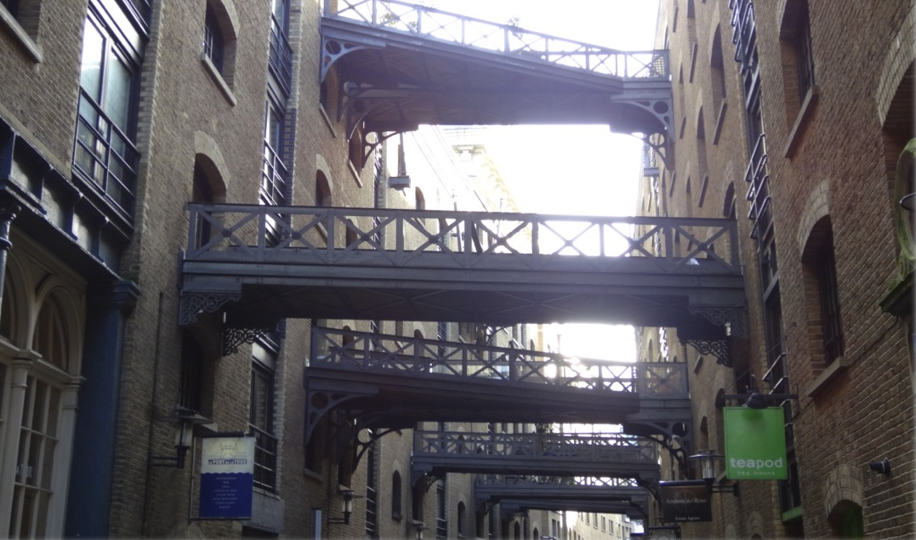
People over traffic
Image courtesy of Guy Fox.

Slide 23
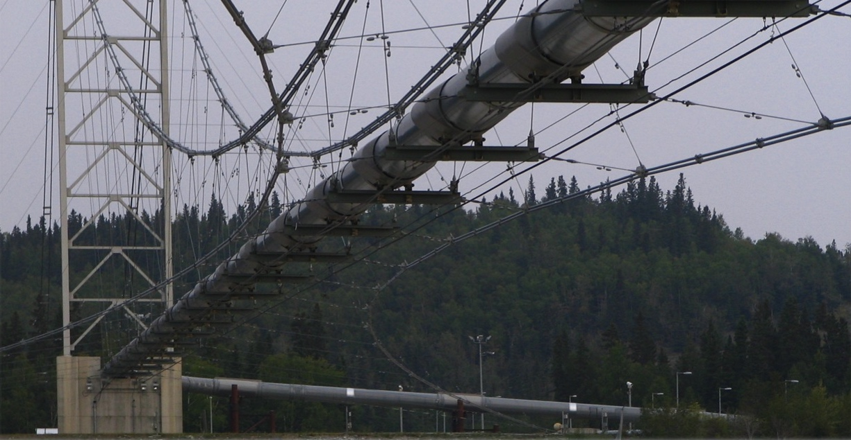
Pipelines over a lake
Image taken from Wikipedia.org courtesy of Derek Ramsey.

Slide 24
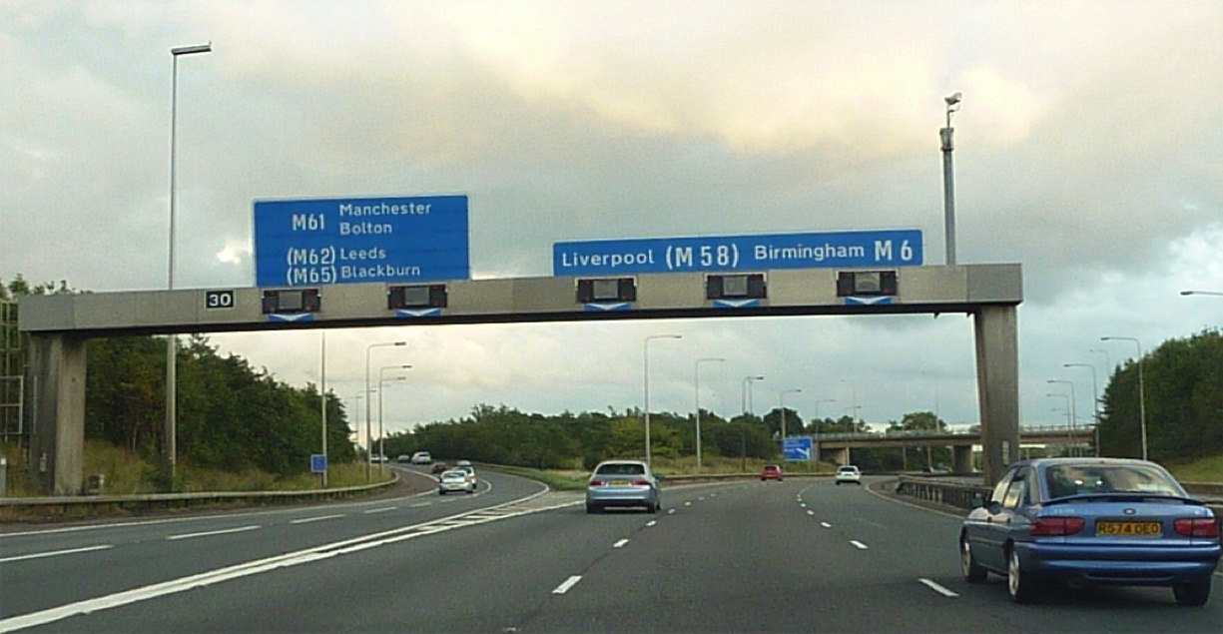
Road signs over traffic
Image taken from Flickr courtesy of Rob Richardson.

Slide 25
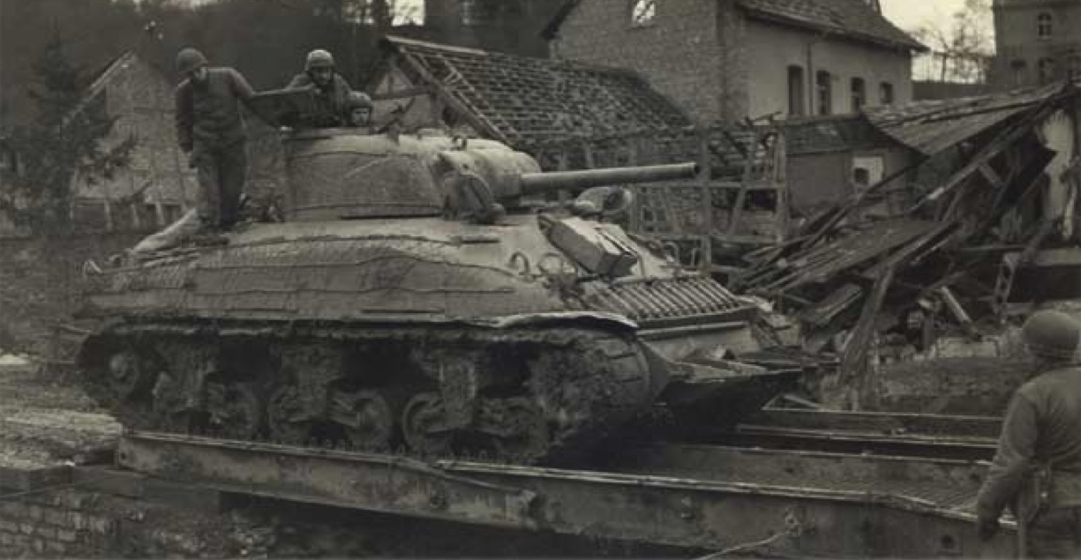
Anything else?
Image courtesy of The 2nd Infantry Division.

Slide 26
Something to Try
How would we manage without bridges?
Take a look at the Map of the River Medway (handout) showing the Medway Tunnel, Rochester Bridge, M2 high level bridge and towns.
What places do you recognise?

Slide 27
Something to Try
How would we manage without bridges?
Take a look at the Map of the River Medway (handout) showing the Medway Tunnel, Rochester Bridge, M2 high level bridge and towns.
What places do you recognise?
This is a map of the Medway in Kent, which has three crossings. Try this activity with a map of your local area, too!

Slide 28
Something to Try
How would we manage without bridges?
Read the Newsflash (handout).
Imagine you had to get from home in Strood (for example) to school in Rochester, and one night Rochester Bridge disappeared!
What effect would this have on your life?

Slide 29
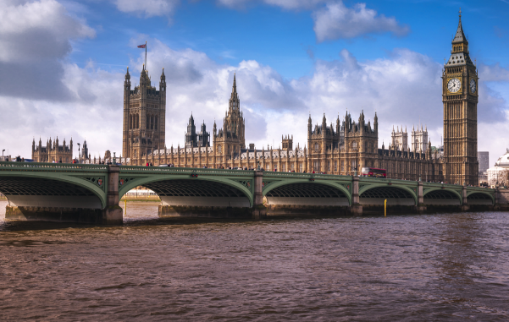
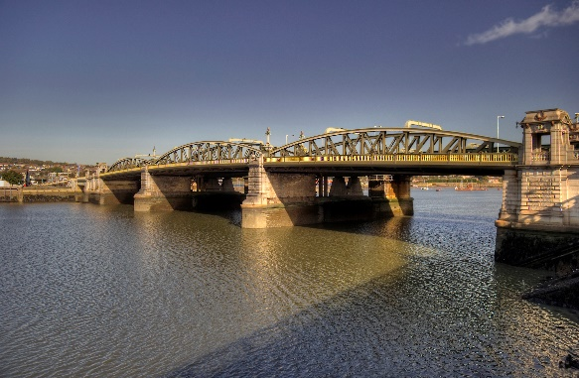
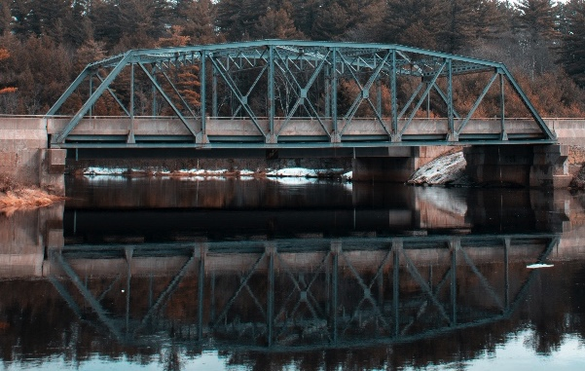
Something to Try
Classifying Bridges Resource

Slide 30
Something to Try
Can you group the pictures of the bridges together?
How did you decide to group them?
Can you explain this to the rest of the group?

Slide 31
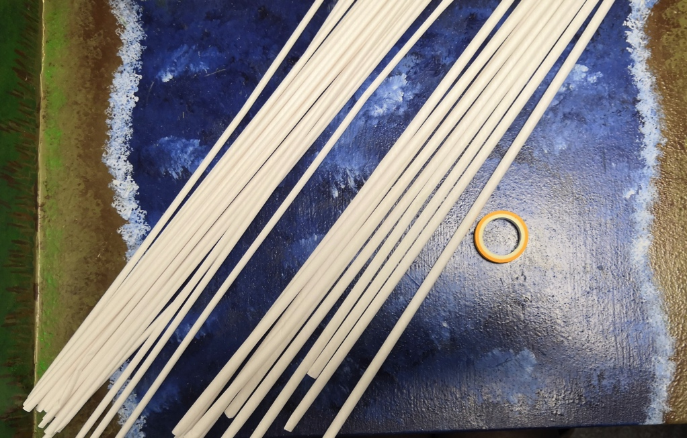
Challenge Time!
Bridges don’t have to involve lots of materials – can you build a bridge out of paper straws, card and tape?

Slide 32
Hot Topics!
You could write a news article or blog about the disappearance of a bridge. It could be the Rochester Bridges or other bridge local to you, or a famous bridge such as Tower Bridge or the Golden Gate bridge. You could think about the disappearance as a result of alien activity, as per the handout, or by a ‘Master Villain’ as in “Despicable Me”.

Slide 33
Out and About
Can you spot any bridges near where you live? What is it going over, and what is using the bridge?

