Slide 1
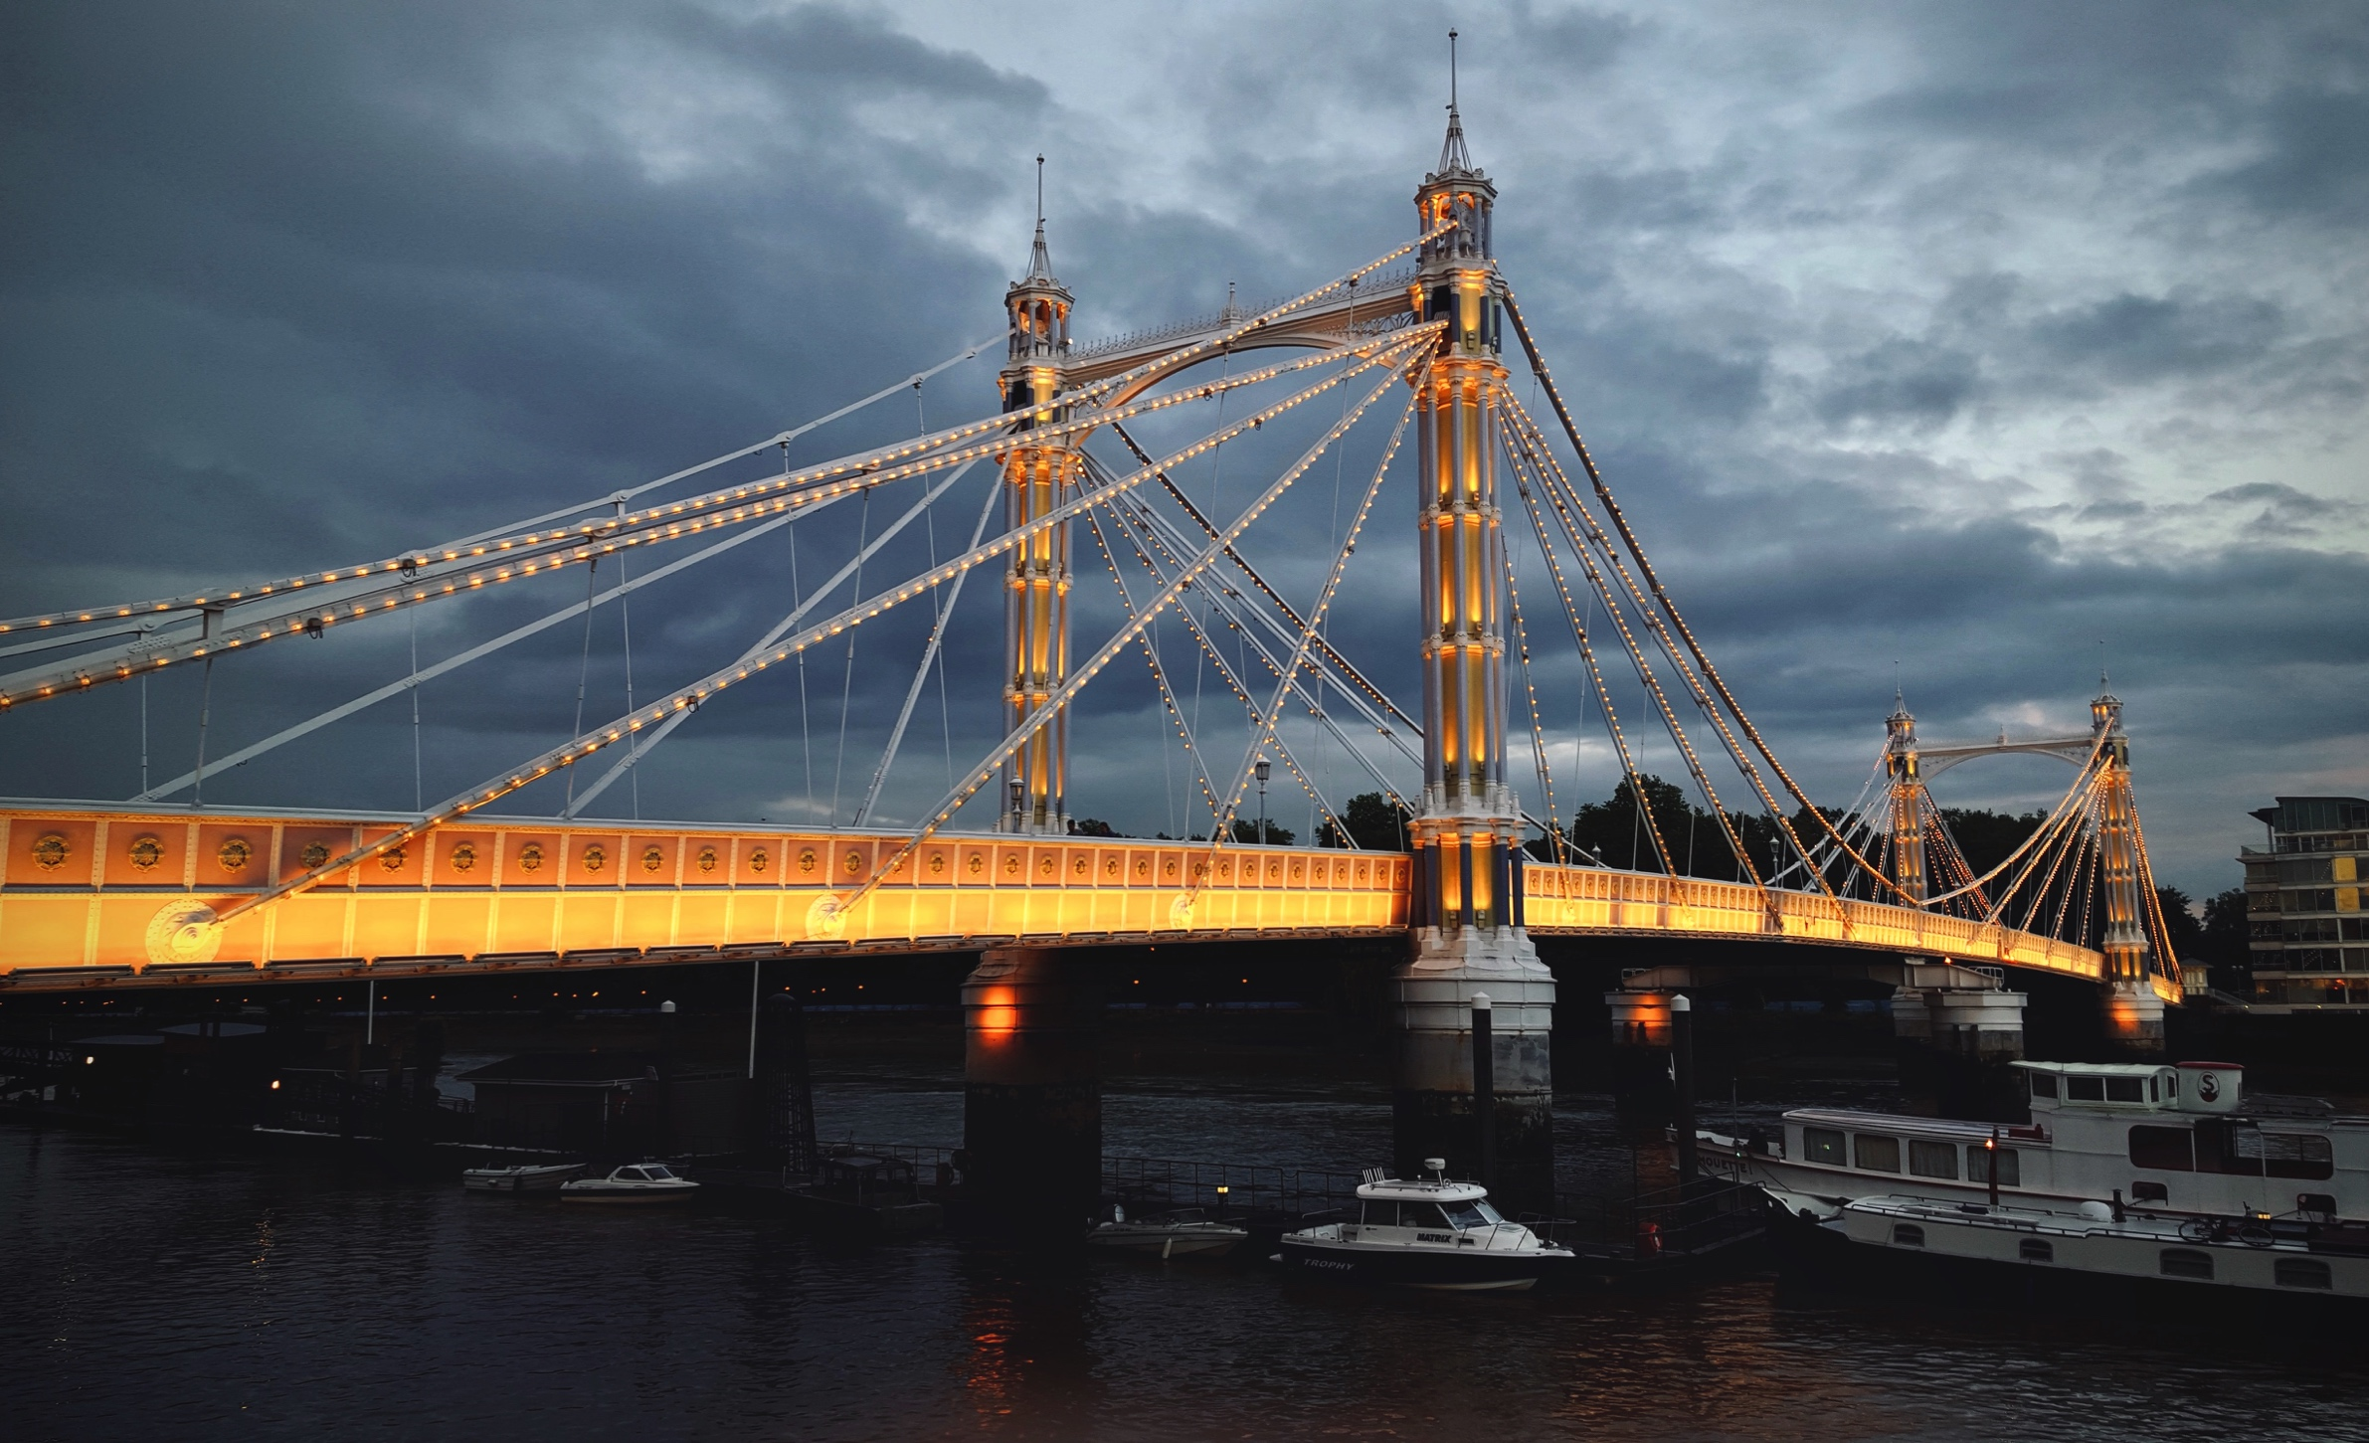
Photo by Jonathon Hoffman on Unsplash
1

Slide 2
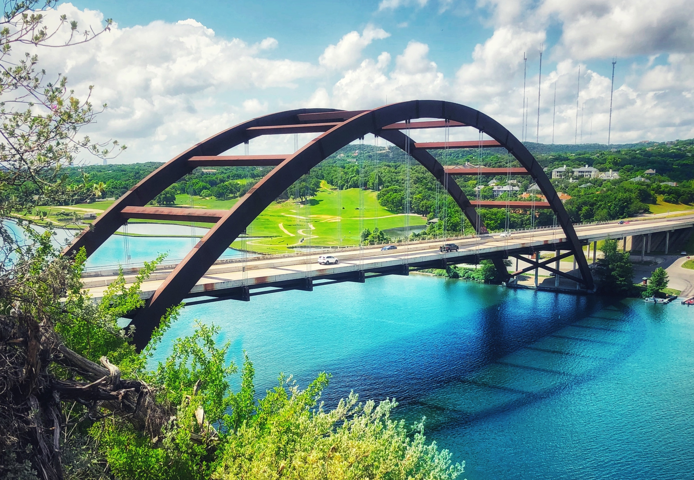
Photo by Ryan Barron on Unsplash
2

Slide 3
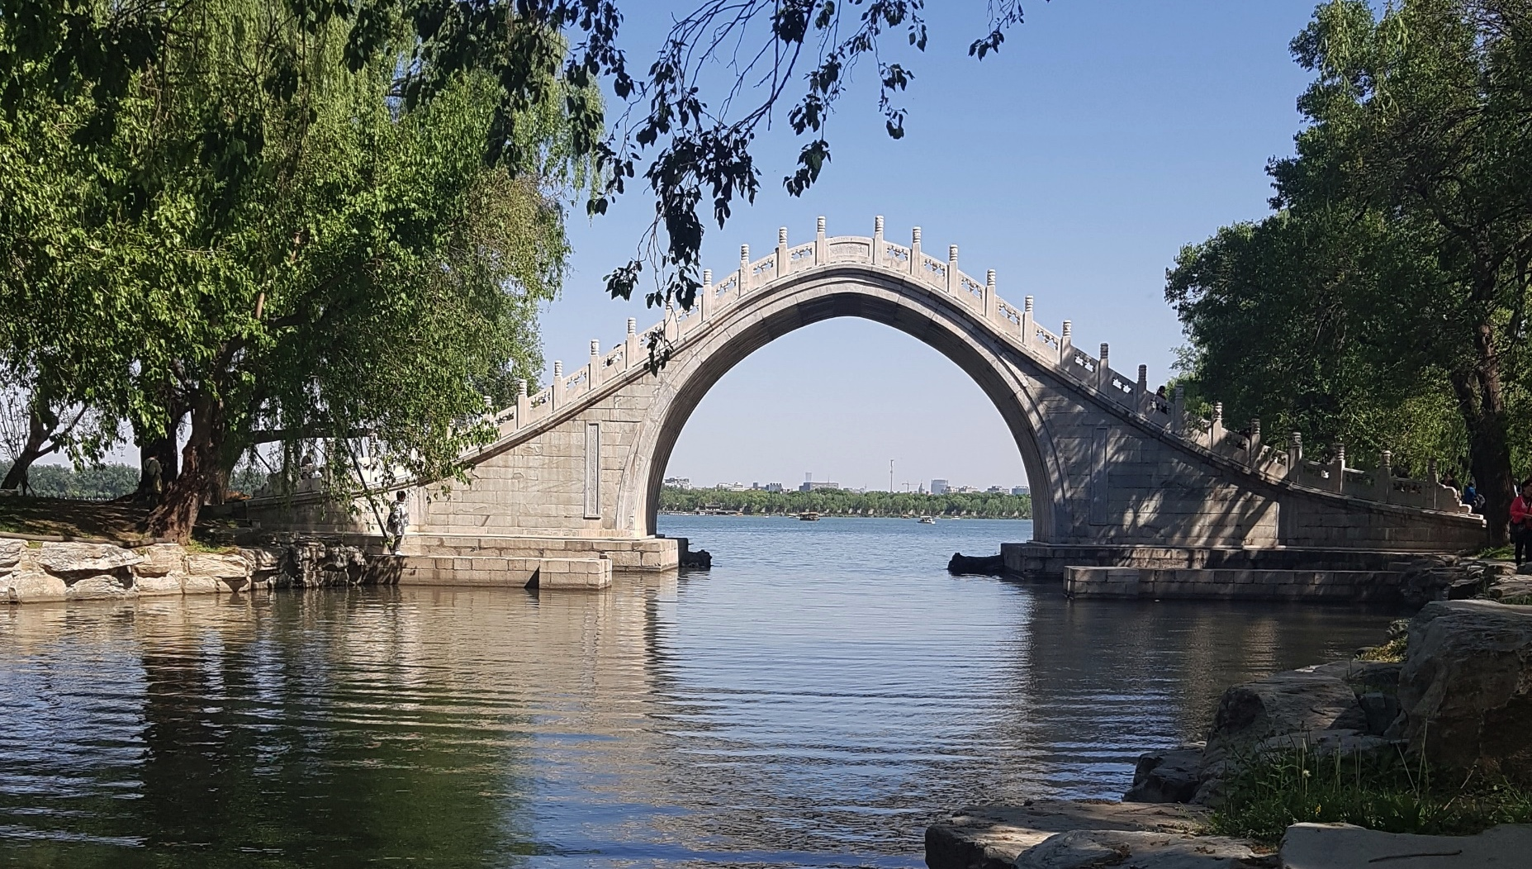
Photo by Tiplister on Unsplash
3

Slide 4
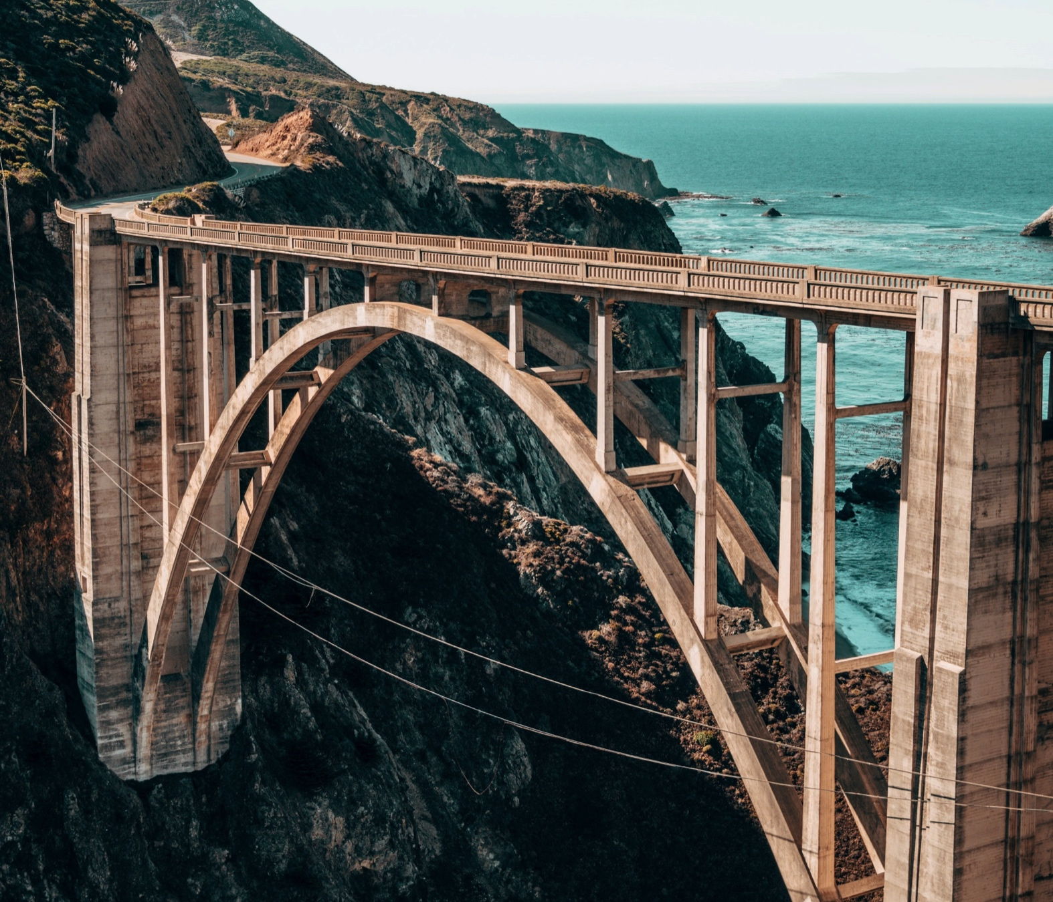
Photo by Cody Hiscox on Unsplash
4

Slide 5
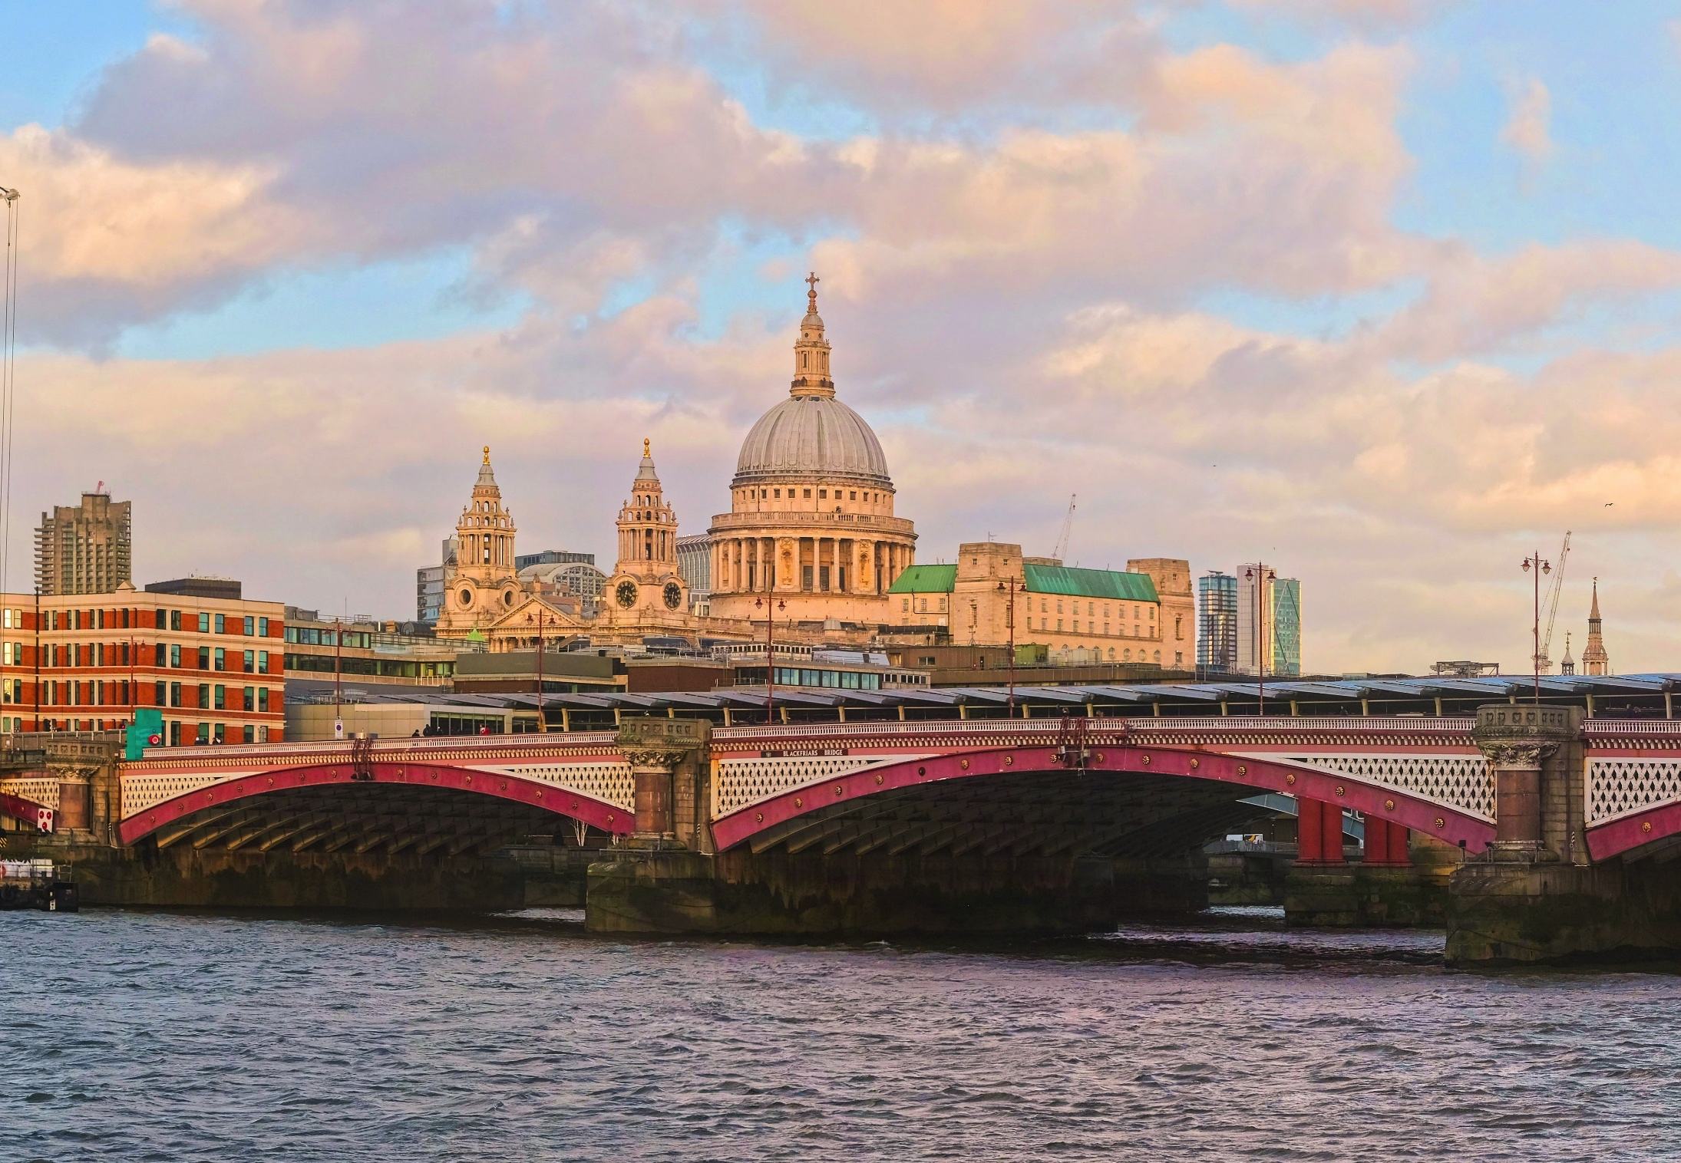
Photo by Viktor Forgacs on Unsplash
5

Slide 6
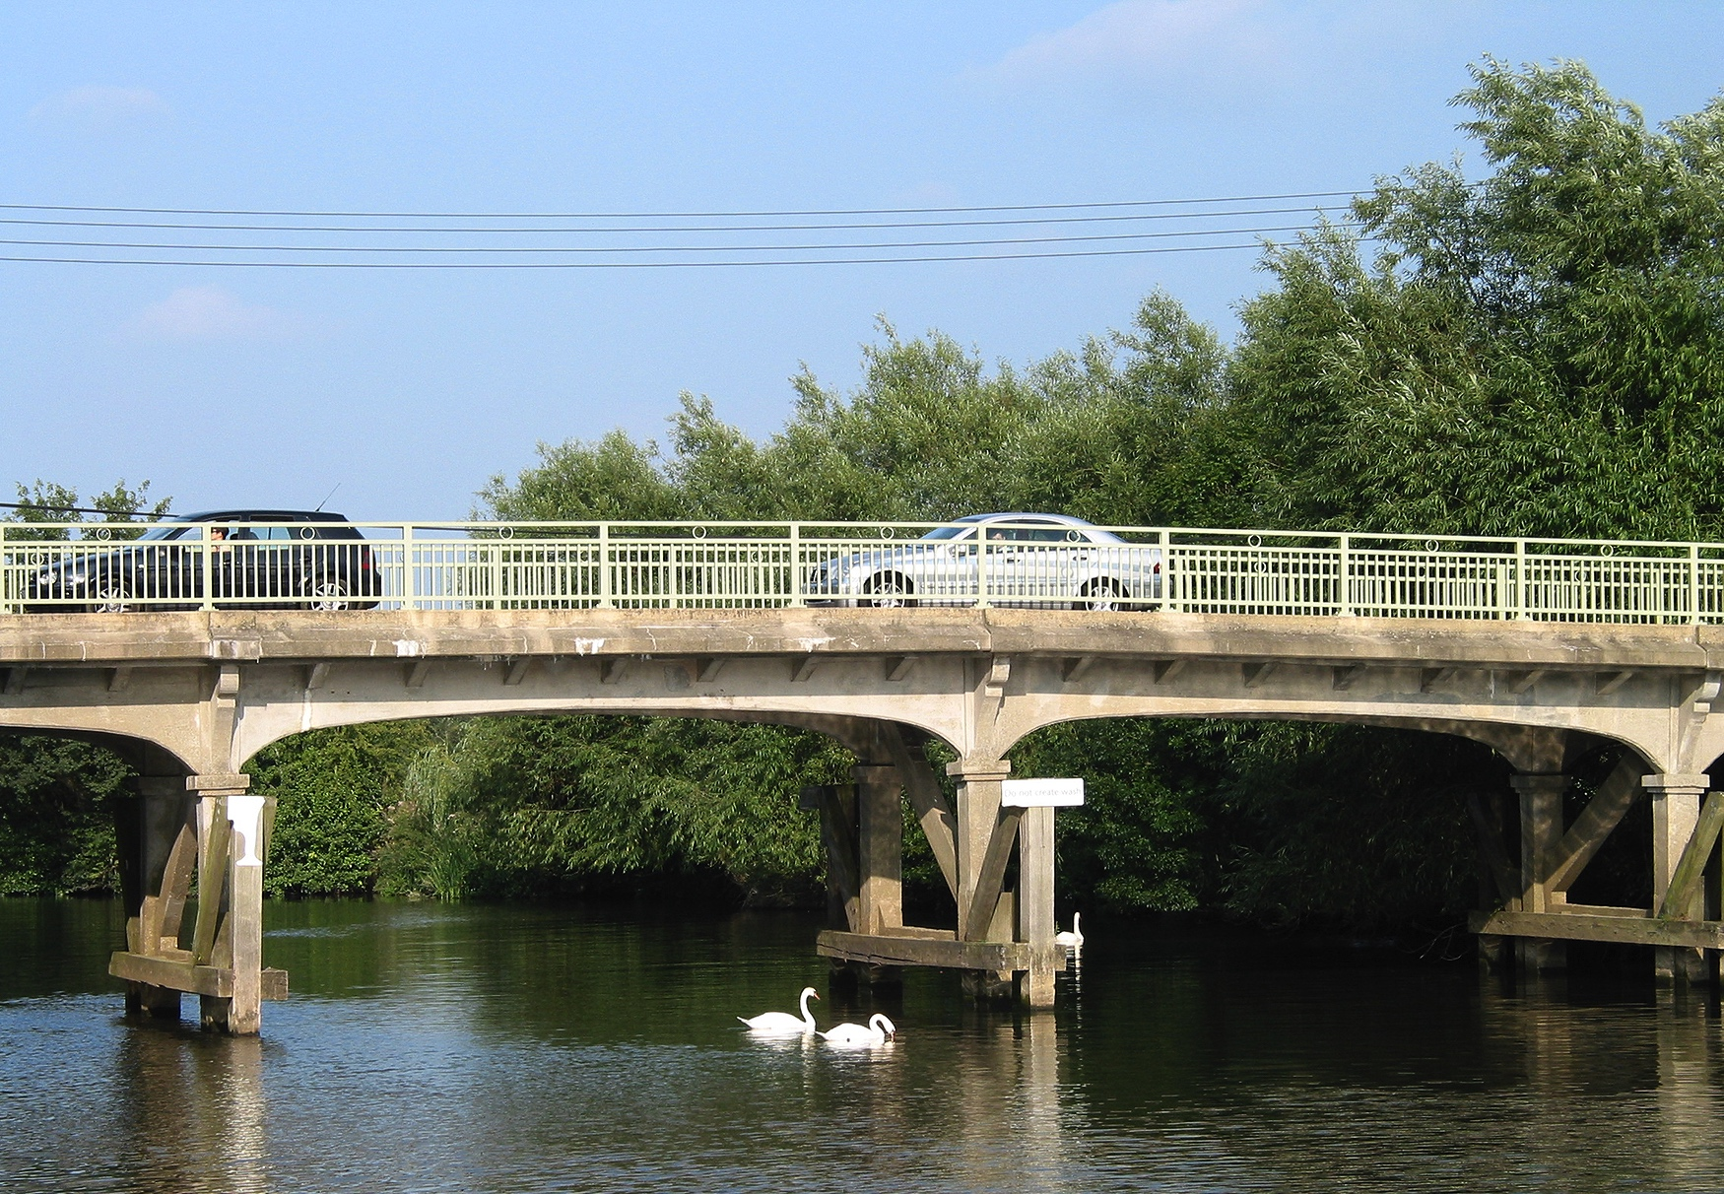
Photo by Rochester Bridge Trust
6

Slide 7
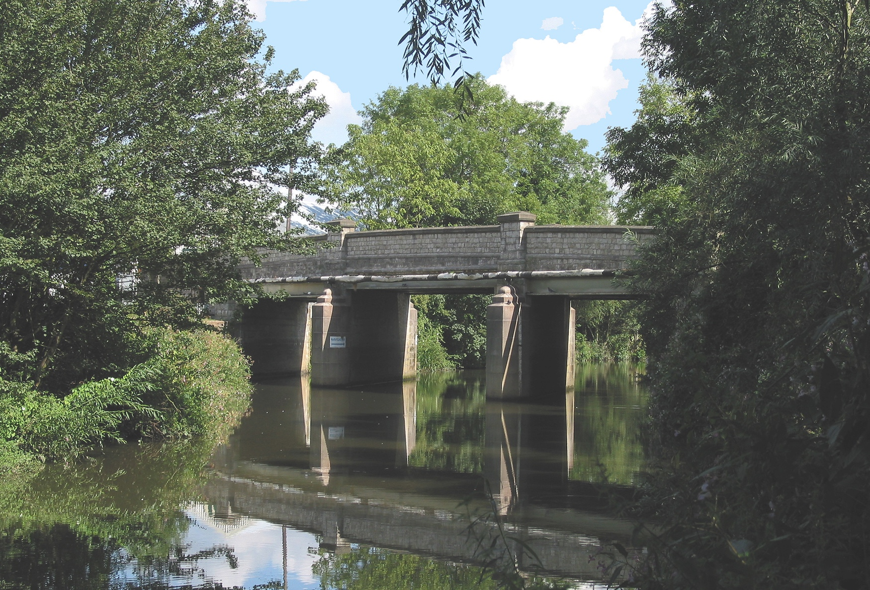
Photo by Rochester Bridge Trust
7

Slide 8
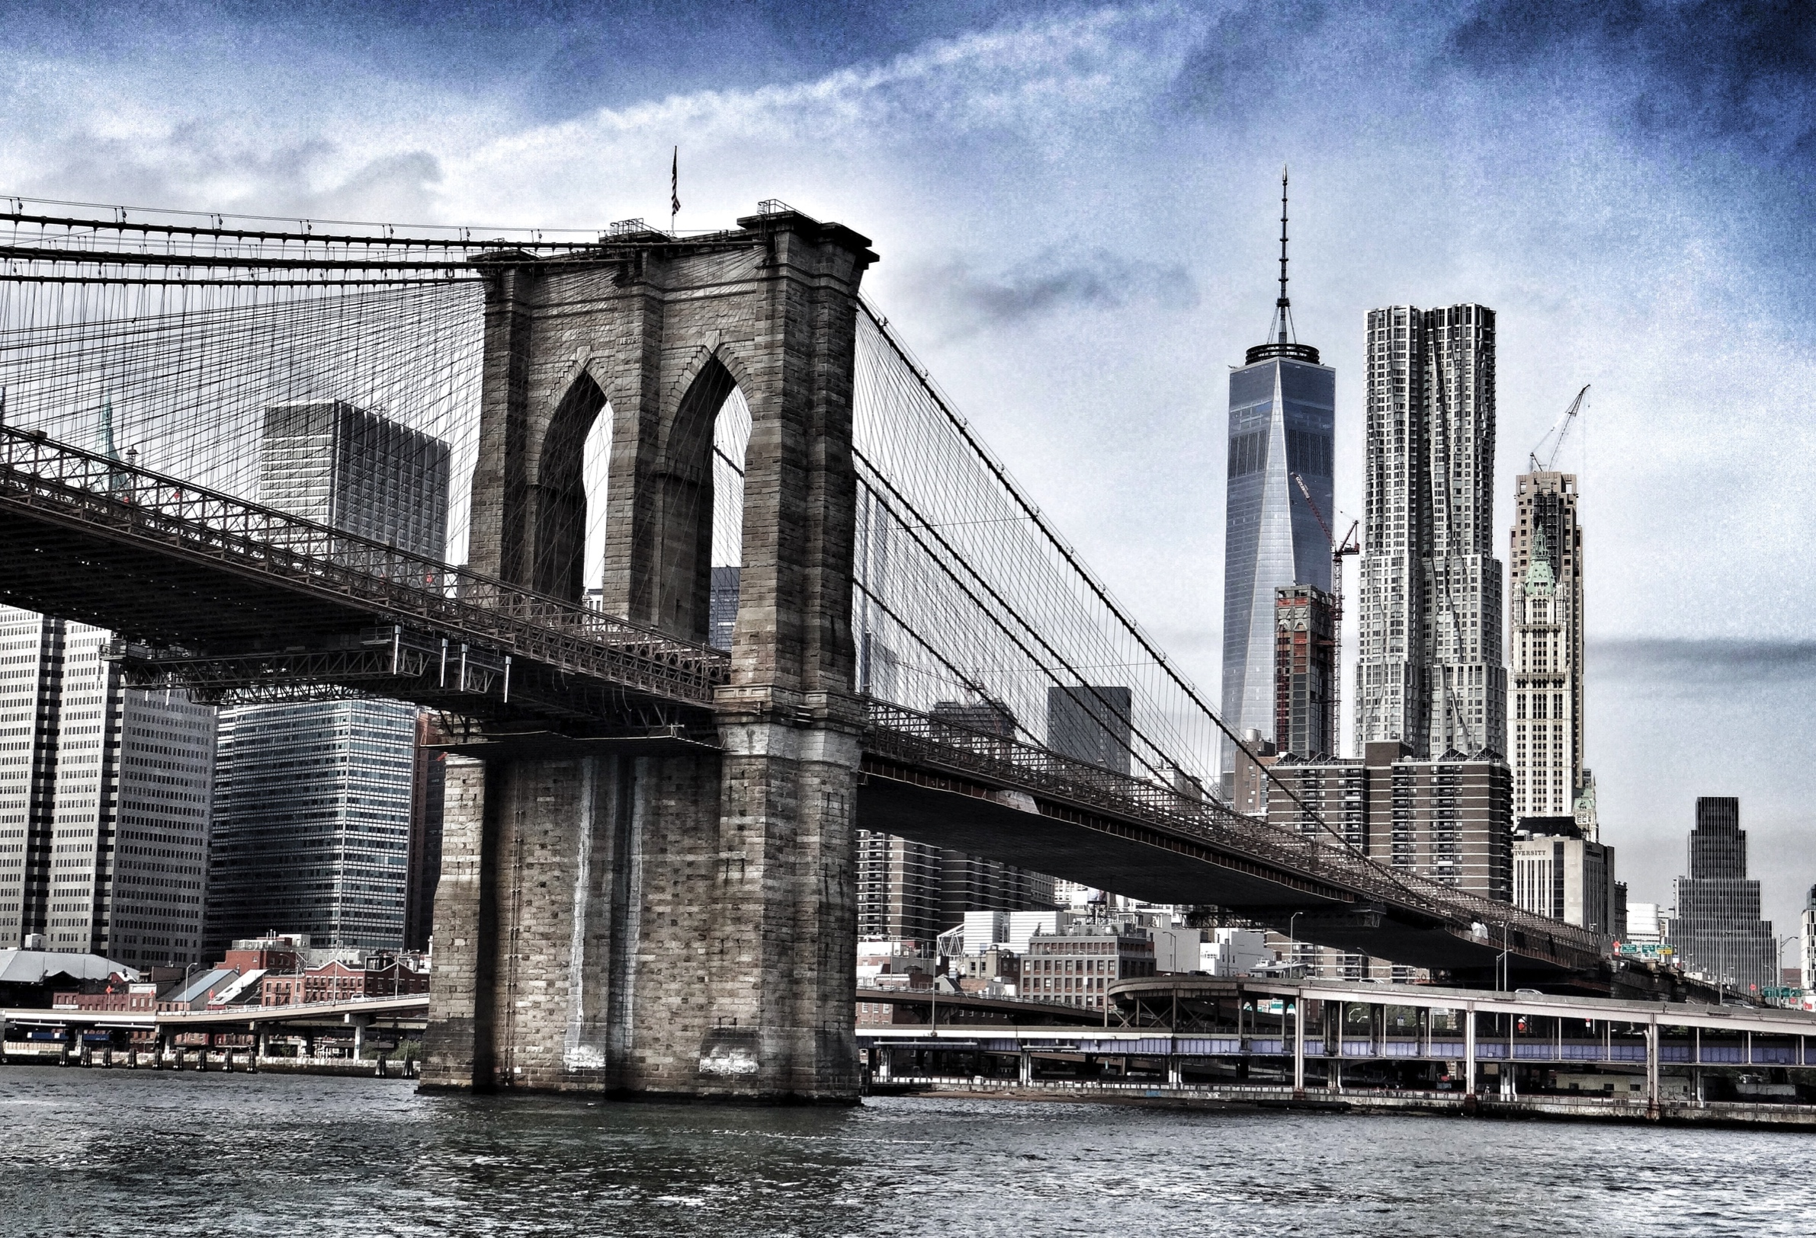
Photo by Hannes Richter on Unsplash
8

Slide 9
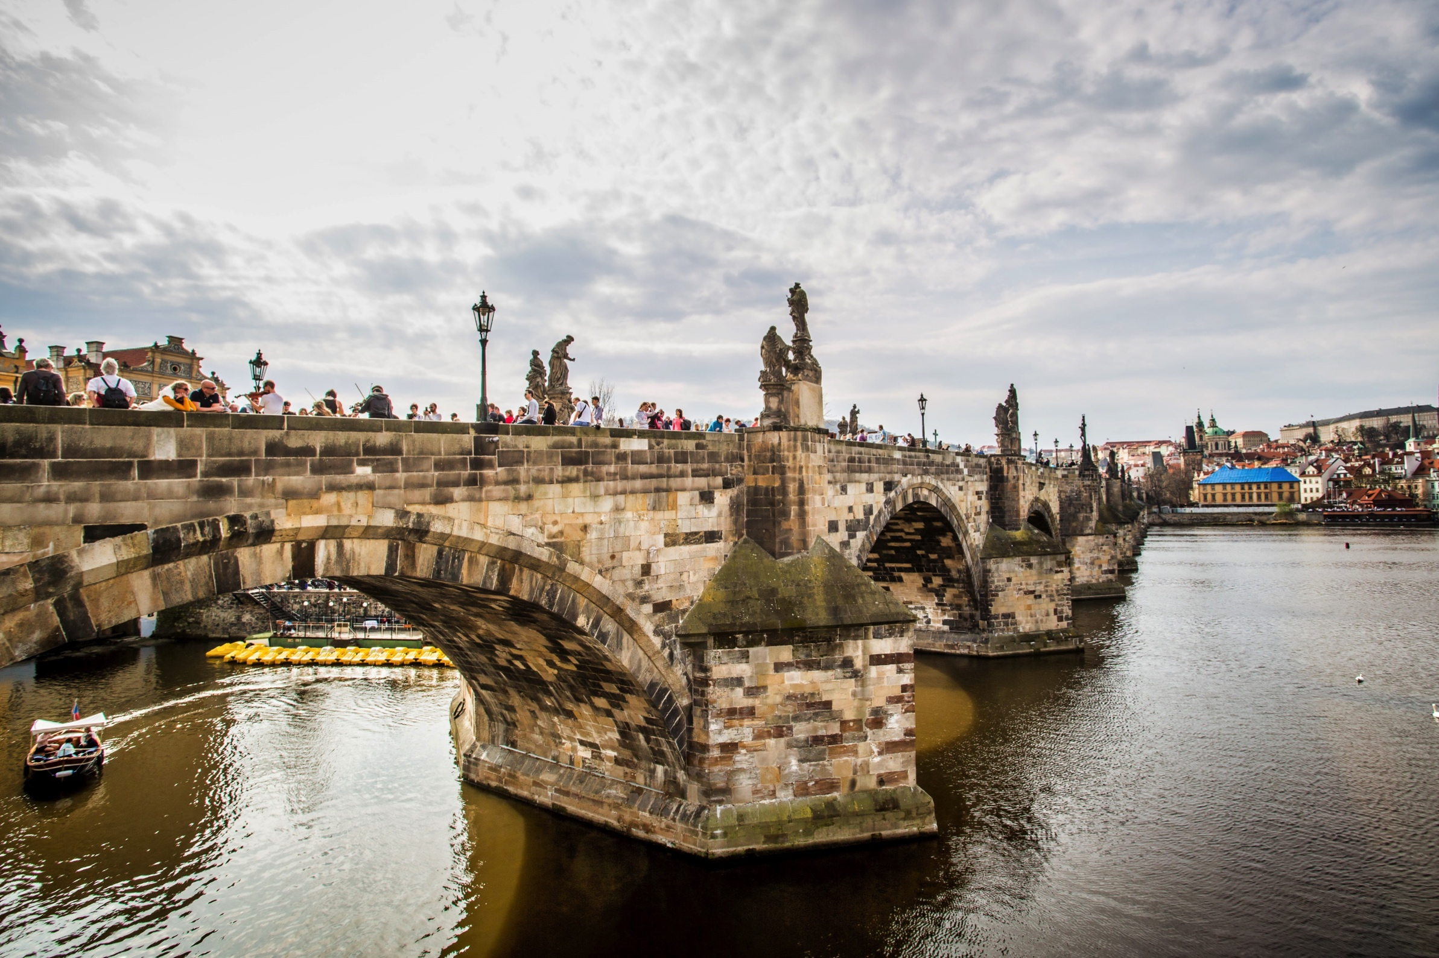
Photo by Sergey Mind on Unsplash
9

Slide 10
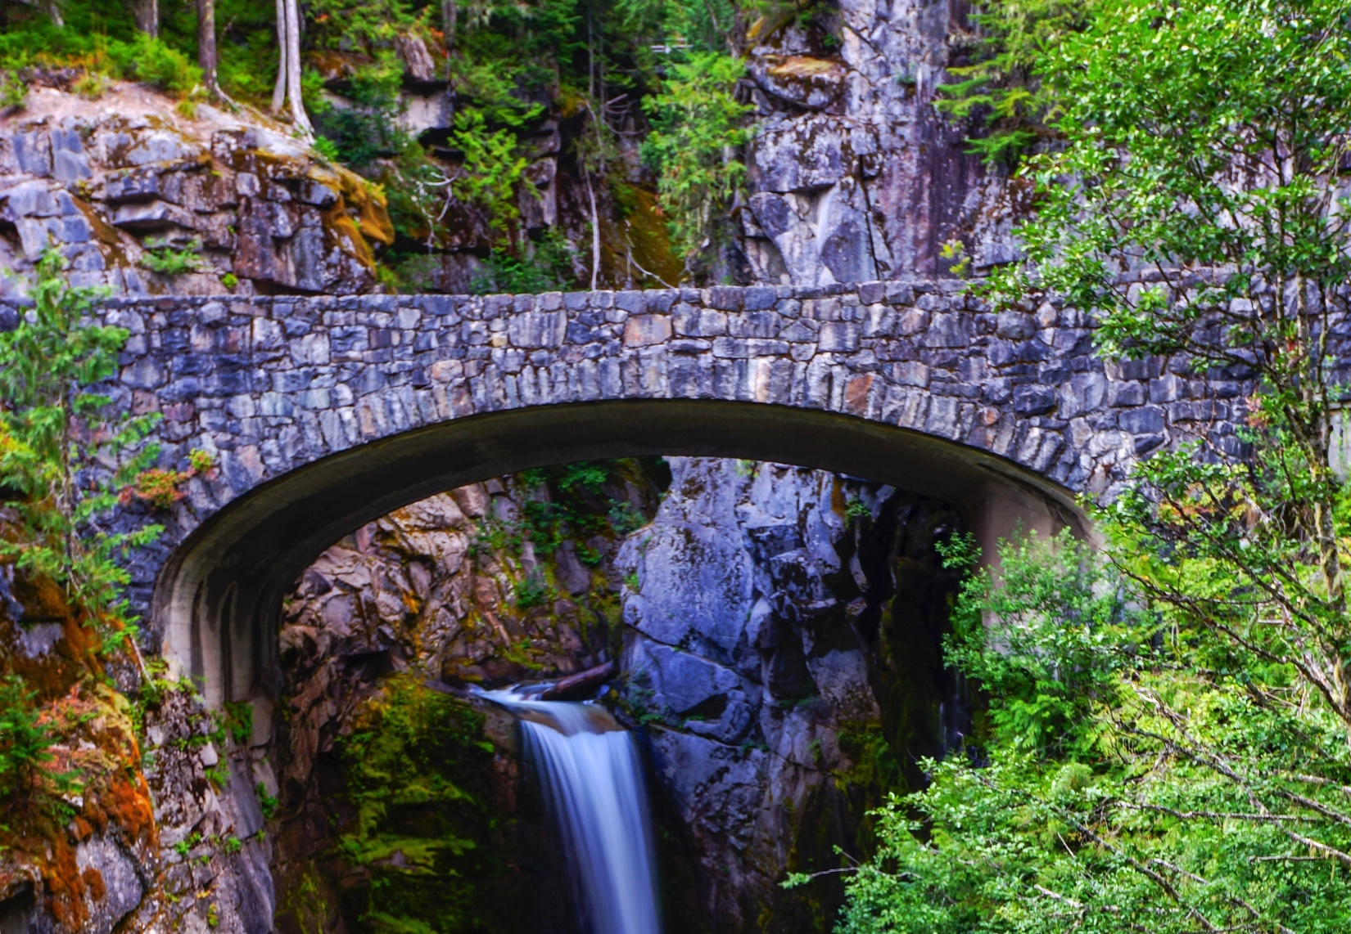
Photo by Baasil Pasha on Unsplash
10

Slide 11
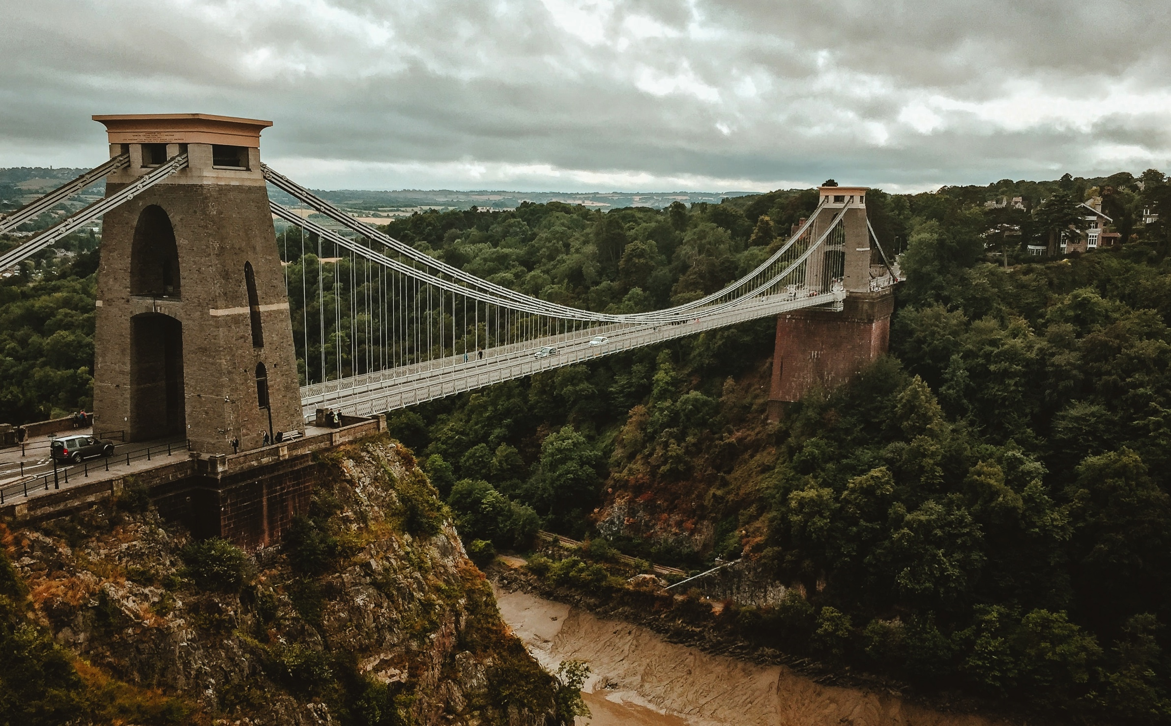
Photo by Hello I'm Nik 🎞 on Unsplash
11

Slide 12
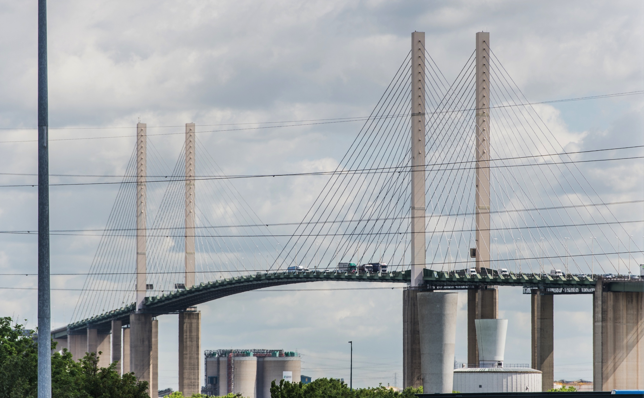
Photo courtesy of Balfour Beatty/Connect Plus
12

Slide 13
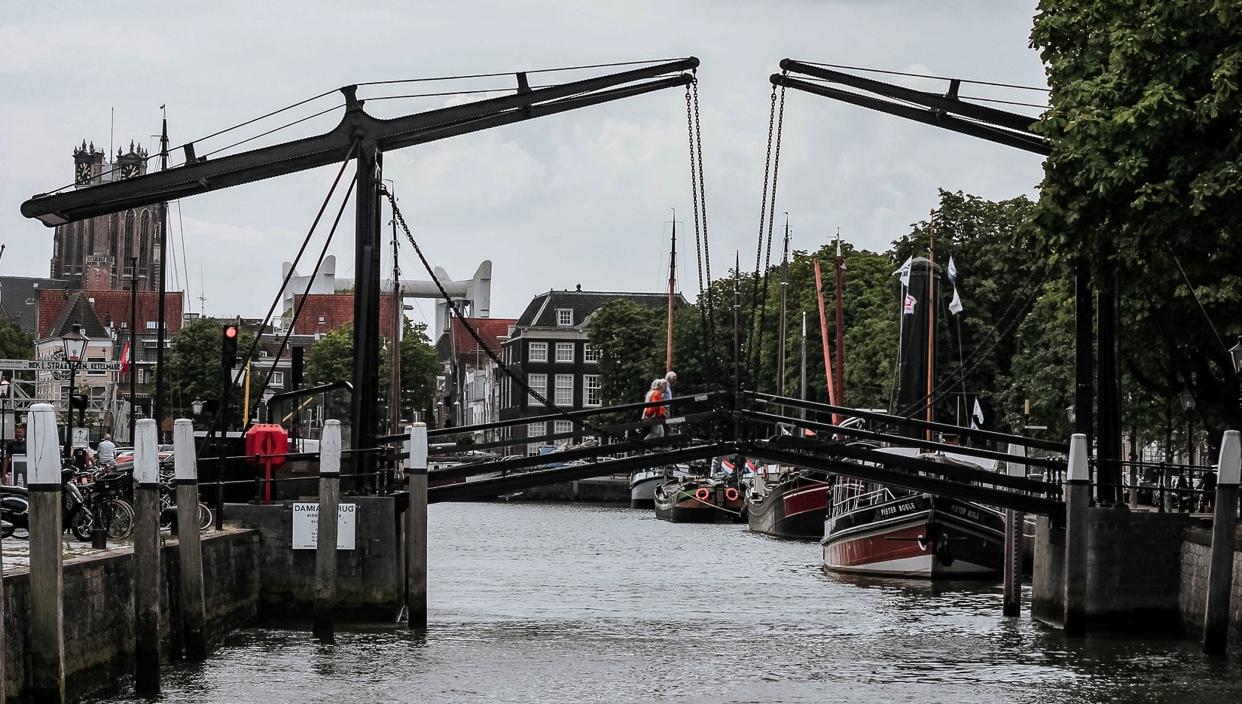
Photo by Micheile Henderson on Unsplash
13

Slide 14
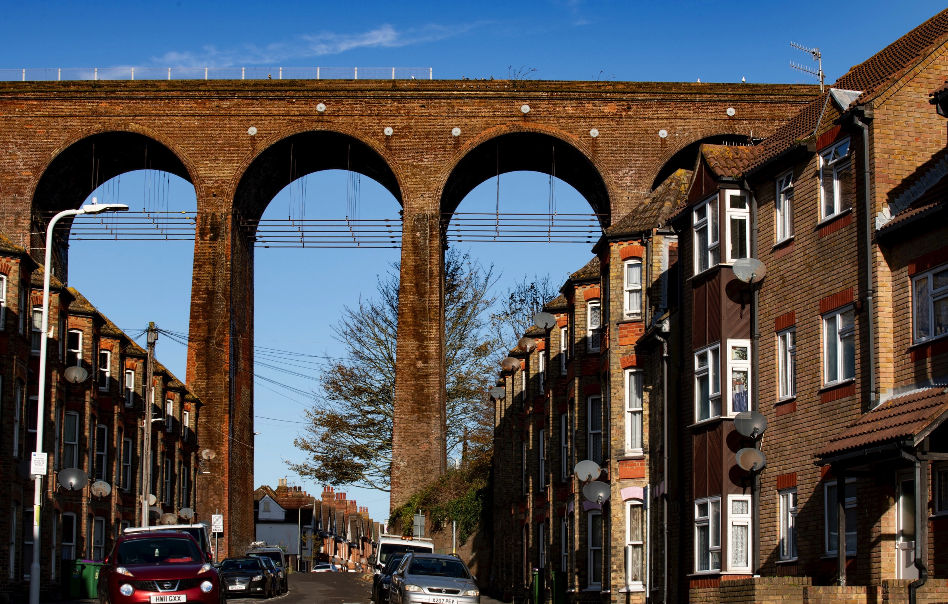
Photo by Craige McGonigle on Unsplash
14

Slide 15
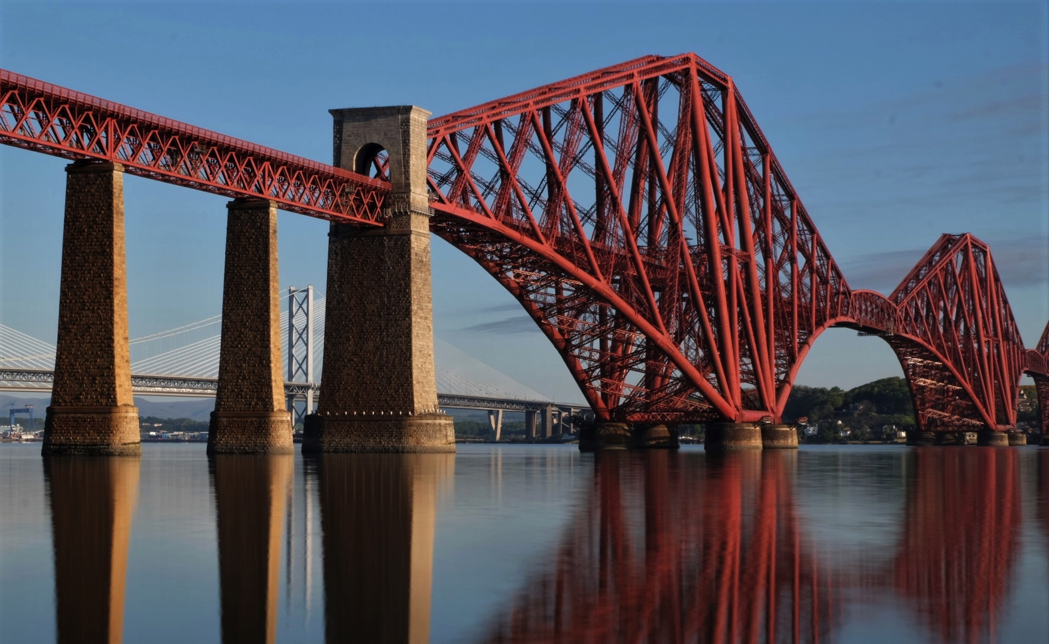
Photo by Esteban on Unsplash
15

Slide 16
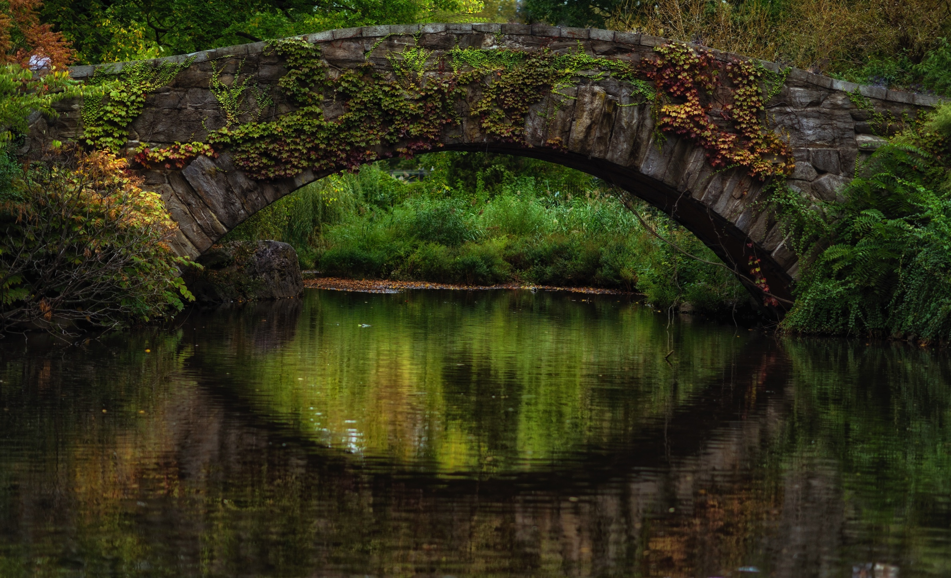
Photo by Ijaz Rafi on Unsplash
16

Slide 17
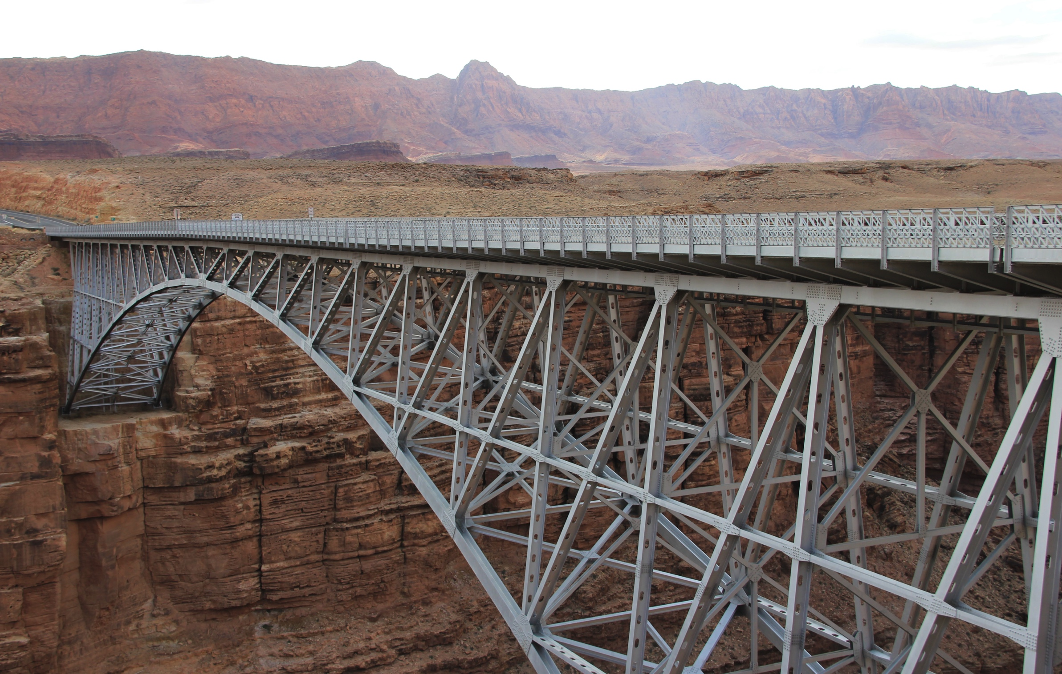
Photo by Patrick Hendry on Unsplash
17

Slide 18
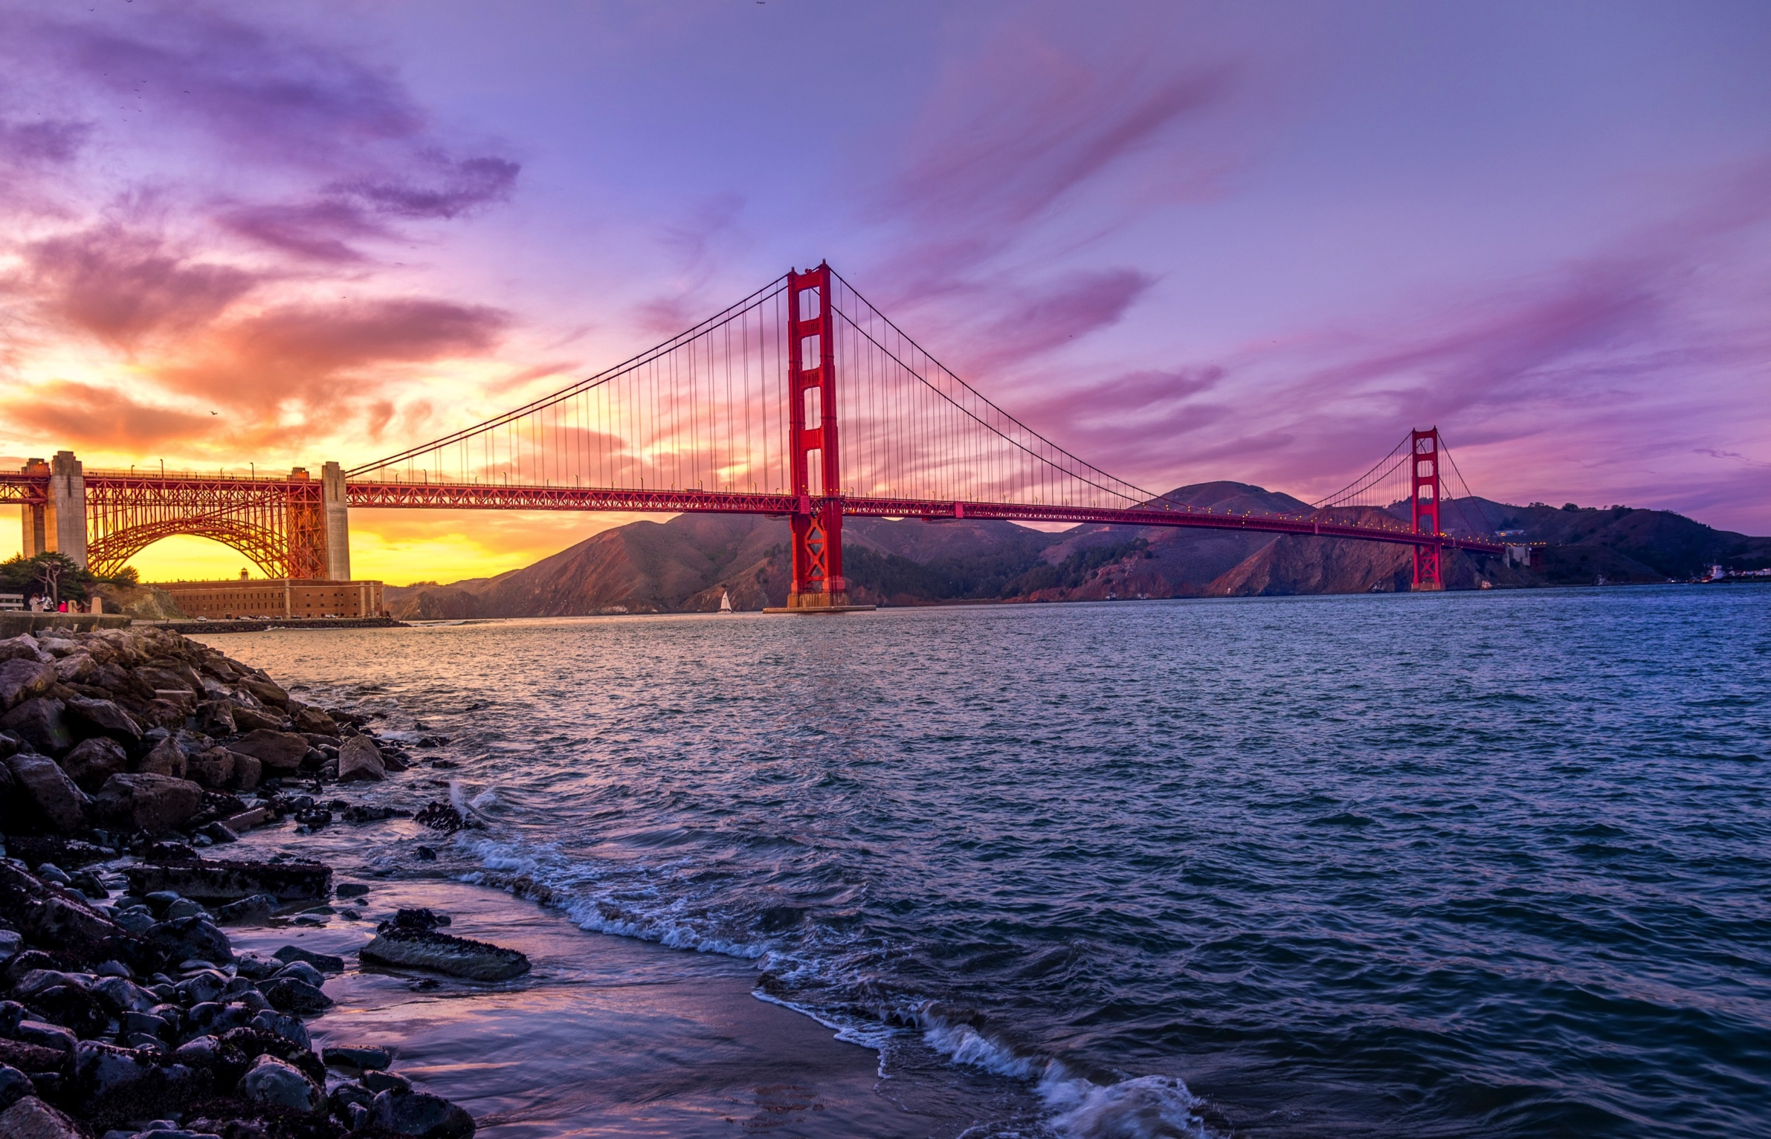
Photo by Umer Sayyam on Unsplash
18

Slide 19
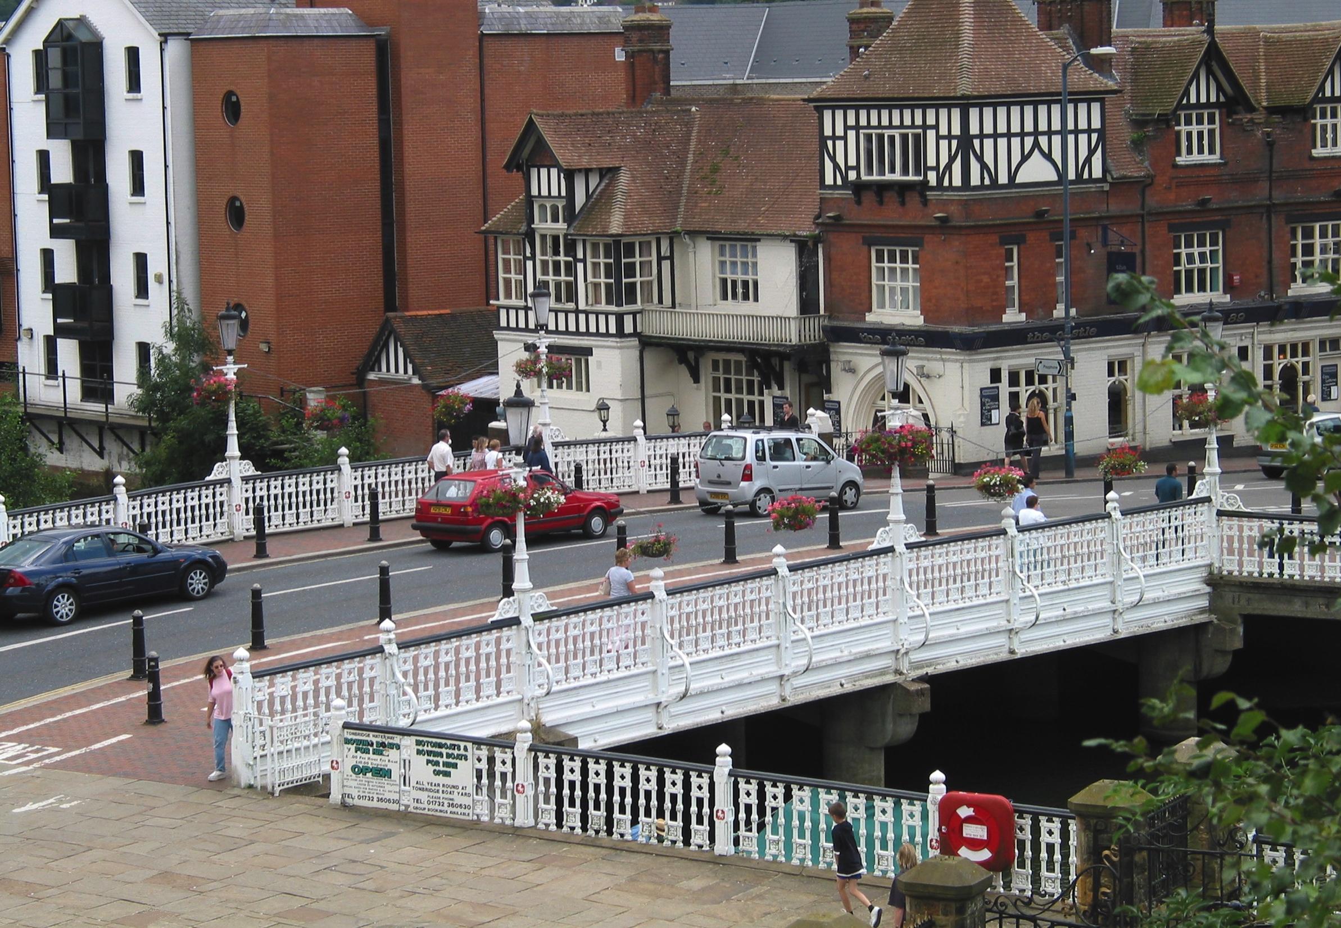
Photo by Rochester Bridge Trust
19

Slide 20
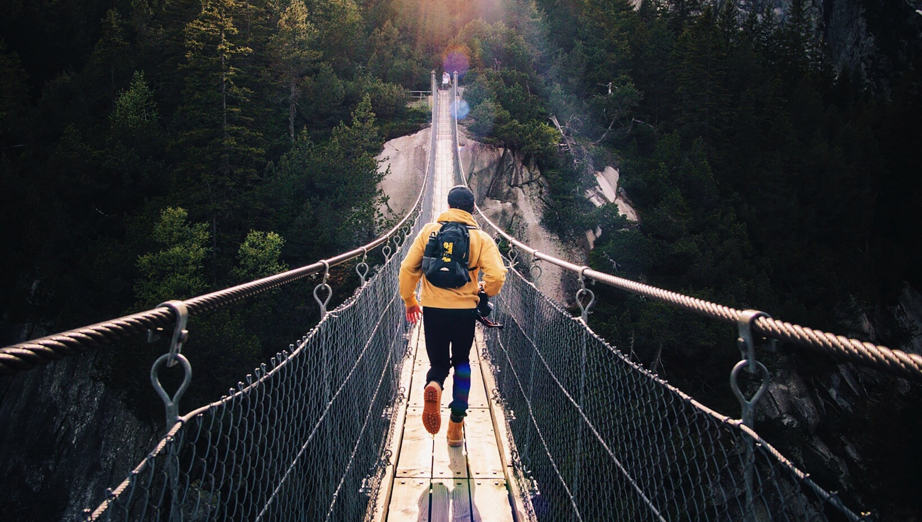
Photo by Fabio Comparelli on Unsplash
20

Slide 21
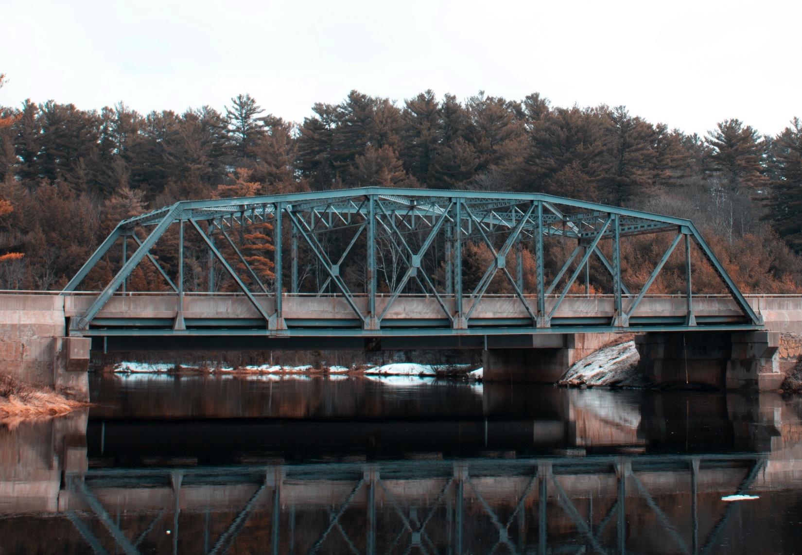
Photo by Lucas Kohoko on Unsplash
21

Slide 22
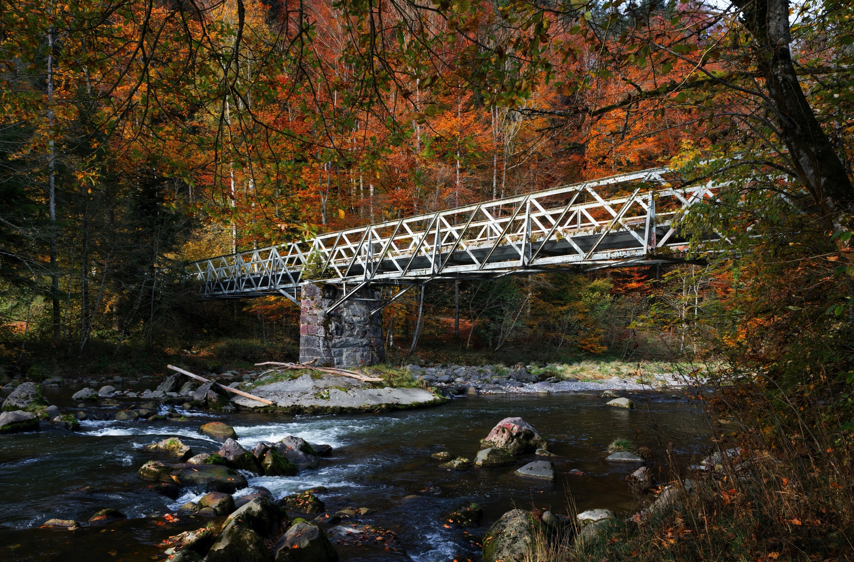
Photo by Ricardo Gomez Angel on Unsplash
22

Slide 23
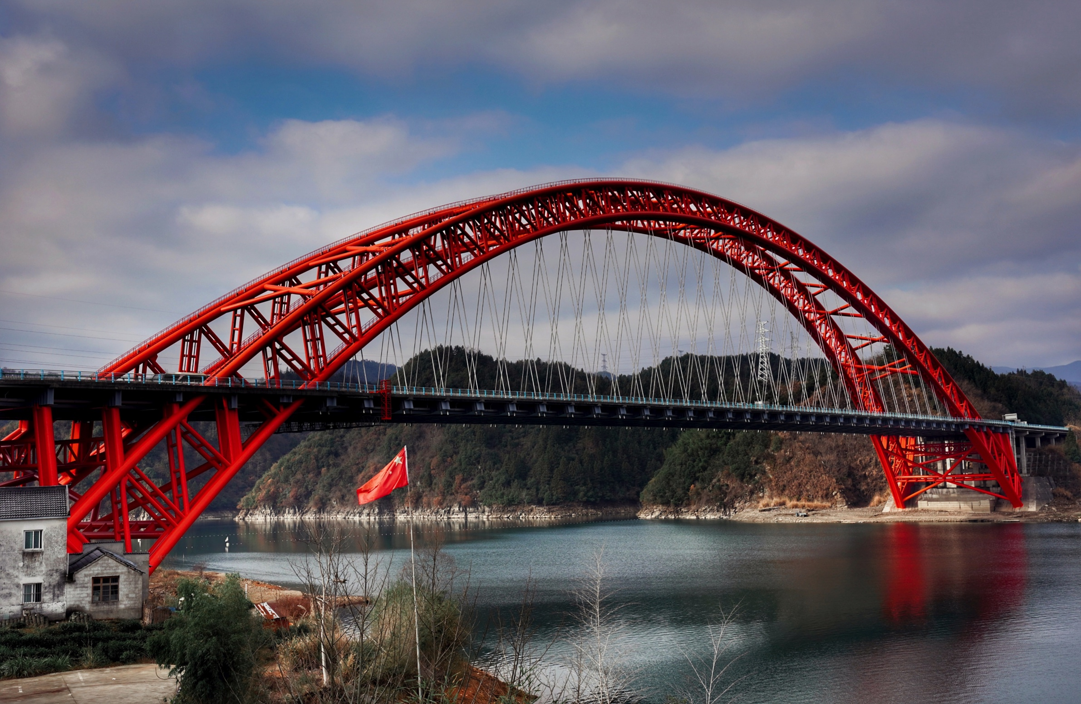
Photo by 瓜田 月下 on Unsplash
23

Slide 24
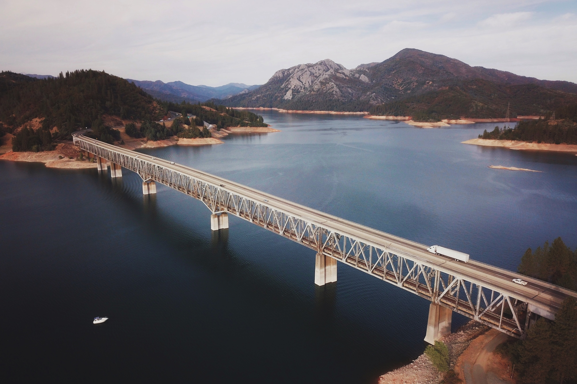
Photo by Brandon DesJarlais on Unsplash
24

Slide 25
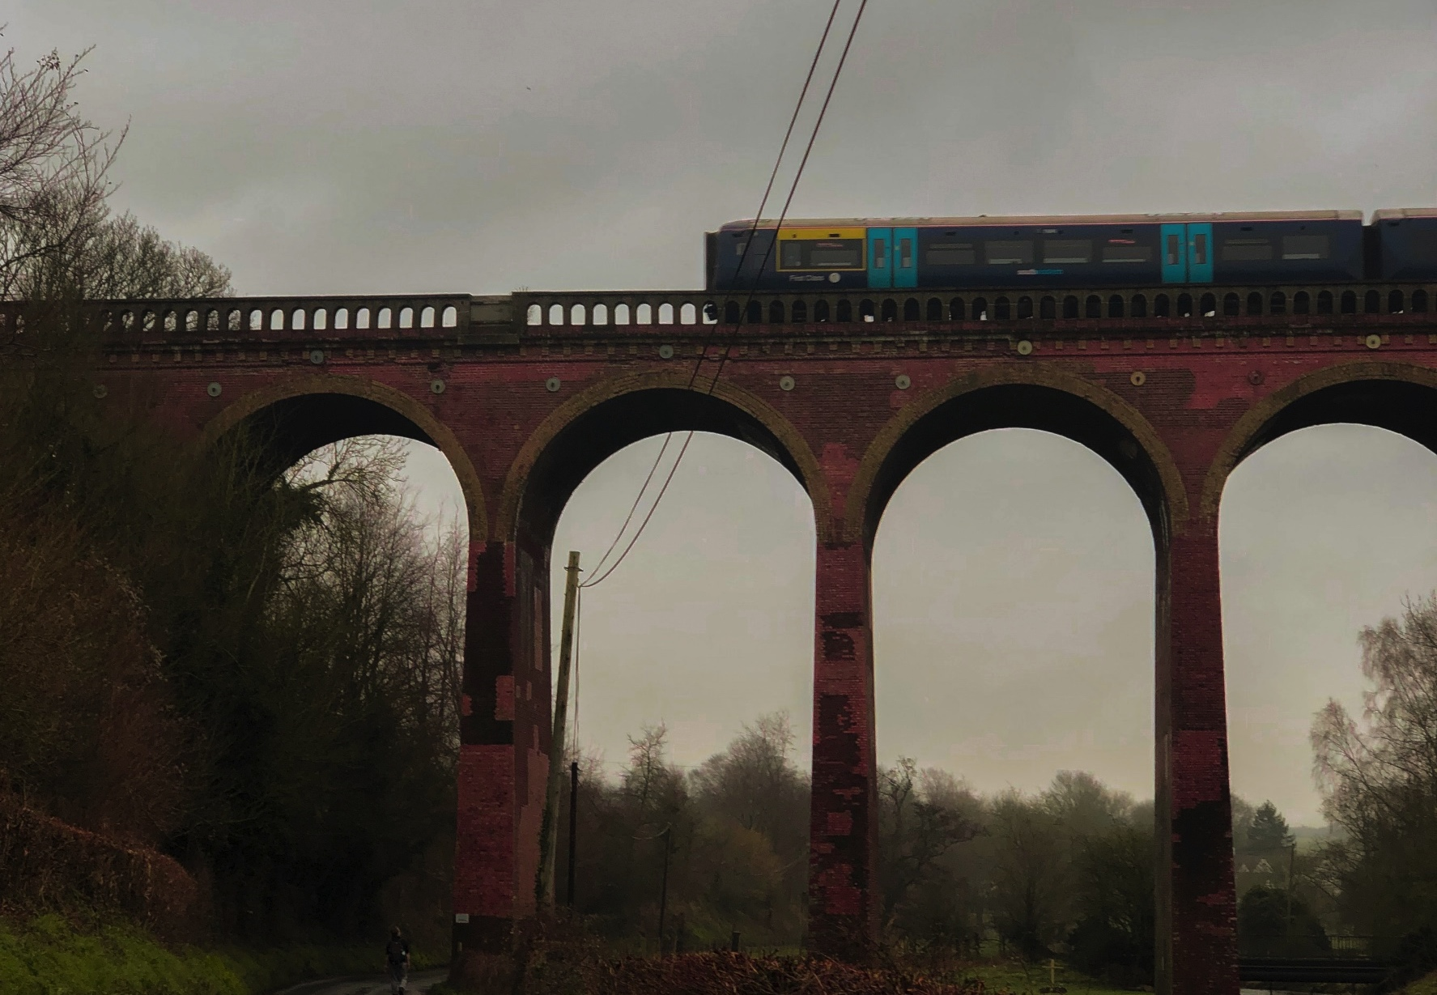
Photo by Elissar Haidar on Unsplash
25

Slide 26
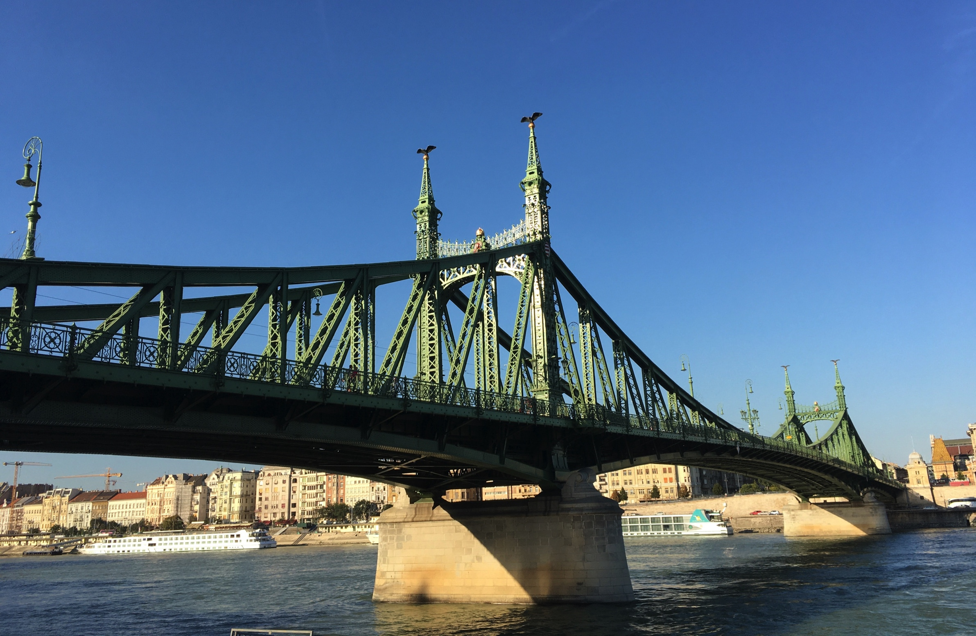
Photo by Hugo Rocha on Unsplash
26

Slide 27
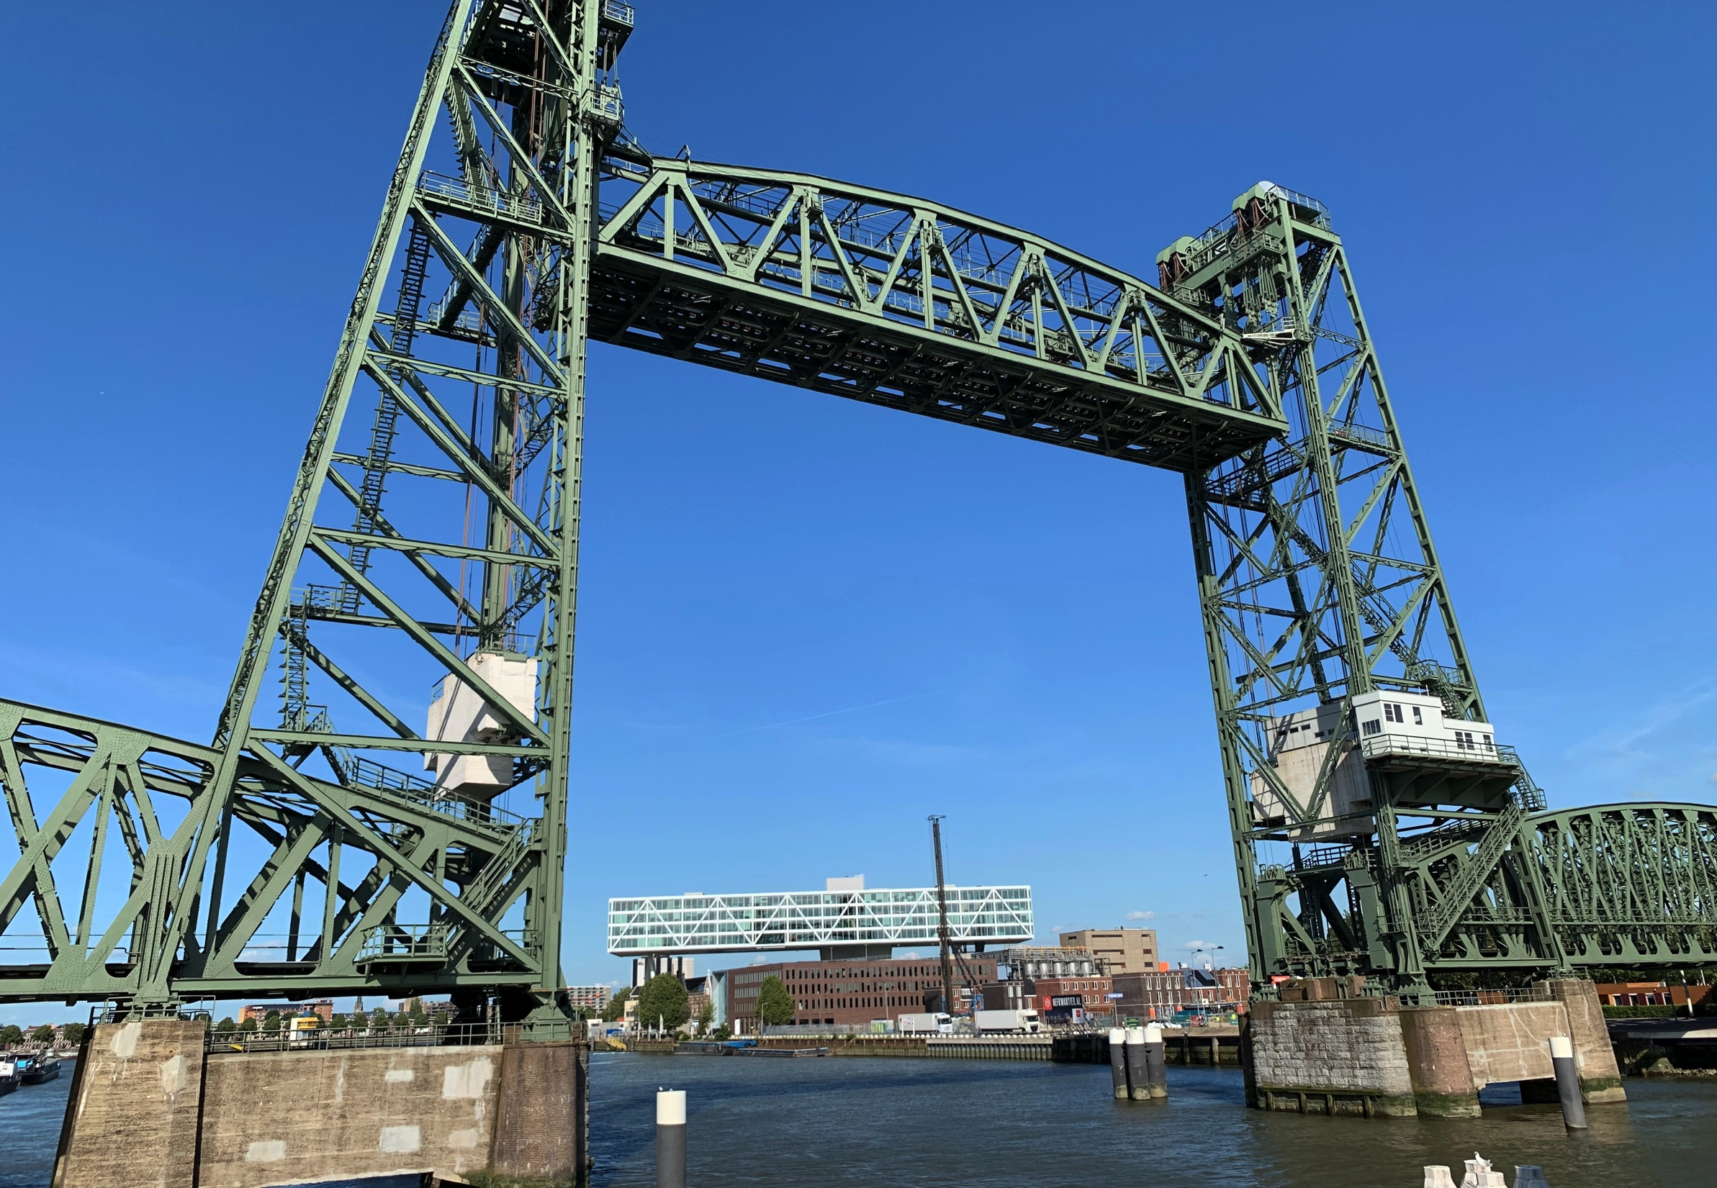
Photo by Nancy Harmsen on Unsplash
27

Slide 28
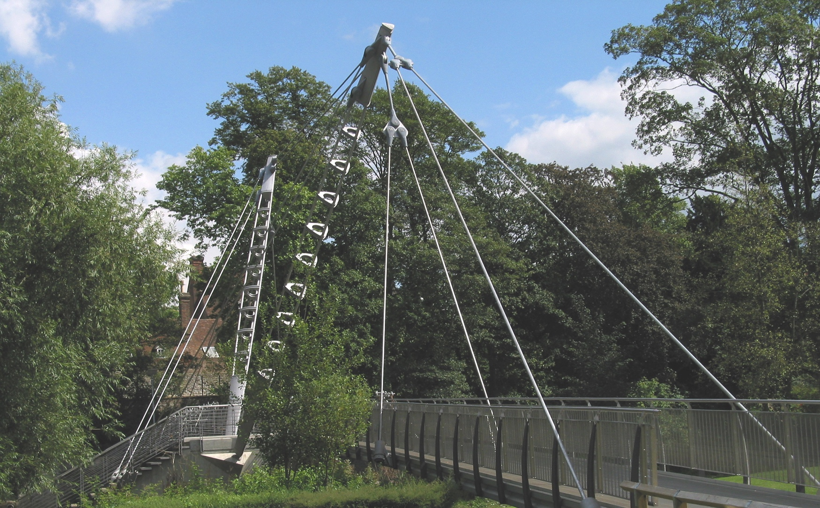
Photo by Rochester Bridge Trust
28

Slide 29
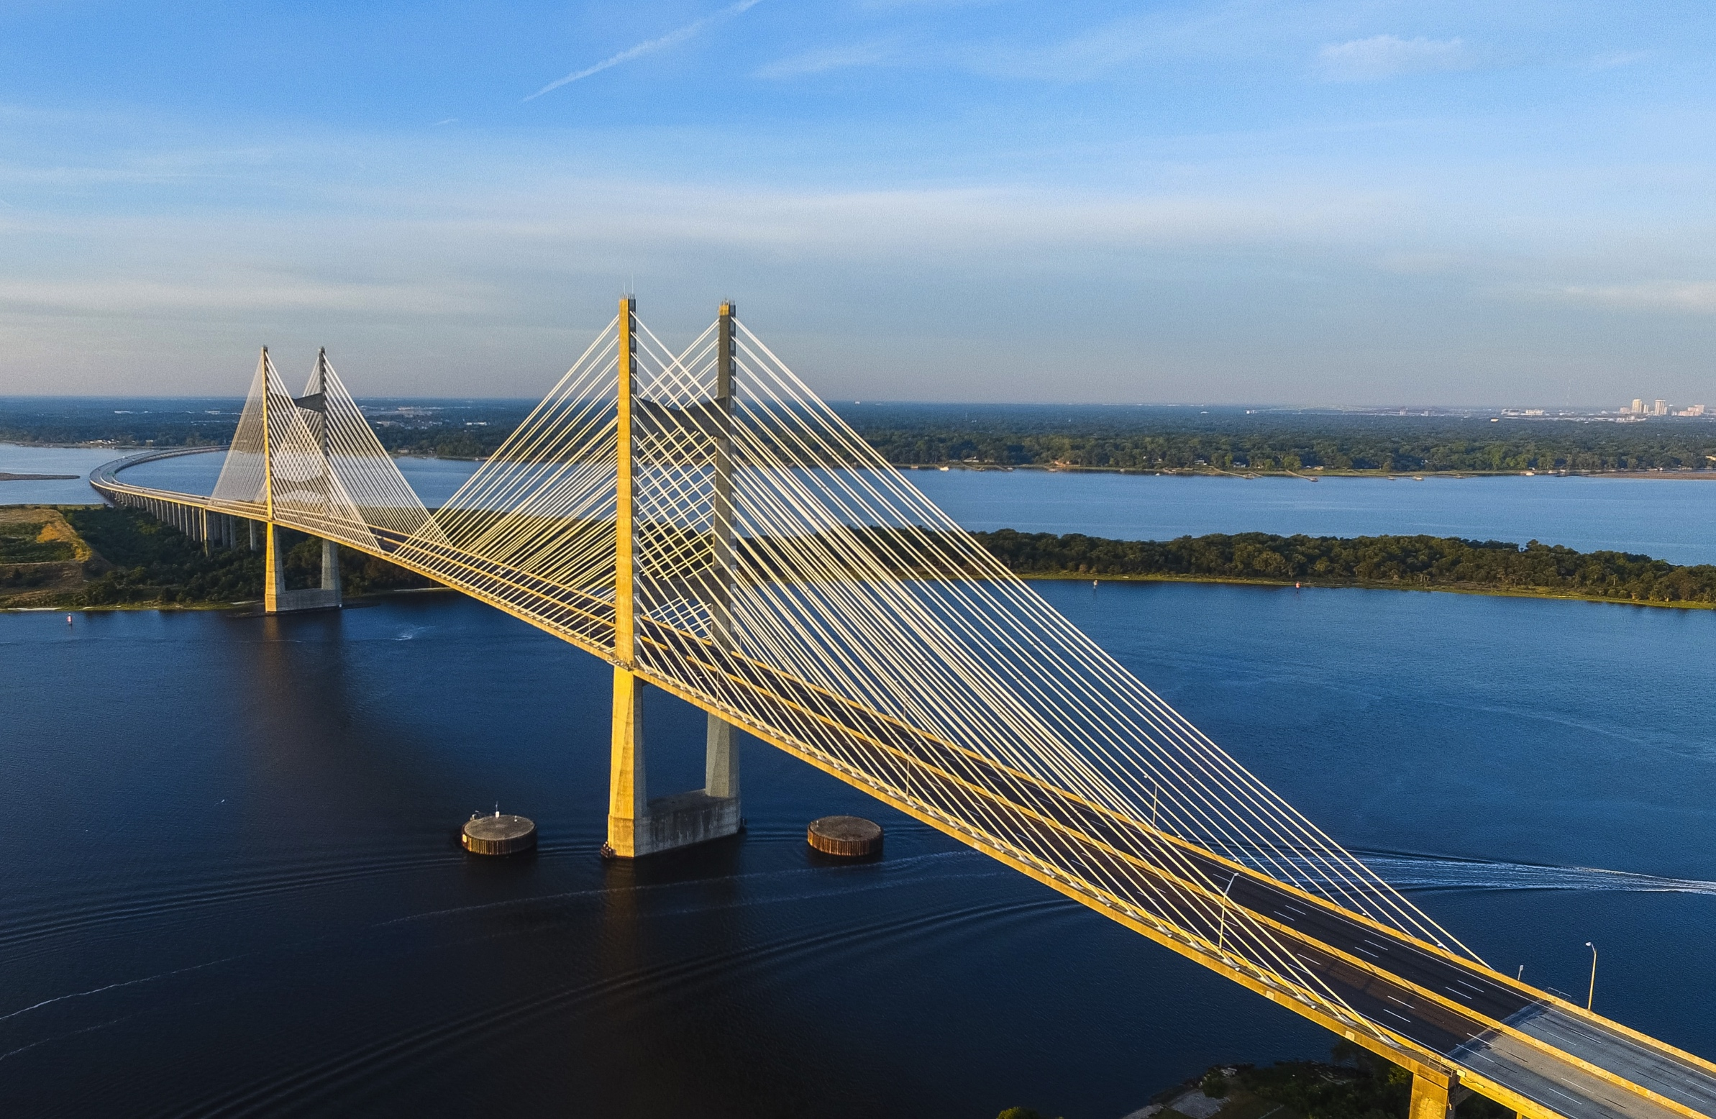
Photo by Lance Asper on Unsplash
29

Slide 30
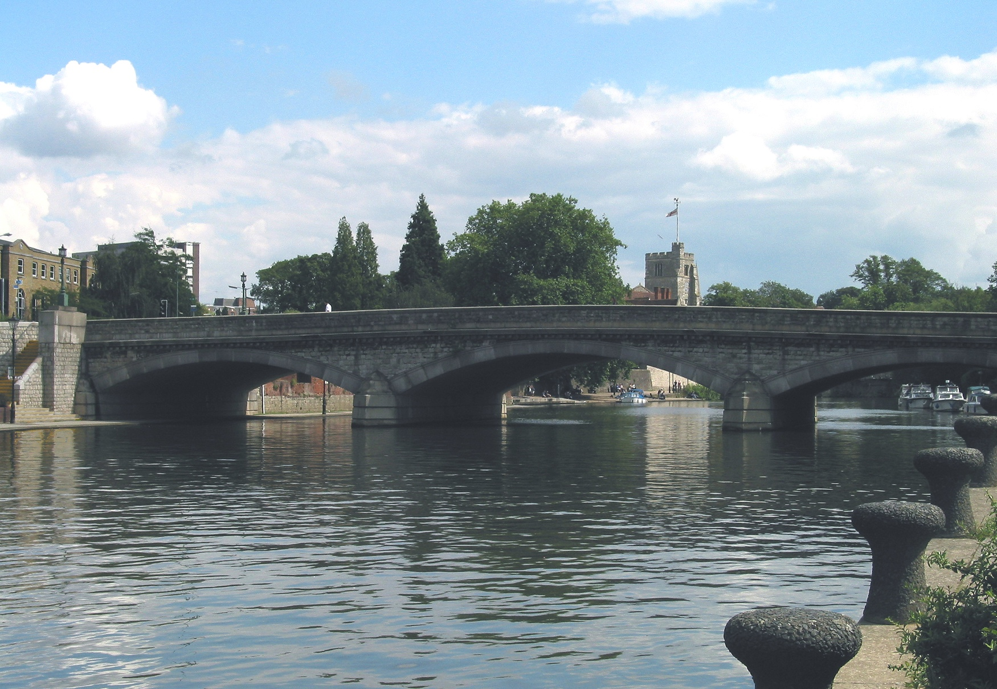
Photo by Rochester Bridge Trust
30

Slide 31
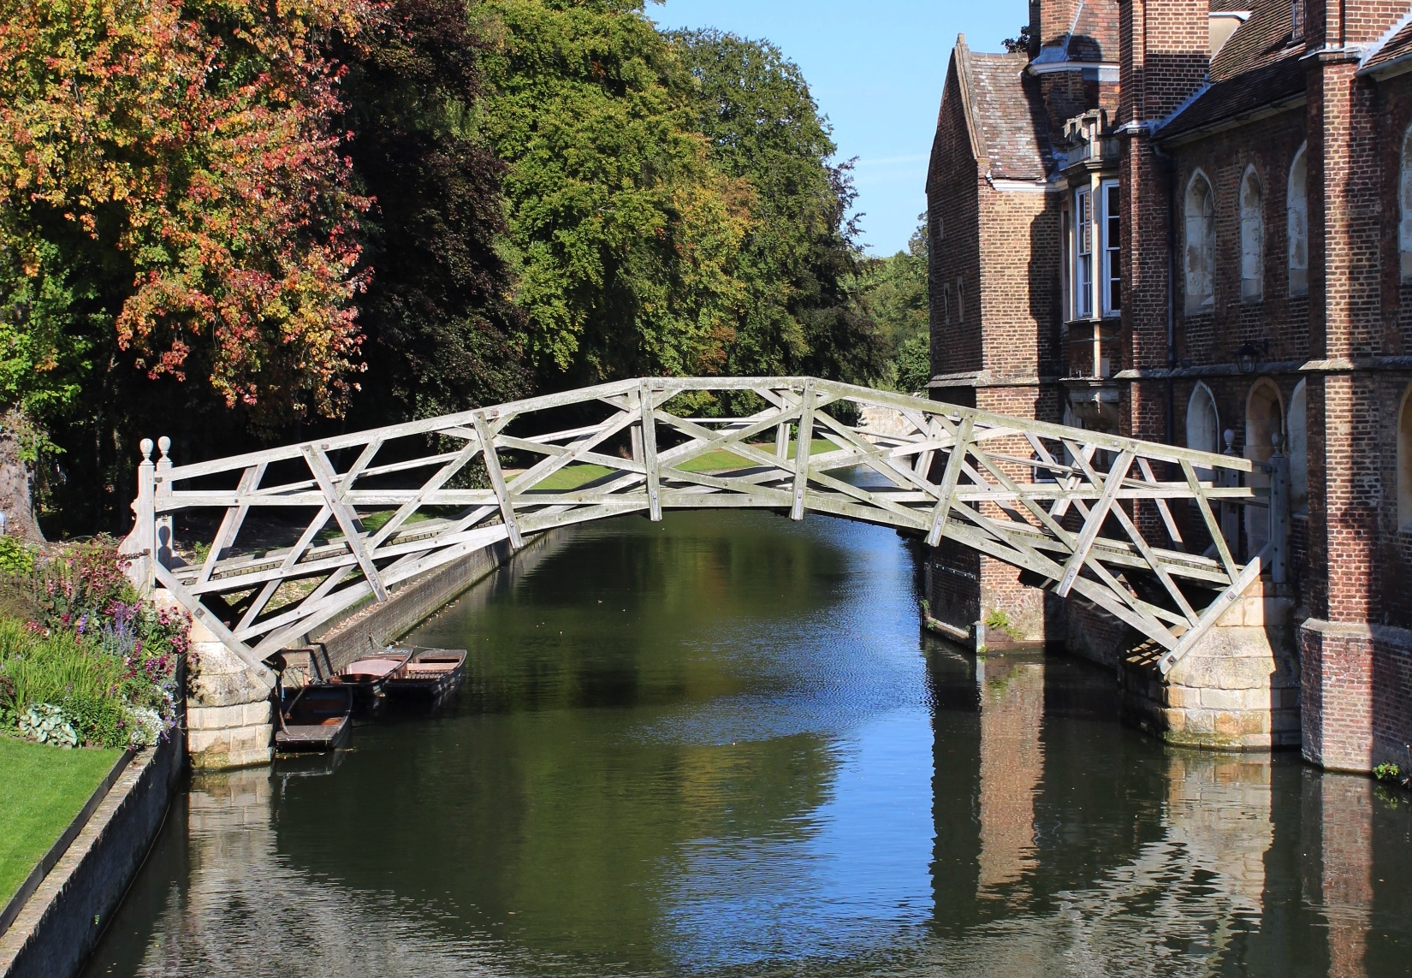
Photo by Karen Cann on Unsplash
31

Slide 32
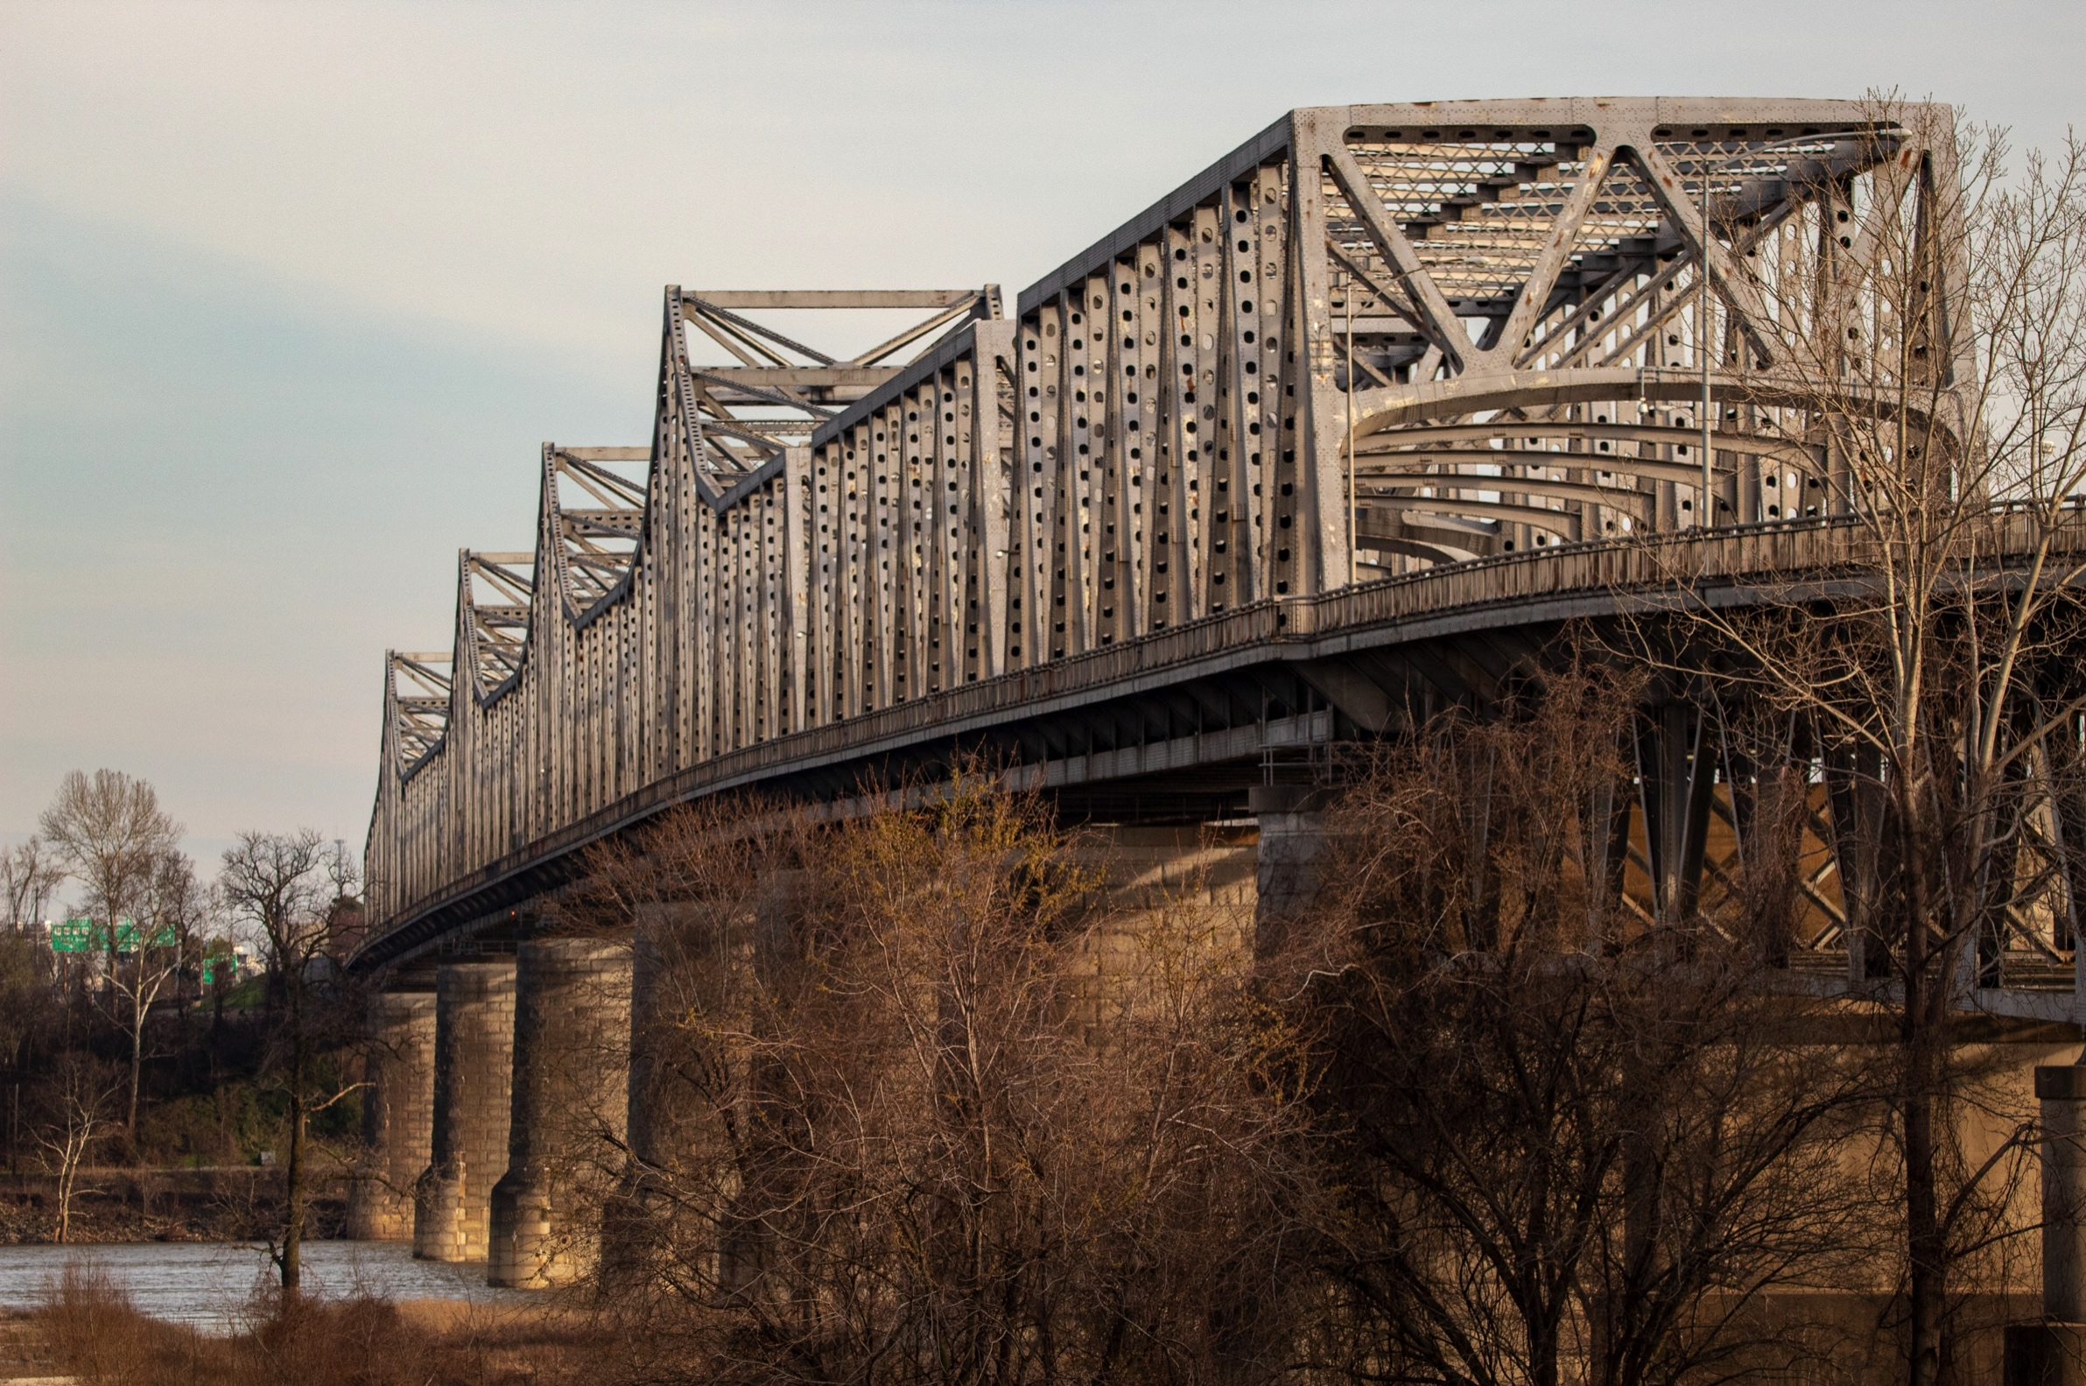
Photo by Joshua J. Cotten on Unsplash
32

Slide 33
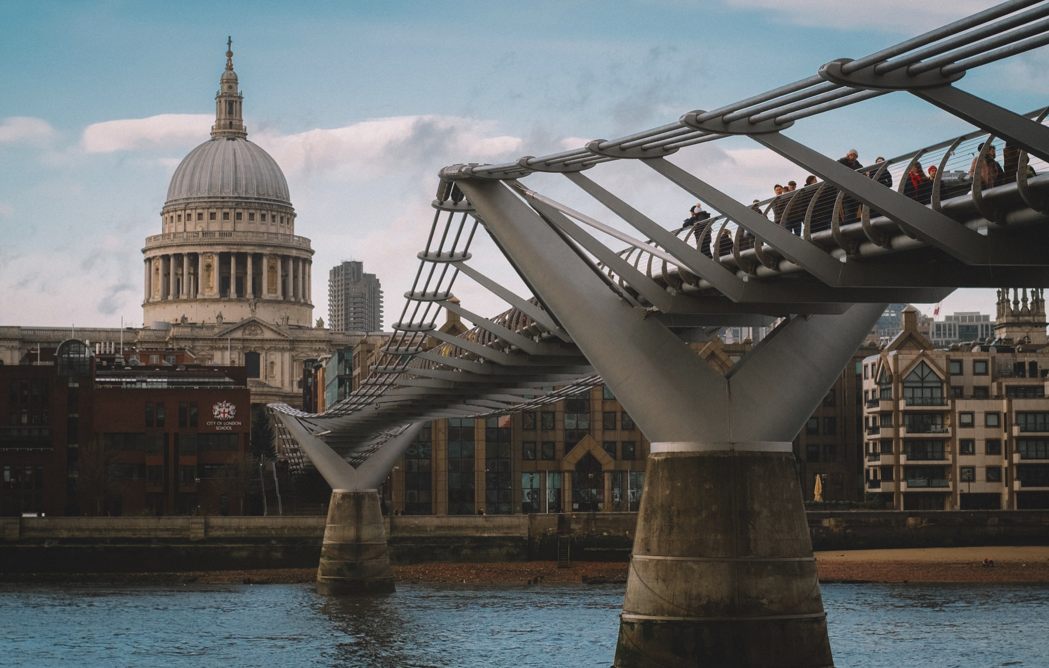
Photo by Viktor Forgacs on Unsplash
33

Slide 34
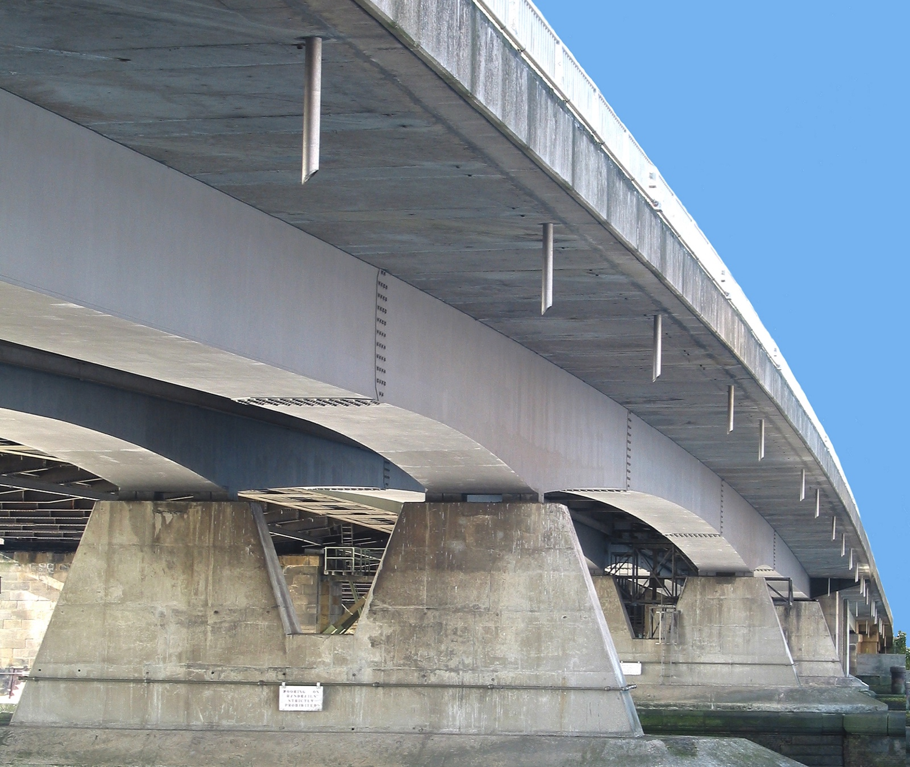
Photo by Rochester Bridge Trust
34

Slide 35
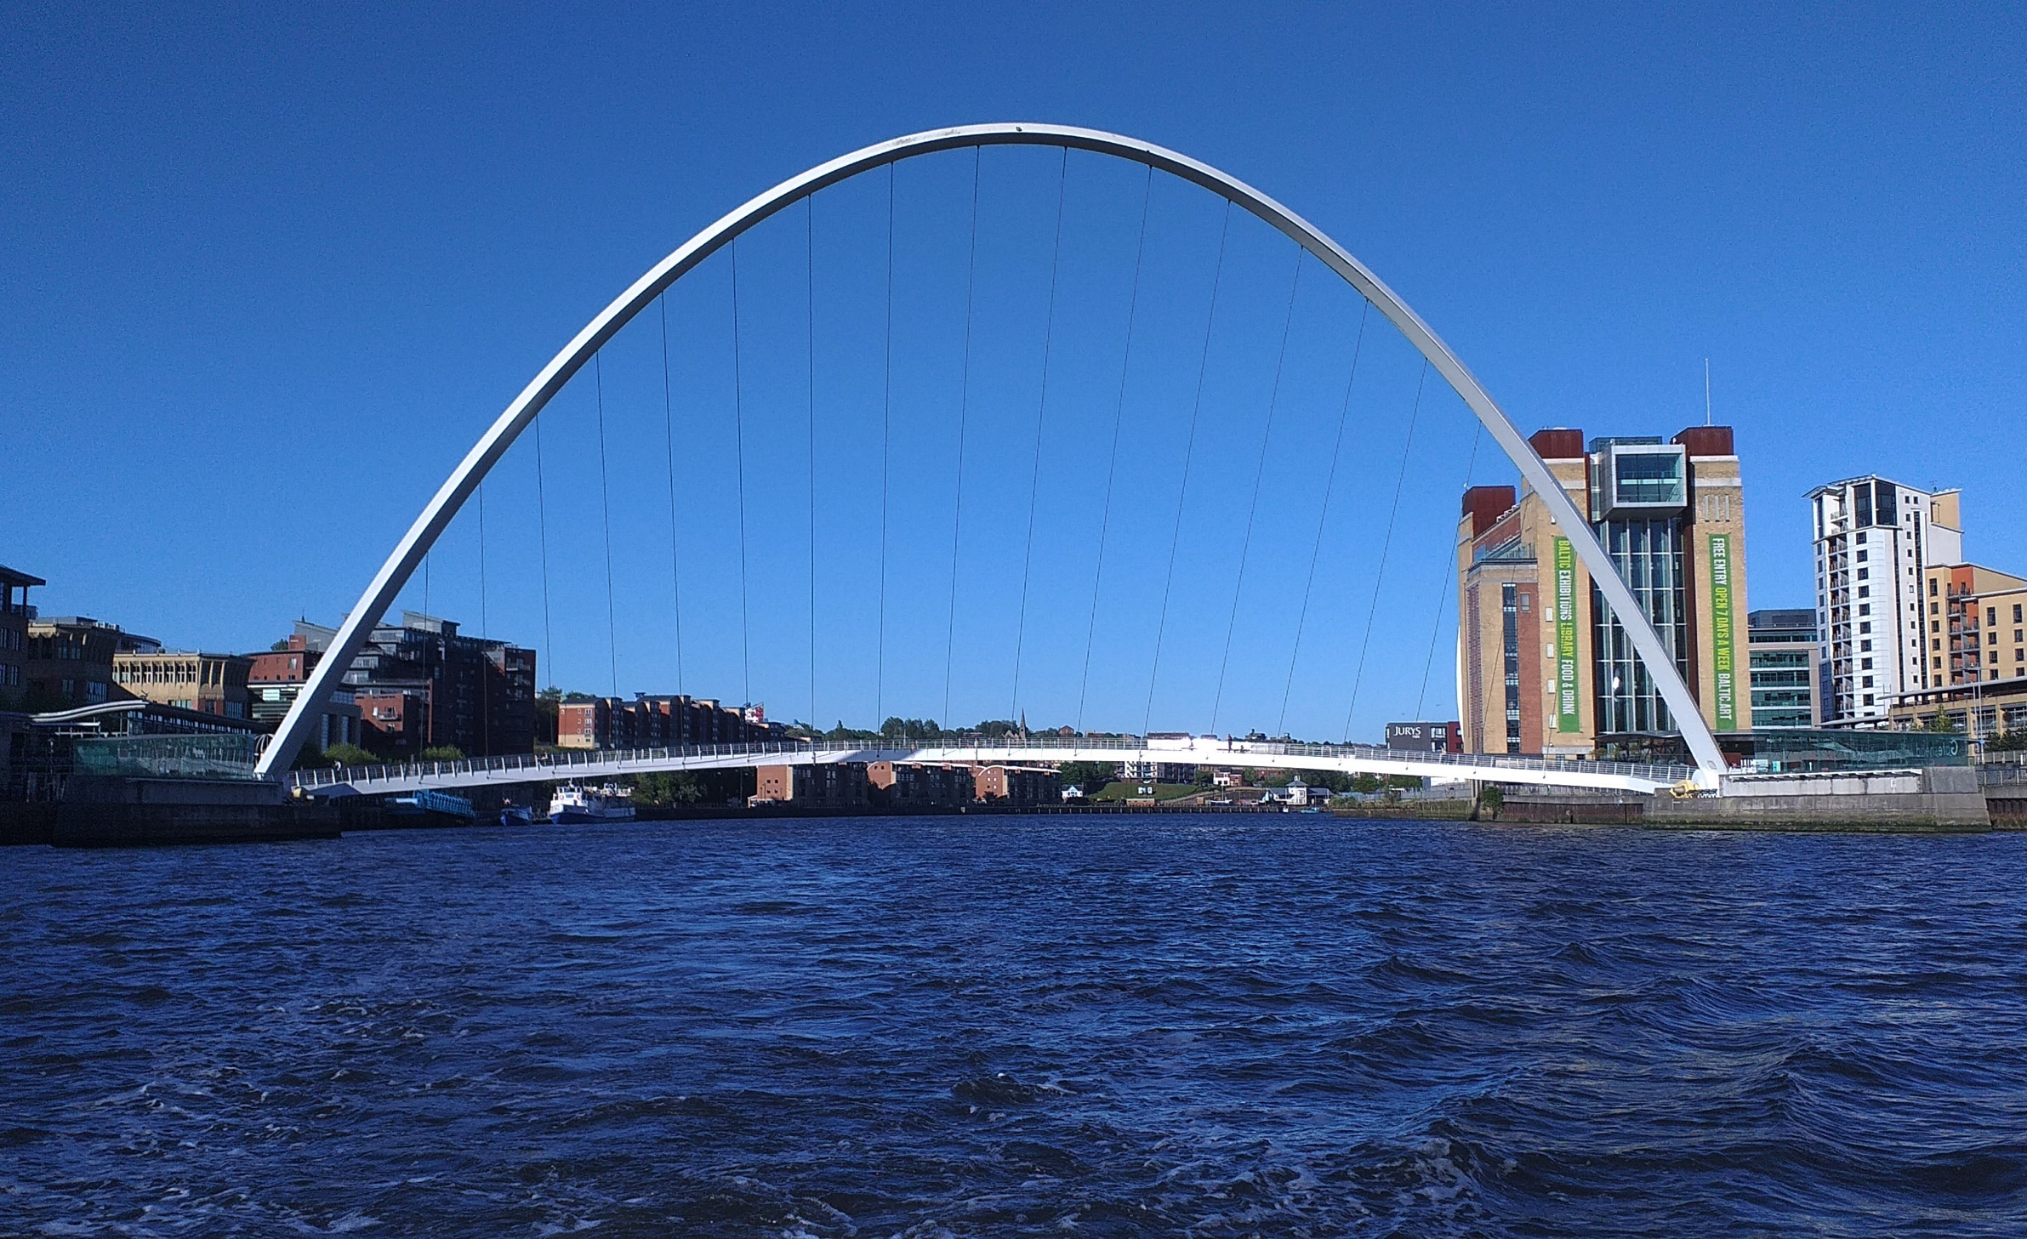
Photo by John McDonald on Unsplash
35

Slide 36
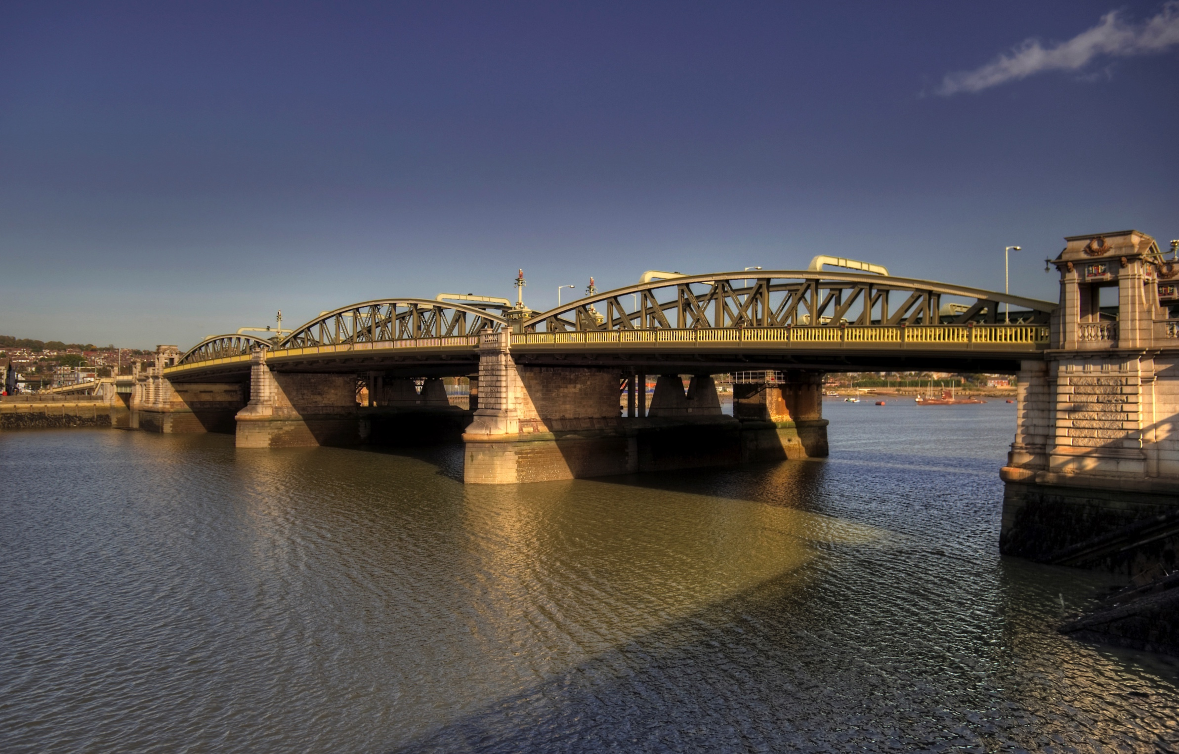
Photo by Rochester Bridge Trust
36

Slide 37
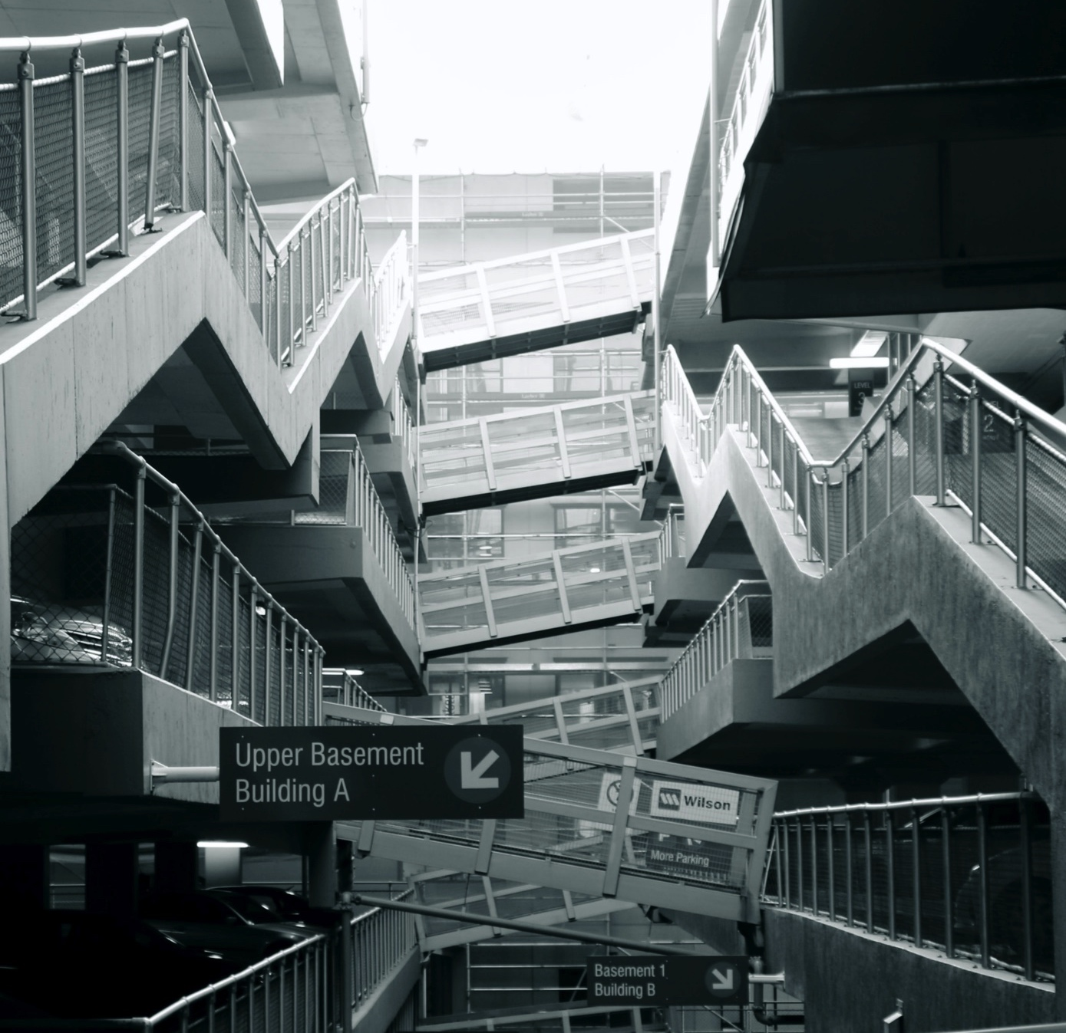
Photo by Simon Infanger on Unsplash
37

Slide 38
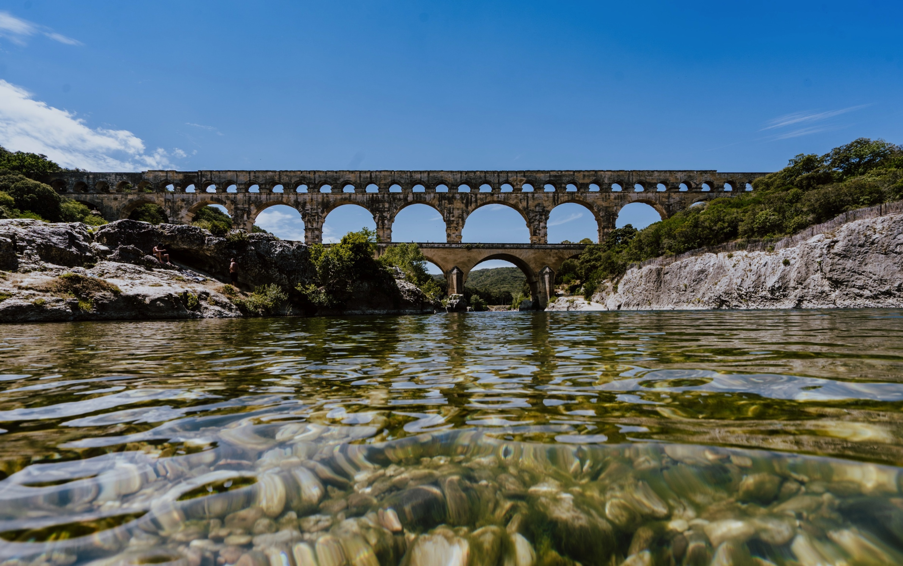
Photo by Xuan Nguyen on Unsplash
38

Slide 39
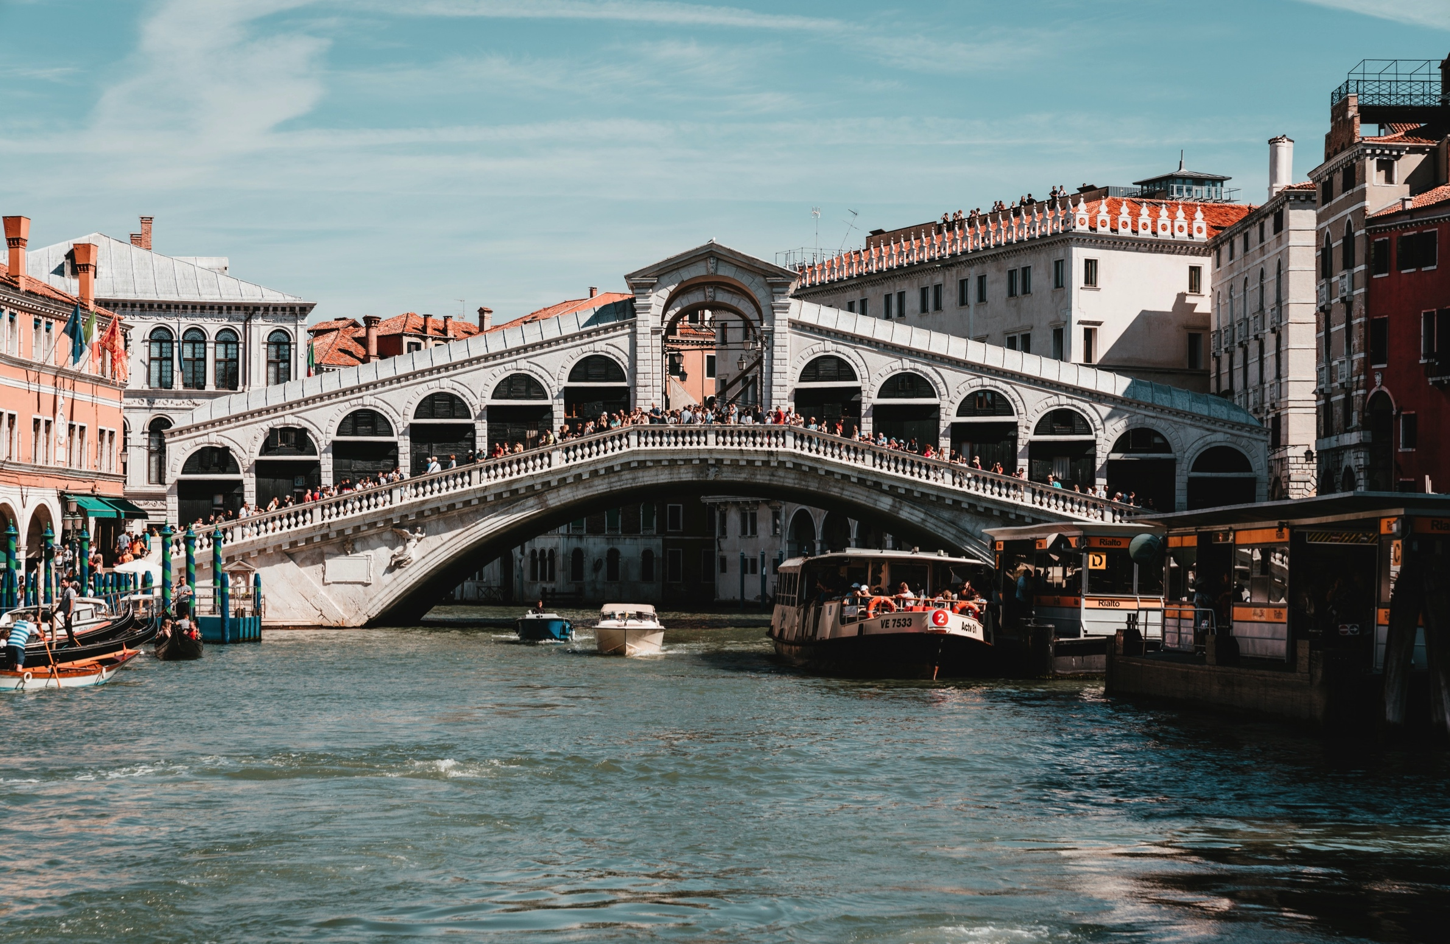
Photo by 🇨🇭 Claudio Schwarz | @purzlbaum on Unsplash
39

Slide 40
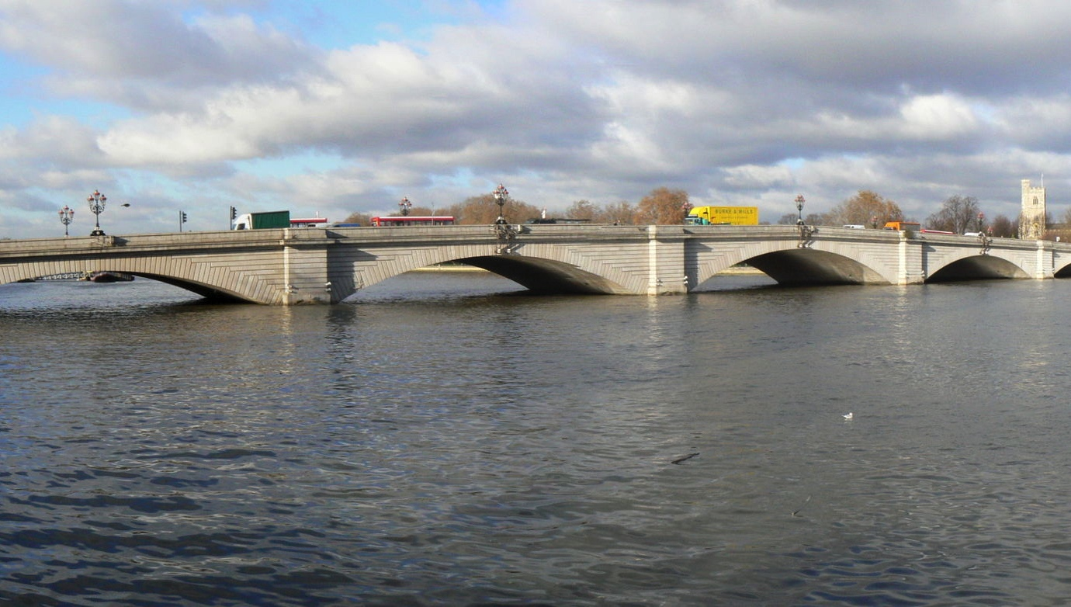
Photo by Rochester Bridge Trust
40

Slide 41
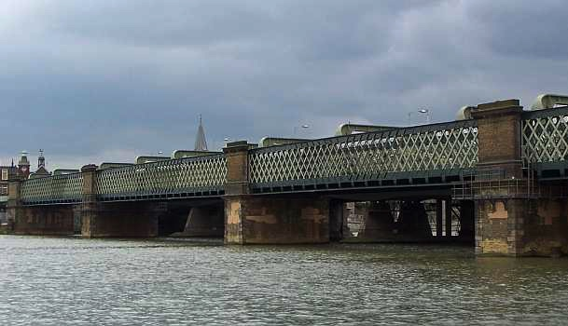
Photo by Rochester Bridge Trust
41

Slide 42
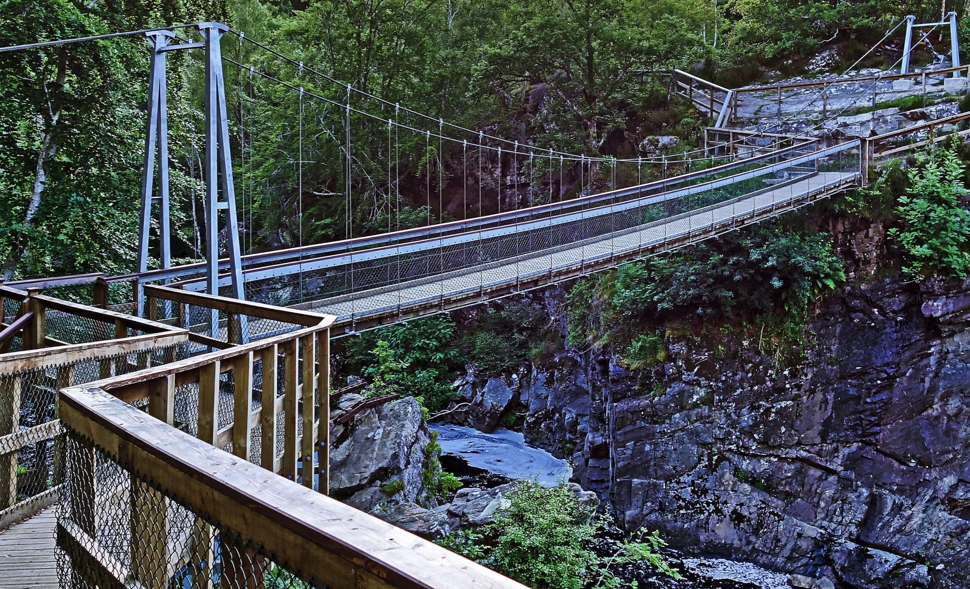
Photo by Andrew Buchanan on Unsplash
42

Slide 43
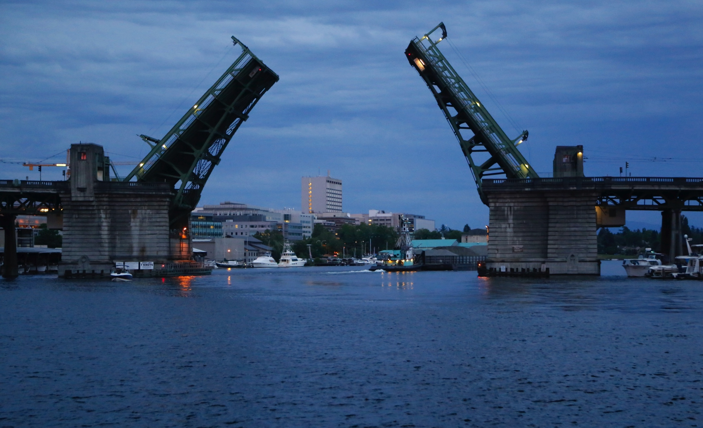
Photo by Georg Eiermann on Unsplash
43

Slide 44
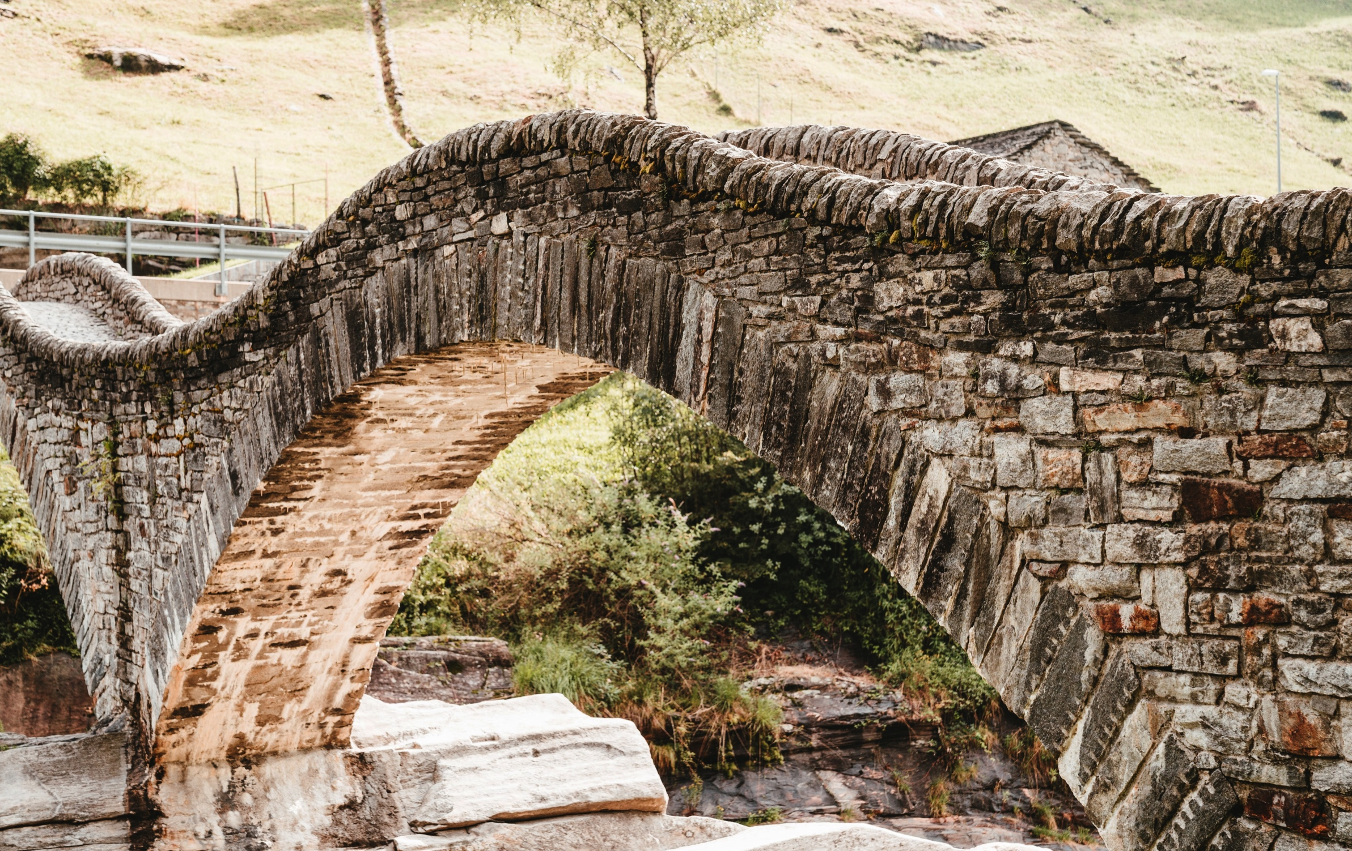
Photo by 🇨🇭 Claudio Schwarz | @purzlbaum on Unsplash
44

Slide 45
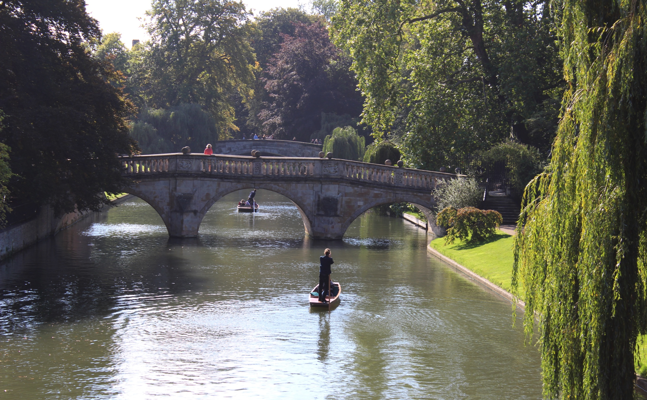
Photo by Karen Cann on Unsplash
45

Slide 46
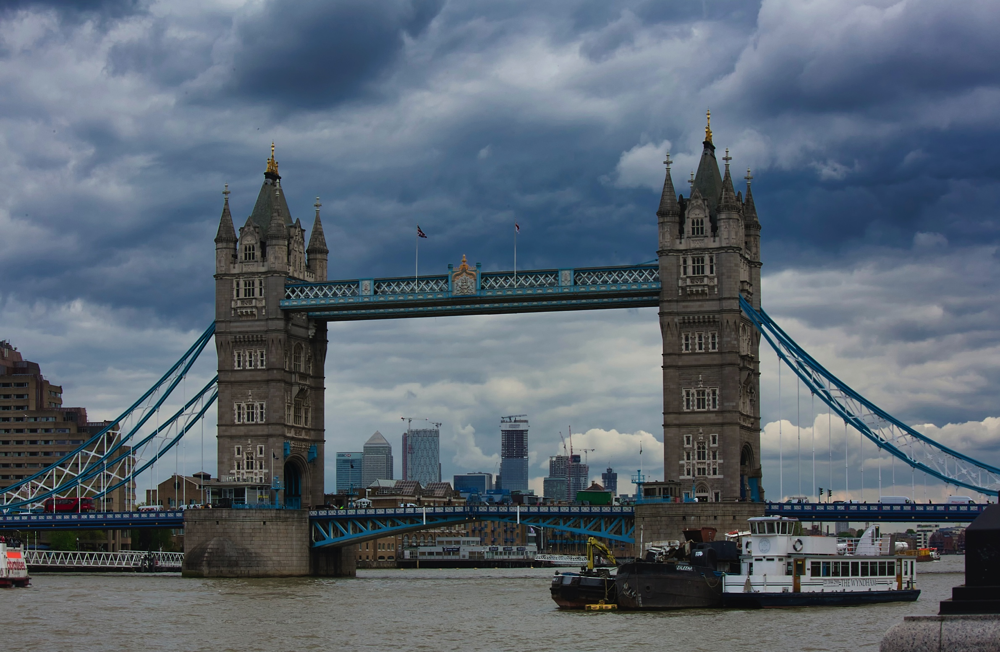
Photo by Dave Francis on Unsplash
46

Slide 47
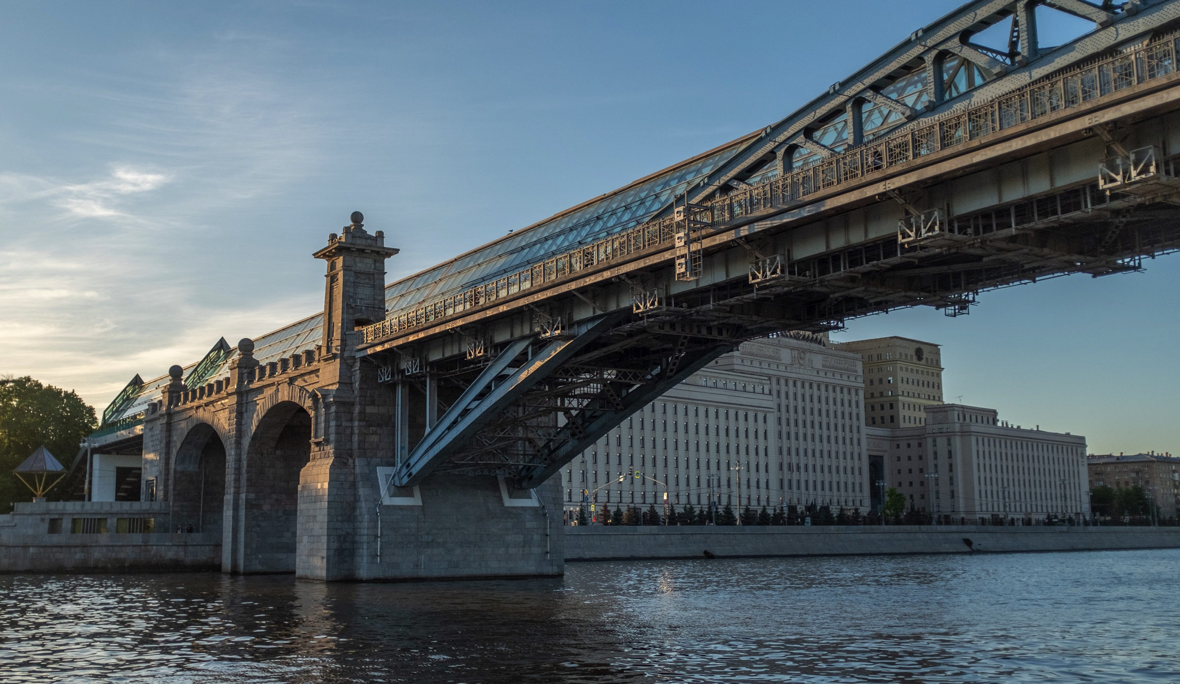
Photo by Ant Rozetsky on Unsplash
47

Slide 48
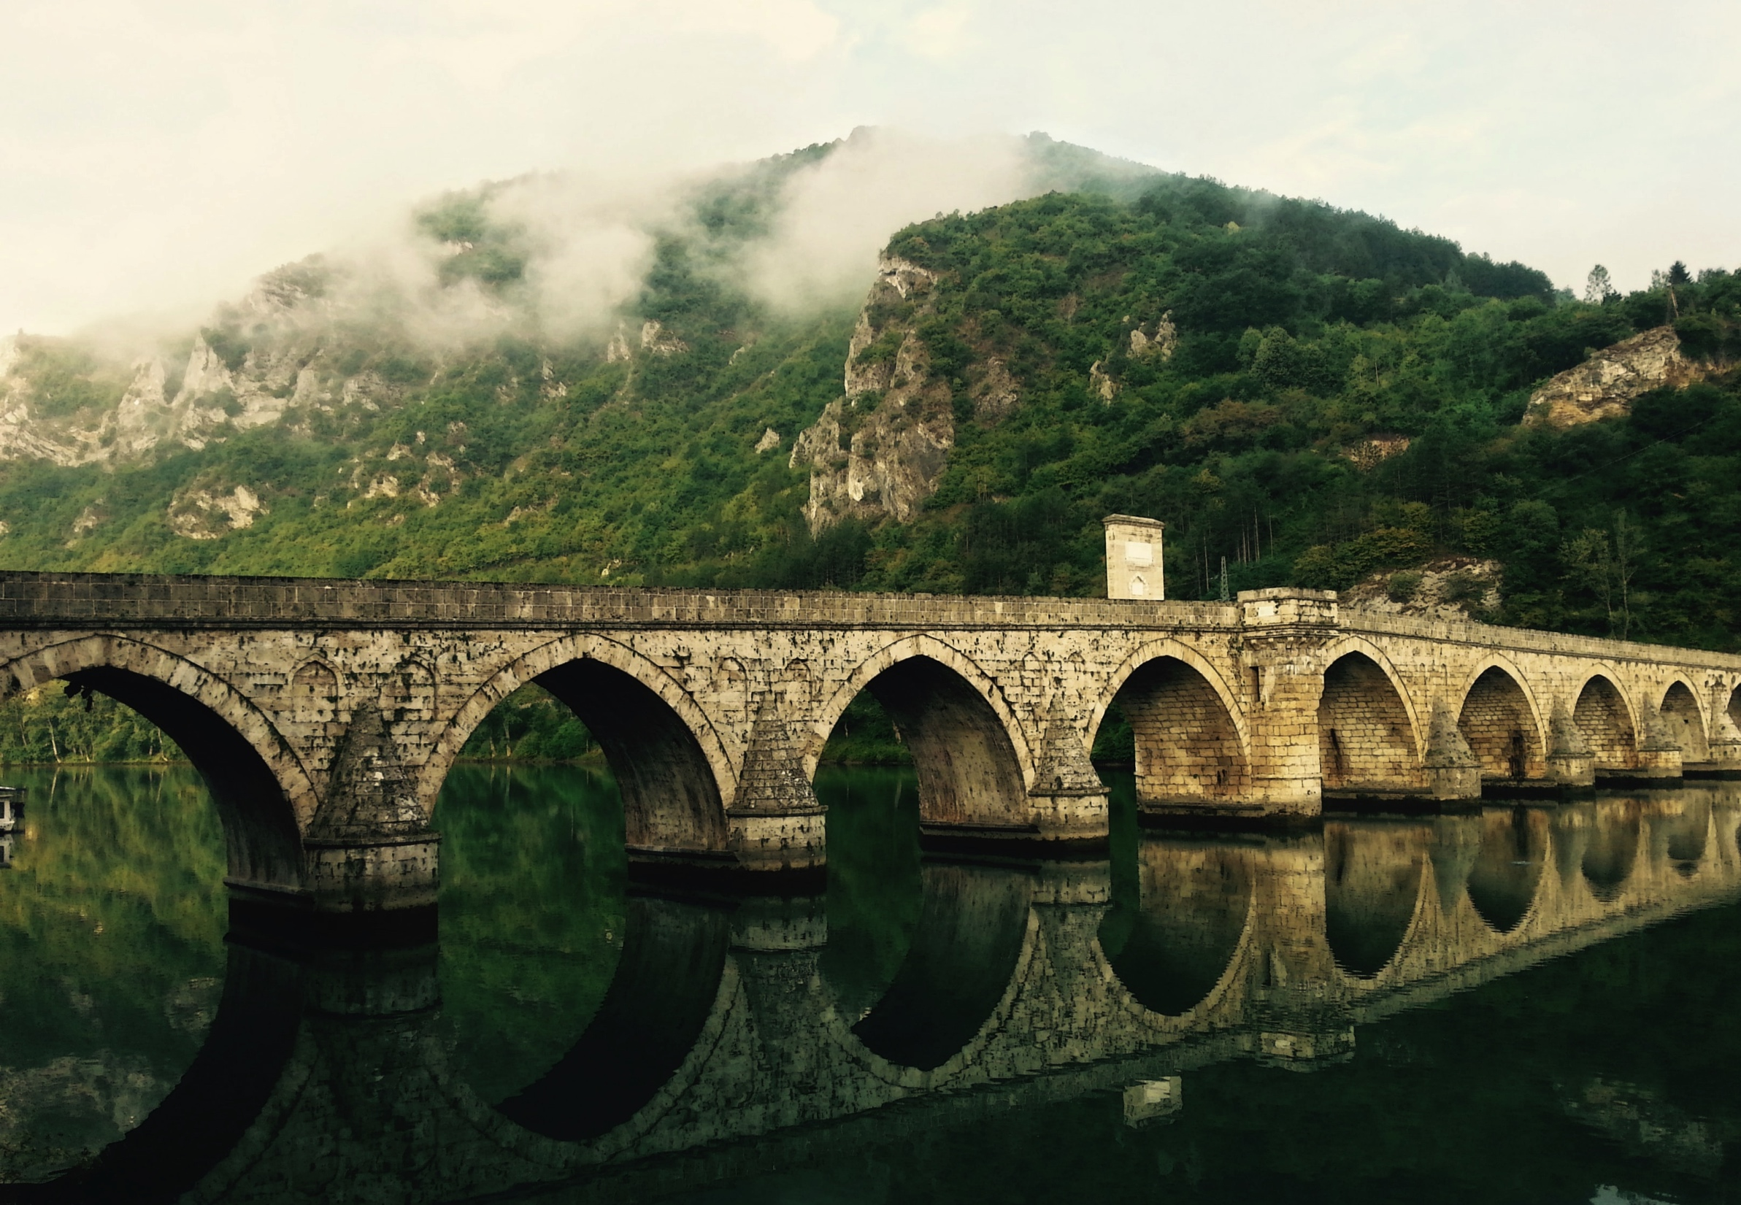
Photo by Torsten Muller on Unsplash
48

Slide 49
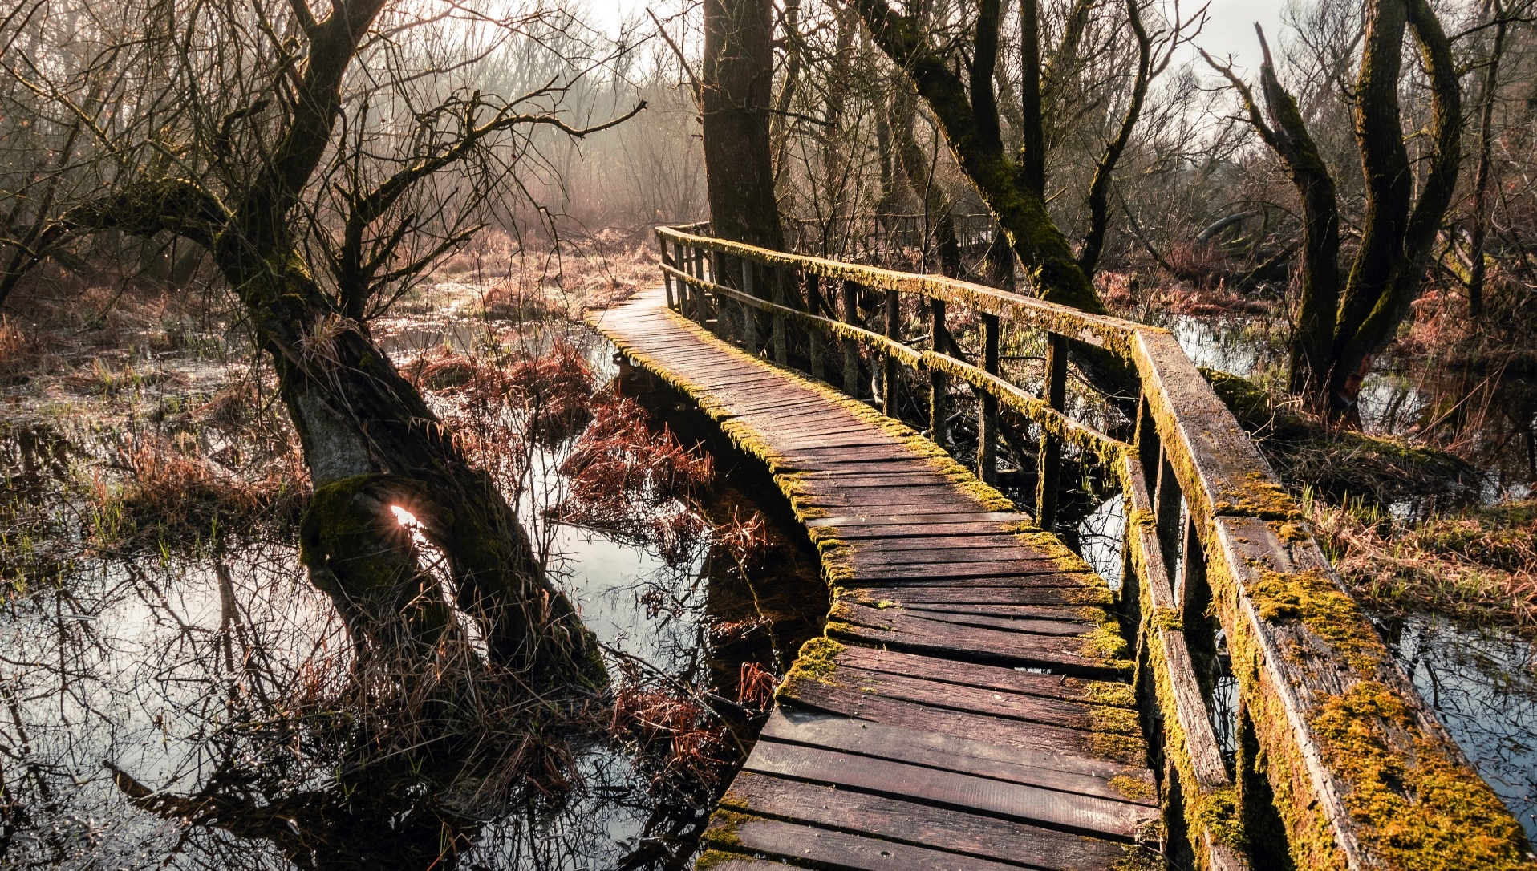
Photo by Norbert Tóth on Unsplash
49

Slide 50
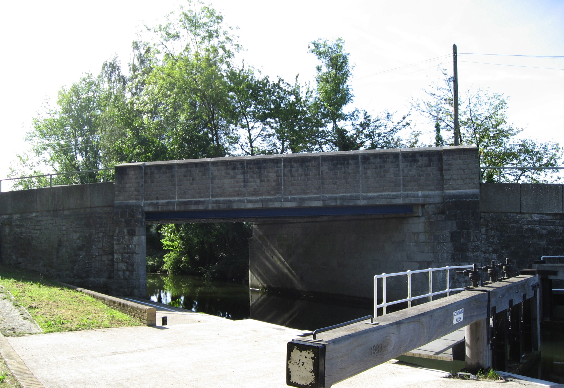
Photo by Rochester Bridge Trust
50

Slide 51
Photo by Steve Sewell on Unsplash
51

Slide 52
Photo by Leighton Robinson on Unsplash
52

Slide 53
Photo by Joseph Pisicchio on Unsplash
53

Slide 54
Photo by Illiya Vjestica on Unsplash
54

Slide 55
Photo by Tayla Bundschuh on Unsplash
55

Slide 56
Photo by Dimitry Anikin on Unsplash
56

Slide 57
57
By Martin Dunst - Own work, CC BY-SA 4.0, https://commons.wikimedia.org/w/index.php?curid=50187071

Slide 58
Richard Leeming from London, UK / CC BY-SA (https://creativecommons.org/licenses/by-sa/2.0)
58

Slide 59
Suicasmo / CC BY-SA (https://creativecommons.org/licenses/by-sa/4.0)
59

Slide 60
McGhiever / CC BY-SA (https://creativecommons.org/licenses/by-sa/4.0)
60

